Slide 1
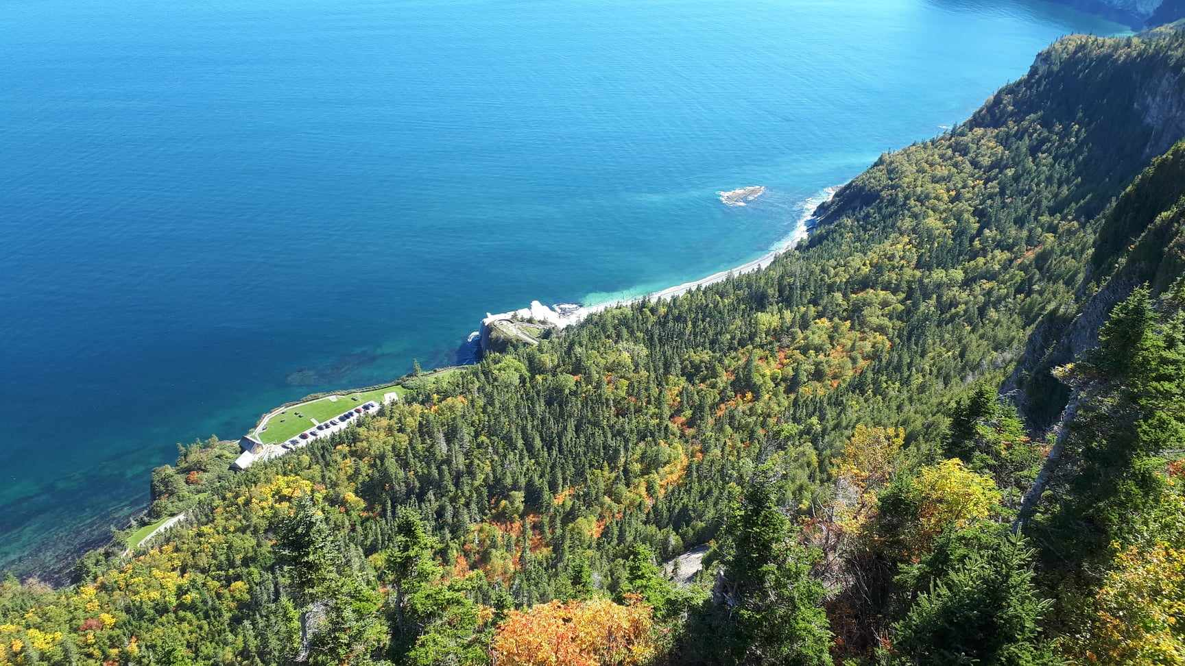
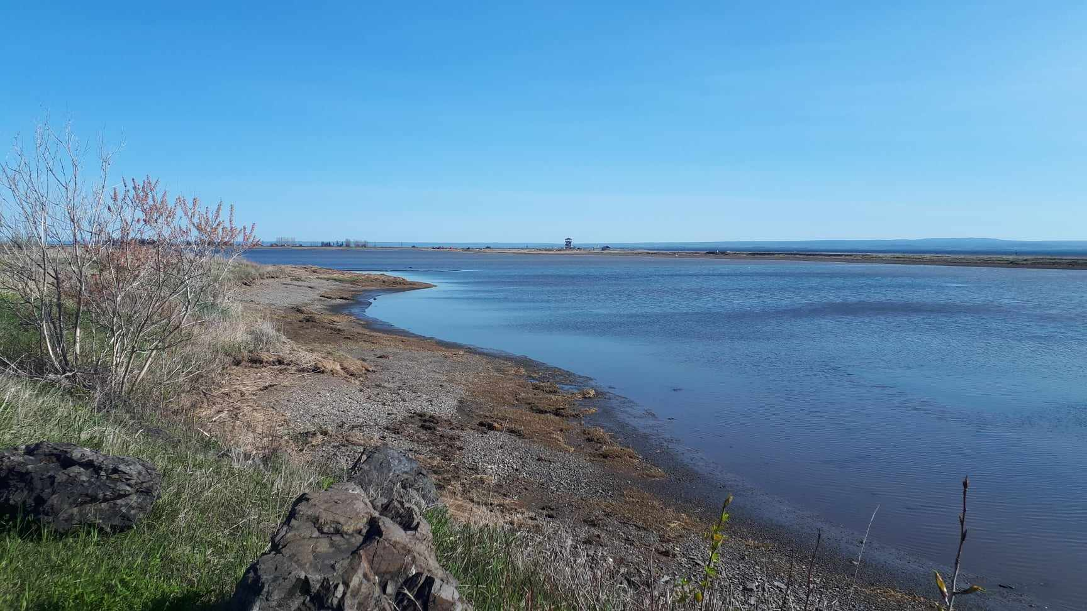
Coastal Biodiversity
An entire world to discover and protect!

Slide 2
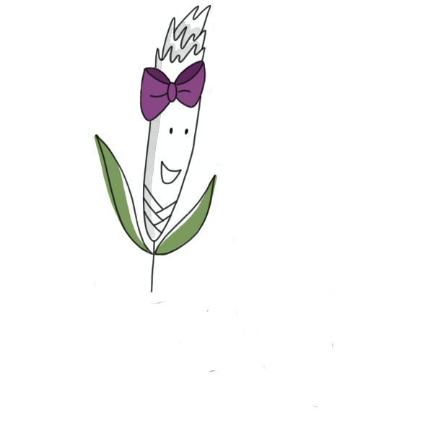
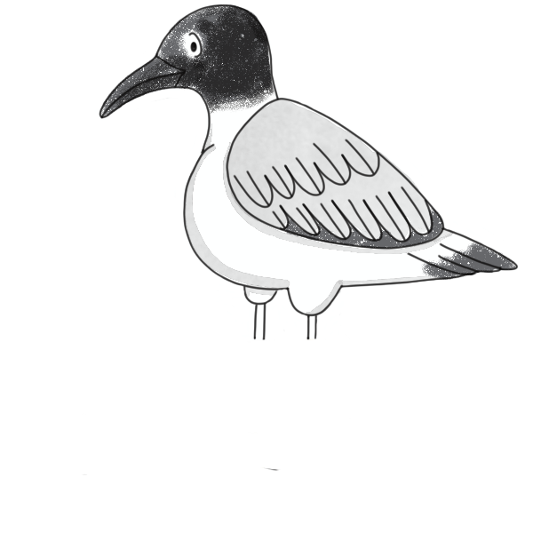
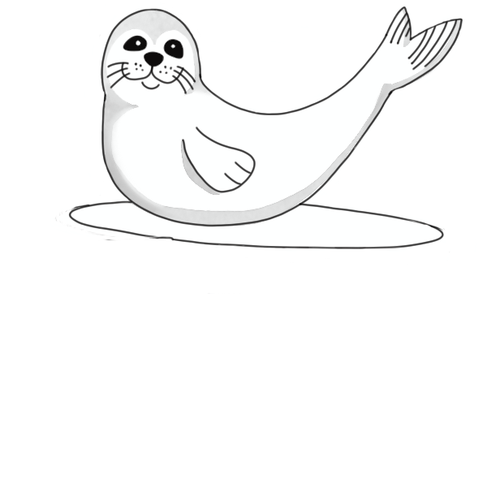
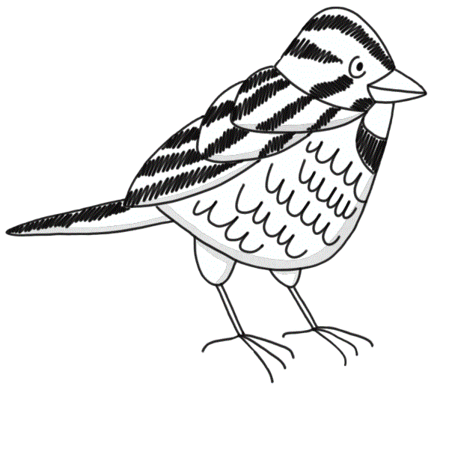
What do you know about biodiversity?
Notes:
Part 1: Introduction to biodiversity
Today, we’ll be talking about biodiversity and why it’s important.
What do you think biodiversity is?
*Write down the students’ answers*
Biodiversity refers to all life forms. An ecosystem is considered healthy when it has high biodiversity. In addition, a diverse environment has a greater chance of fighting threats such as erosion and invasive alien species (IAS).
Give examples: Are rocks part of the biodiversity?
You can make a comparison with our society. To make a city work, we need people with different jobs (firefighters, teachers, doctors, etc.), just as an ecosystem needs its biodiversity to be healthy and function properly (different species and individuals, each having a unique role to play).
Today, we’re going to look at what an environment with high biodiversity looks like, how to tell the difference between invasive and native species, and how we can support environments with high biodiversity!
Before we start, I’ll define some terms we’ll be using in this workshop.

Slide 3
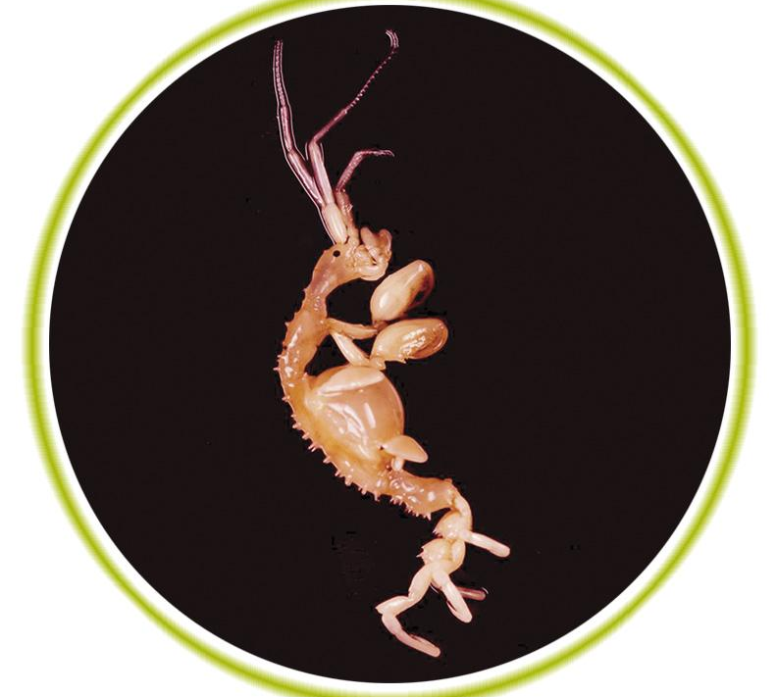
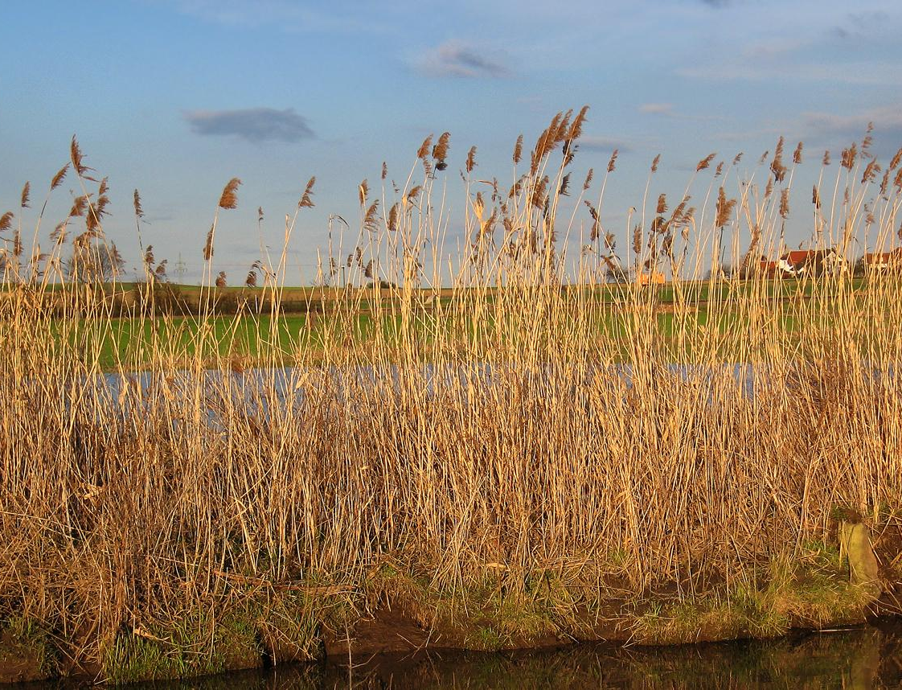
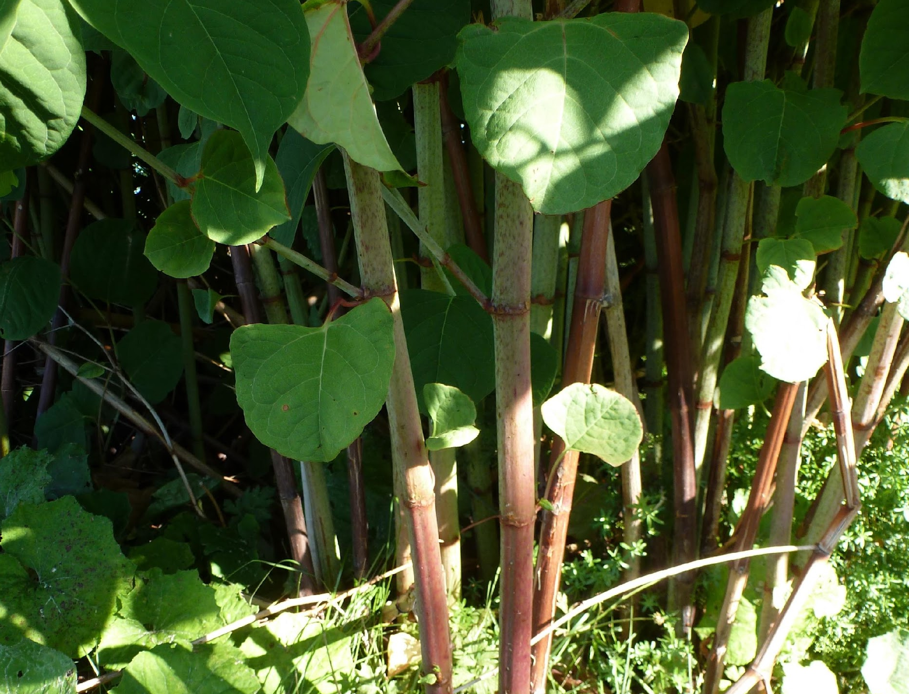
IAS et AIS
Common reed (Phragmites australis)
Japanese skeleton shrimp (Caprella mutica)
Invasive Alien Species
Aquatic Invasive Species
Japanese knotweed (Reynoutria japonica)
Notes:
We’ll explain what native species, invasive alien species (IAS) and aquatic invasive species (AIS) are.
*Ask students what they remember from the comic book about IAS and AIS.*
What is a native species?
This is a species found in its natural range, without any human intervention. Plant and animal species have the ability to colonize new habitats. However, this lengthy process, taking place over several generations, helps the ecosystem adapt to this new presence.
An IAS is an animal or plant species introduced to a new natural environment through human activity. In some cases, the introduced species won’t do any harm or be able to survive our winters. However, when they do manage to take hold, they can take up all the space and resources already used by native species. As a result, these native species are less present, which compromises the biodiversity of the environment. Some species (birds, for example) leave their environment when too many changes happen in the area and they can’t find what they need to survive (food, breeding sites, etc.). In addition, IAS have few predators.
Here, we have the common reed (Phragmites australis). This species reproduces very quickly and doesn’t benefit any animal. It can change the composition of the soil, which prevents other plant species from taking root. This was the case for the Japanese knotweed below, a species introduced for gardening purposes in the 1900s, but which quickly spread throughout Quebec.
An AIS is the same as an IAS, but it refers specifically to aquatic species. This type of invasive species requires a special term because they are highly mobile. They’re often carried from one place to another by ships, clinging to boats like certain molluscs. Some larvae can even be carried thousands of kilometres! This was the case for the Japanese skeleton shrimp (up to 3.5 cm long) that was brought to Quebec. It has very few predators and can tolerate the cold waters of the St. Lawrence. The river’s heavy maritime traffic contributed to the spread of this species.

Slide 4
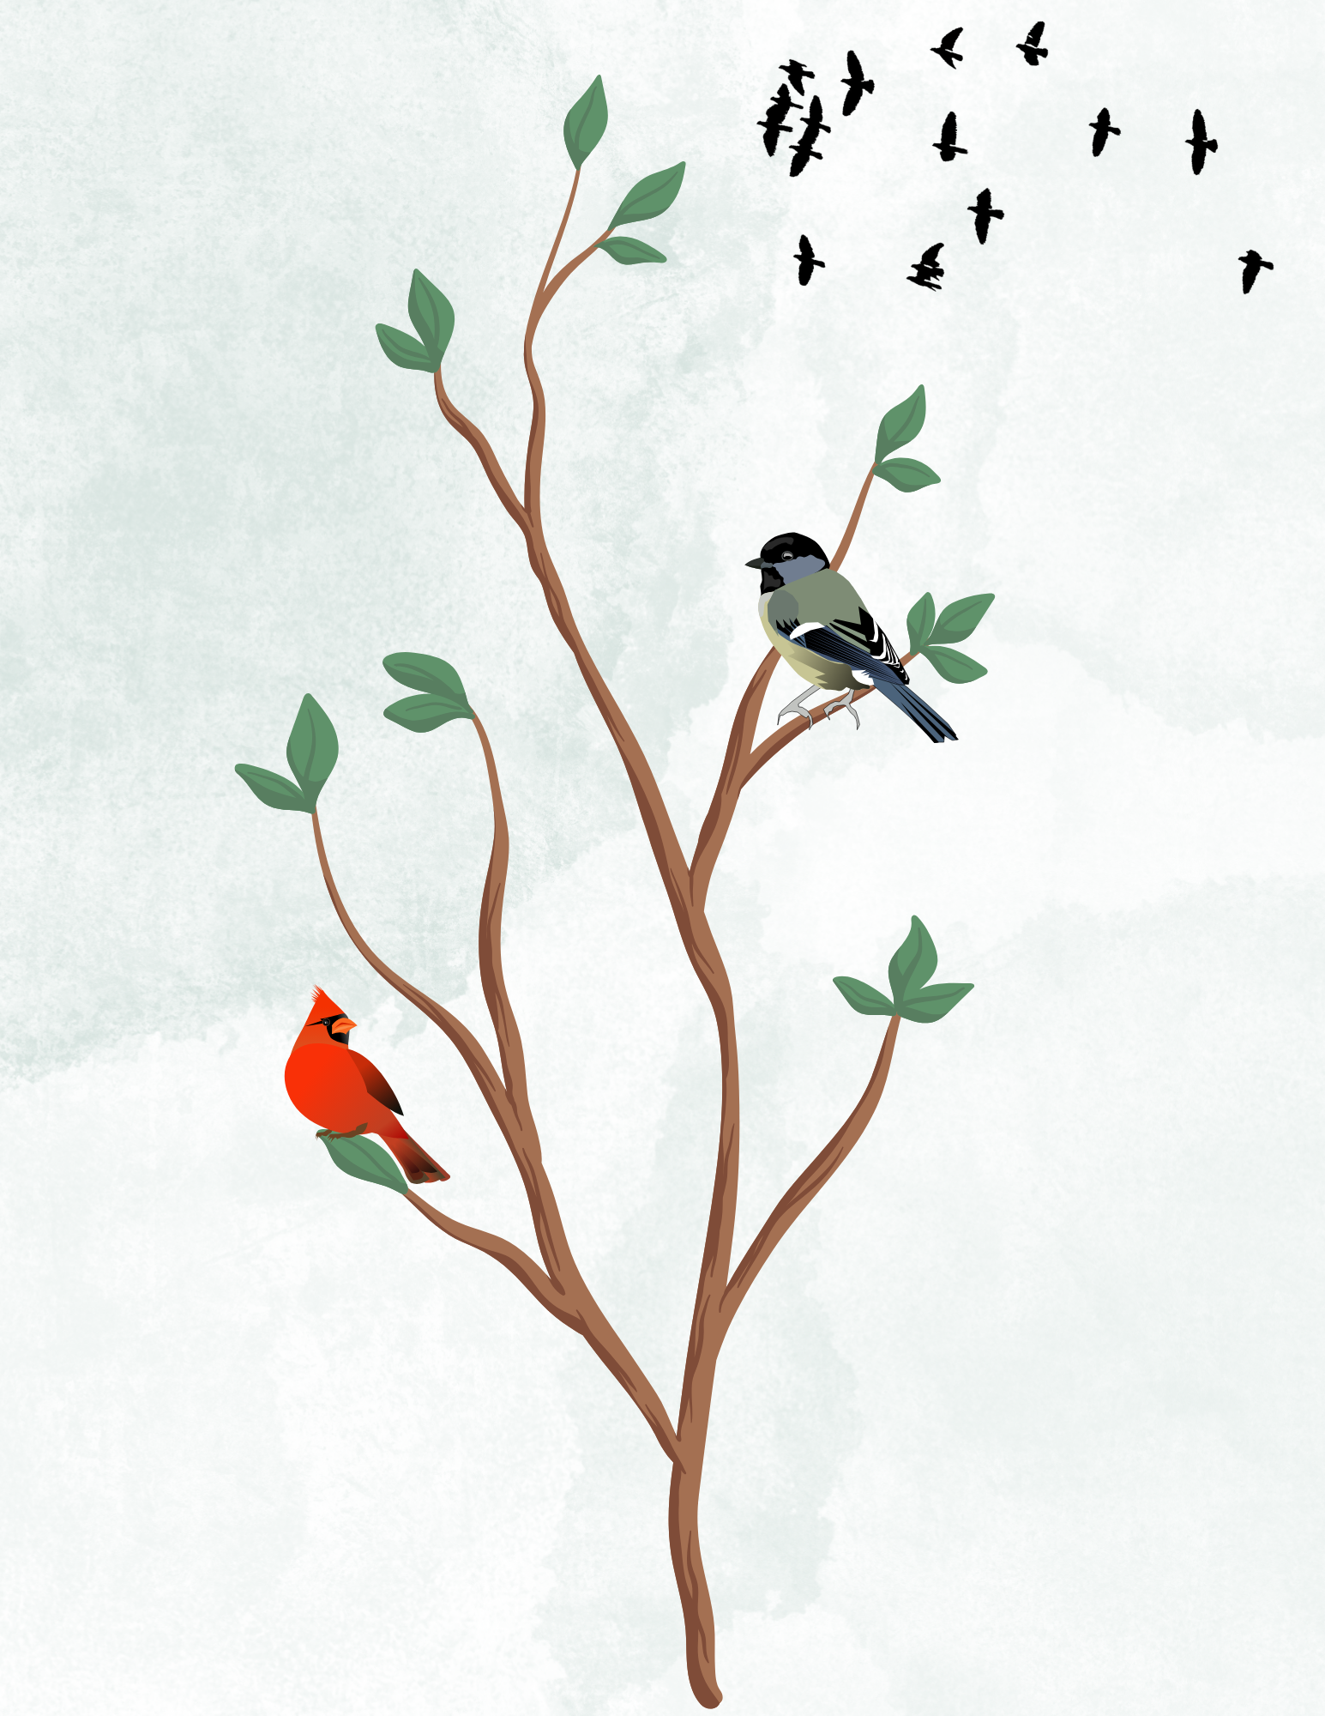
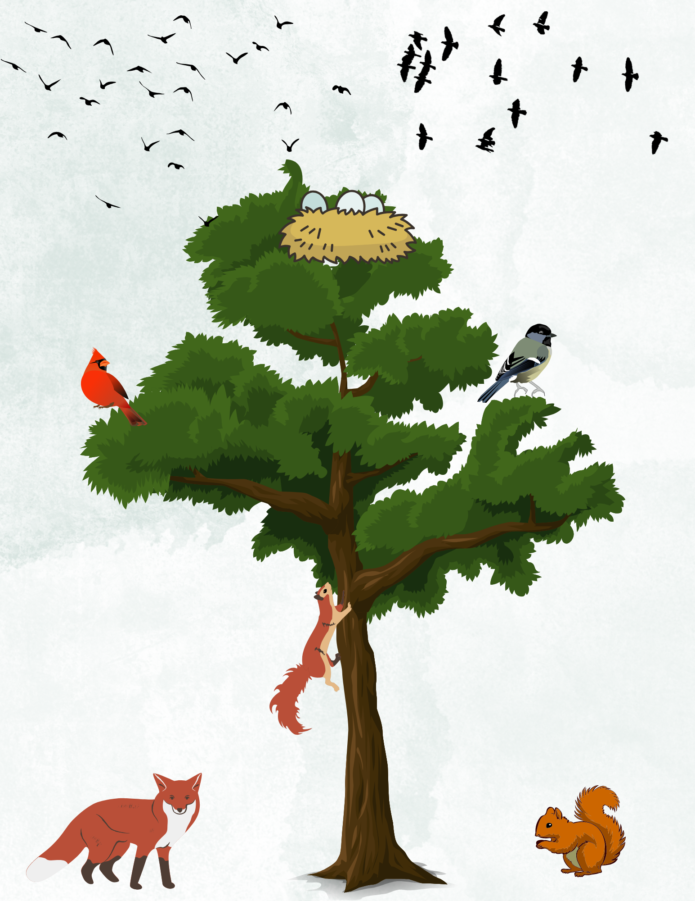
What is biodiversity ?
Notes:
Think of a tree:
In a small tree, a few birds will land on the branches every now and again.
In a medium-sized tree, birds will stop to eat insects in the bark and some squirrels will climb it.
In a very large tree, birds will make their nests, chickadees and woodpeckers will nest inside the trunk, rodents will live in the roots, and so on.
We can see that the stronger and bigger the tree is (like an ecosystem), the more diverse the habitats are, and the more species depend on it for their survival.
A riparian buffer strip with a wide variety of plant species, such as sand ryegrass, beach pea, and shrubs like rose bushes, serves as a food source for migratory birds and helps prevent coastal erosion.
However, biodiversity must be maintained. Coastal erosion, invasive alien species (IAS) and negative interactions between flora, fauna and humans are reducing the biodiversity in our coastal environments.
Let’s look at the next few images and see if these environments have high or low biodiversity.

Slide 5
High or low biodiversity ?
Notes:
Here, we see a riparian buffer strip with thick vegetation. We also see just one species: the common reed (Phragmites australis).
This species takes up all the space on the riparian buffer strip. It reproduces very quickly because of its far-reaching stolons and rhizomes. However, it doesn’t benefit any animal and therefore contributes very little to the biodiversity. It’s a invasive alien species.

Slide 6
High or low biodiversity ?
Notes:
In this image, we see sand ryegrass (like Ella) and other plants like beach pea. There’s also a lot of beach wrack, which is a food source for many insects. Beach wrack also fertilizes coastal vegetation.
There’s also driftwood. Driftwood helps keep sediment in place so plants can take root, which in turn prevents erosion.
An environment with high biodiversity is beautiful, isn’t it?
Does anyone know what beach wrack is?
Beach wrack is composed of plants and bivalve shells washed up on the shore.
Does anyone know what driftwood is?
Driftwood is wood that floats in the water and washes up on the shore.

Slide 7
High or low biodiversity ?
Notes:
At first glance, it might seem like this environment has low biodiversity. However, this wetland is actually a salt marsh filled with many different habitats! The thick vegetation in these environments stores carbon, retains sediment and creates an aquatic maze that floods at high tide. As a result, many species of fish, amphibians, insects, mammals and birds can coexist in the same habitat. Next time you see a salt marsh, take a look at what’s happening in the water, in the plants and in the air.
When it rains, wetlands absorb water to prevent flooding. During a dry spell or a heat wave, they release water to hydrate the soil and plants.

Slide 8
Coexistence with flora and fauna
Notes:
Part 2: Coexistence with flora and fauna
What activities do you do at the beach?
*Write the answers on the board*
What does coexistence with flora and fauna mean?
Well-rooted sand ryegrass protects the beach from erosion and serves as a food source for animal species. It’s like a buffet!
Animals and humans share these spaces and can coexist without harming one another, which is truly wonderful! However, there are times when our actions do harm fauna and flora.
Can it affect the biodiversity?
Our actions can sometimes affect the environment we enter, for instance, when we leave garbage behind or feed wildlife. When we disturb natural environments, we also affect the flora and fauna in that area. We need to act responsibly to cause as little disturbance as possible to the nature around us.
What species might we encounter during these activities?
We can come across gulls, shorebirds, insects, seals, sand ryegrass, chipmunks, warblers, etc.
These species play an important role in the biodiversity of the environment. Our actions can negatively affect them and in turn, the biodiversity. We need to think about the species around us so we can help protect them.
The next slides show activities you may have done before. What species do you think we might see during these activities?

Slide 9
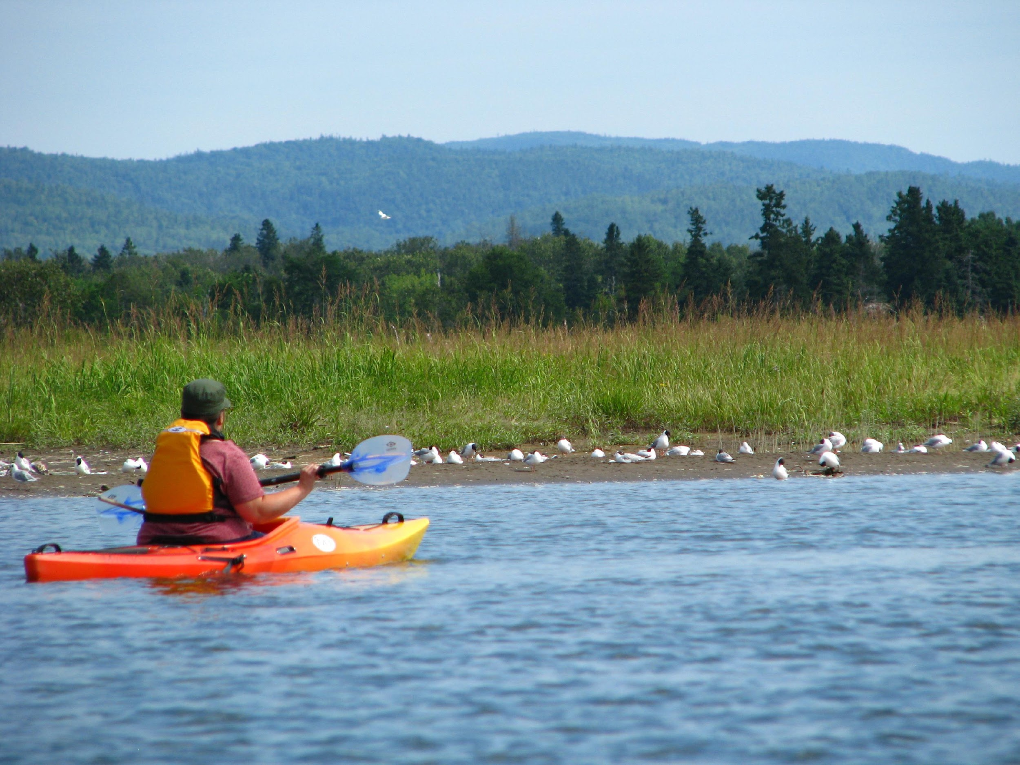
Sea kayaking
What animal or plant species might we encounter ?
Notes:
Raise your hand if you’ve been sea kayaking before.
What animals might we encounter while sea kayaking ?
We might see gulls, seals, harbour porpoise, rorqual (the species will depend on where you are in Quebec) and more.
What can we do to not disturb them?
We should always keep at least 100 metres away from wildlife, 400 metres away from endangered species (beluga, right whale, blue whale, etc.) and 200 metres away from animals that are resting.
Some animals might even approach you. If they do, stop paddling, wait for them to leave and, if possible, keep your distance.
You can bring binoculars with you to get a better look at wildlife.
After using your kayak, be sure to wash it thoroughly to avoid transporting aquatic invasive species (AIS).

Slide 10
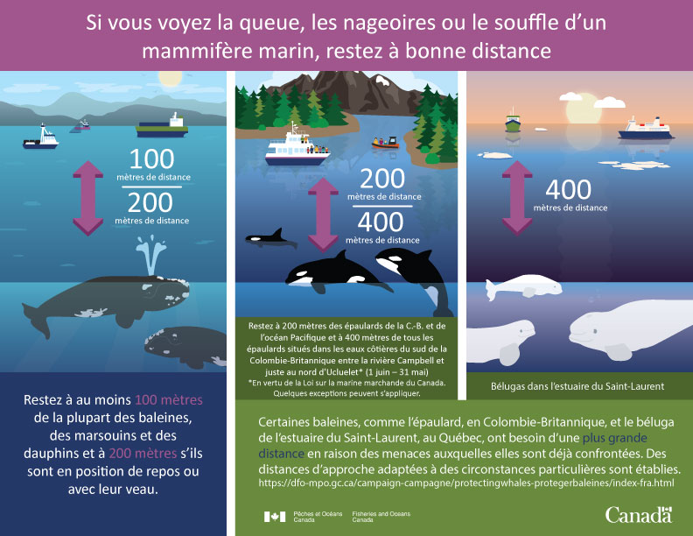
Notes:
Remember to keep a distance of at least 200 metres from all marine mammals.
Why should we keep a distance of 400 metres from belugas?
The St. Lawrence Estuary beluga population is roughly 900 (1), compared to the estimated 7,800 to 10,100 in the 1900s (2). Today, this population is on the mend. That’s why it’s important to keep our distance from these mammals so we don’t disturb them. In doing so, we’re helping this species recover!
Here’s a reminder of the distances we need to keep from marine mammals. The website of Baleinesendirect (1) is also full of information on marine mammals.
https://baleinesendirect.org/decouvrir/especes-baleines-saint-laurent/13-especes/beluga/
https://www3.mffp.gouv.qc.ca/faune/especes/menacees/fiche.asp?noEsp=3

Slide 11
What should I do if I find a marine mammal in distress ?
Notes:
What can I do?
If you see a marine mammal in distress or beached, dead or alive, be it a whale or a seal, call the Quebec Marine Mammal Emergency Response Network at 1-877-722-5346. At Comité ZIP Gaspésie, we’re also trained to respond to these types of emergencies.
This organization works with a network of volunteers who are trained to help marine mammals in need along the St. Lawrence riparian zone, from Quebec City to Gaspésie and the Îles de Mingan. This network works to better document incidents involving marine mammals in order to prevent them from happening in the future. The volunteers take samples from the animal carcasses.
It’s important to call this organization instead of intervening, which can be dangerous for us and the animal.
Story : My friend’s dog once picked up a bone while we were walking on the beach. Through the dog’s teeth, we noticed a large blue tag with a telephone number and a code from the Marine Mammal Emergency Network attached to the bone. I called the number, and the organization’s Rimouski-based volunteer came and picked up the tag. She told us the bone belonged to a harbour porpoise that had been beached earlier that summer. She had already taken all the samples she needed, so she left the bone on the beach. *This story is an anecdote to explain how the organization works.*

Slide 12
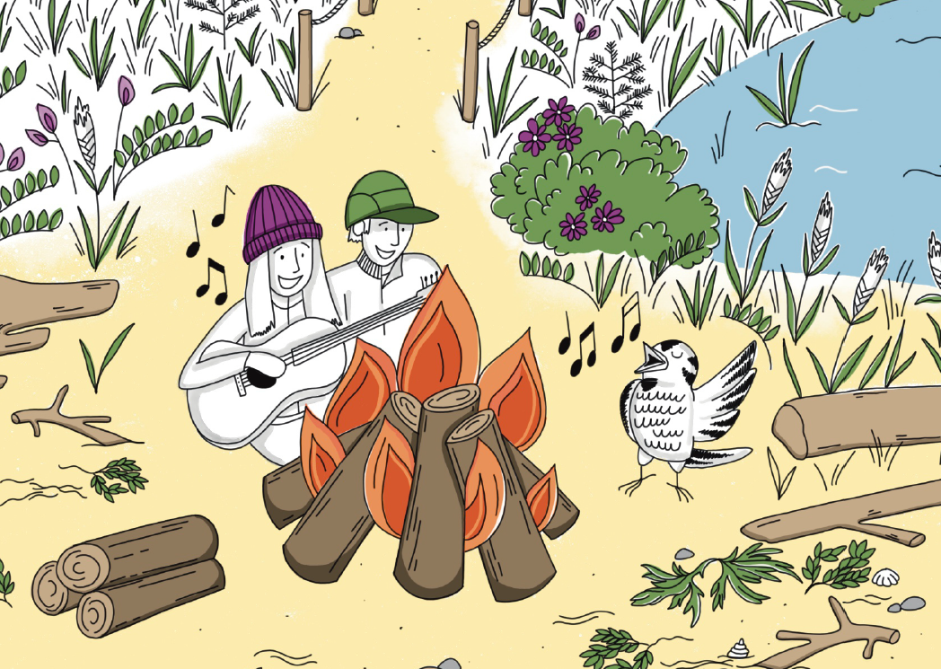
Having a picnic on the beach
What animal or plant species might we encounter ?
Notes:
Having a picnic on the beach is a great summer activity. Who’s done it before?
What animals can we see while at the beach?
Mosquitoes, molluscs, bivalves, birds, gulls, etc.
How can we protect these animals?
By picking up our trash, not feeding the wildlife, not trampling the riparian buffer strip and staying on trails. These actions will help reduce erosion by promoting plant growth as well as minimize disturbances to wildlife, all of which contribute to a healthy coastal environment. Also, by keeping dogs on a leash so they don’t chase the animals and not using drones to get a closer look at wildlife.
We can enjoy everything the area has to offer, without disturbing the environment. That way, we can better coexist with nature!

Slide 13
How can we not disturb wildlife ?
Notes:
Are there any other outdoor activities where we might encounter wildlife?
Wrote down the activities suggested. What animals might we encounter during these activities?
How can you avoid disturbing these species during your activities?
*Go over the students’ answers*

Slide 14
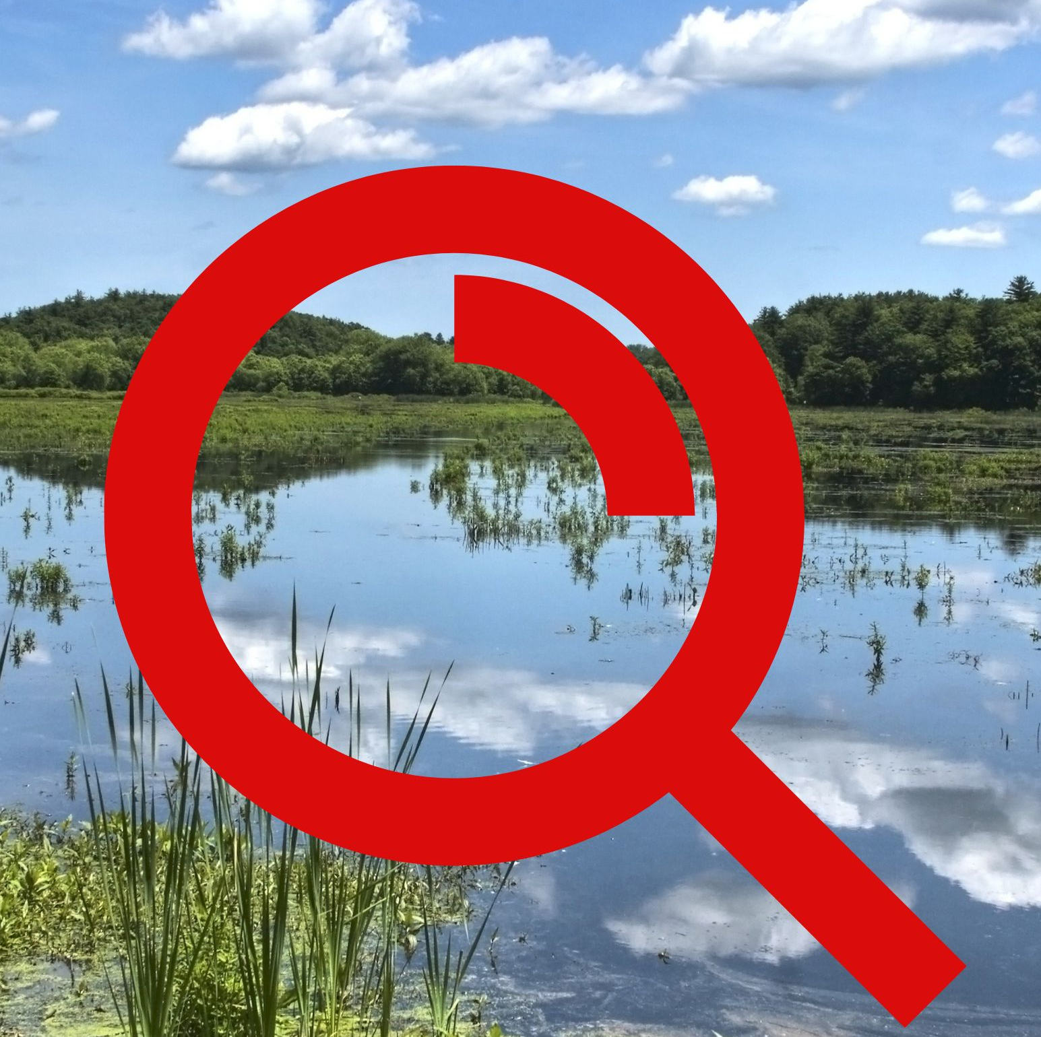
Let the search begin!
Notes:
Part 3 : Biodiversity scavenger hunt!
The next step is to hold a scavenger hunt to learn more about the species that make up a healthy shoreline. We’ll also learn how to identify the main invasive alien species in our area.

Slide 15
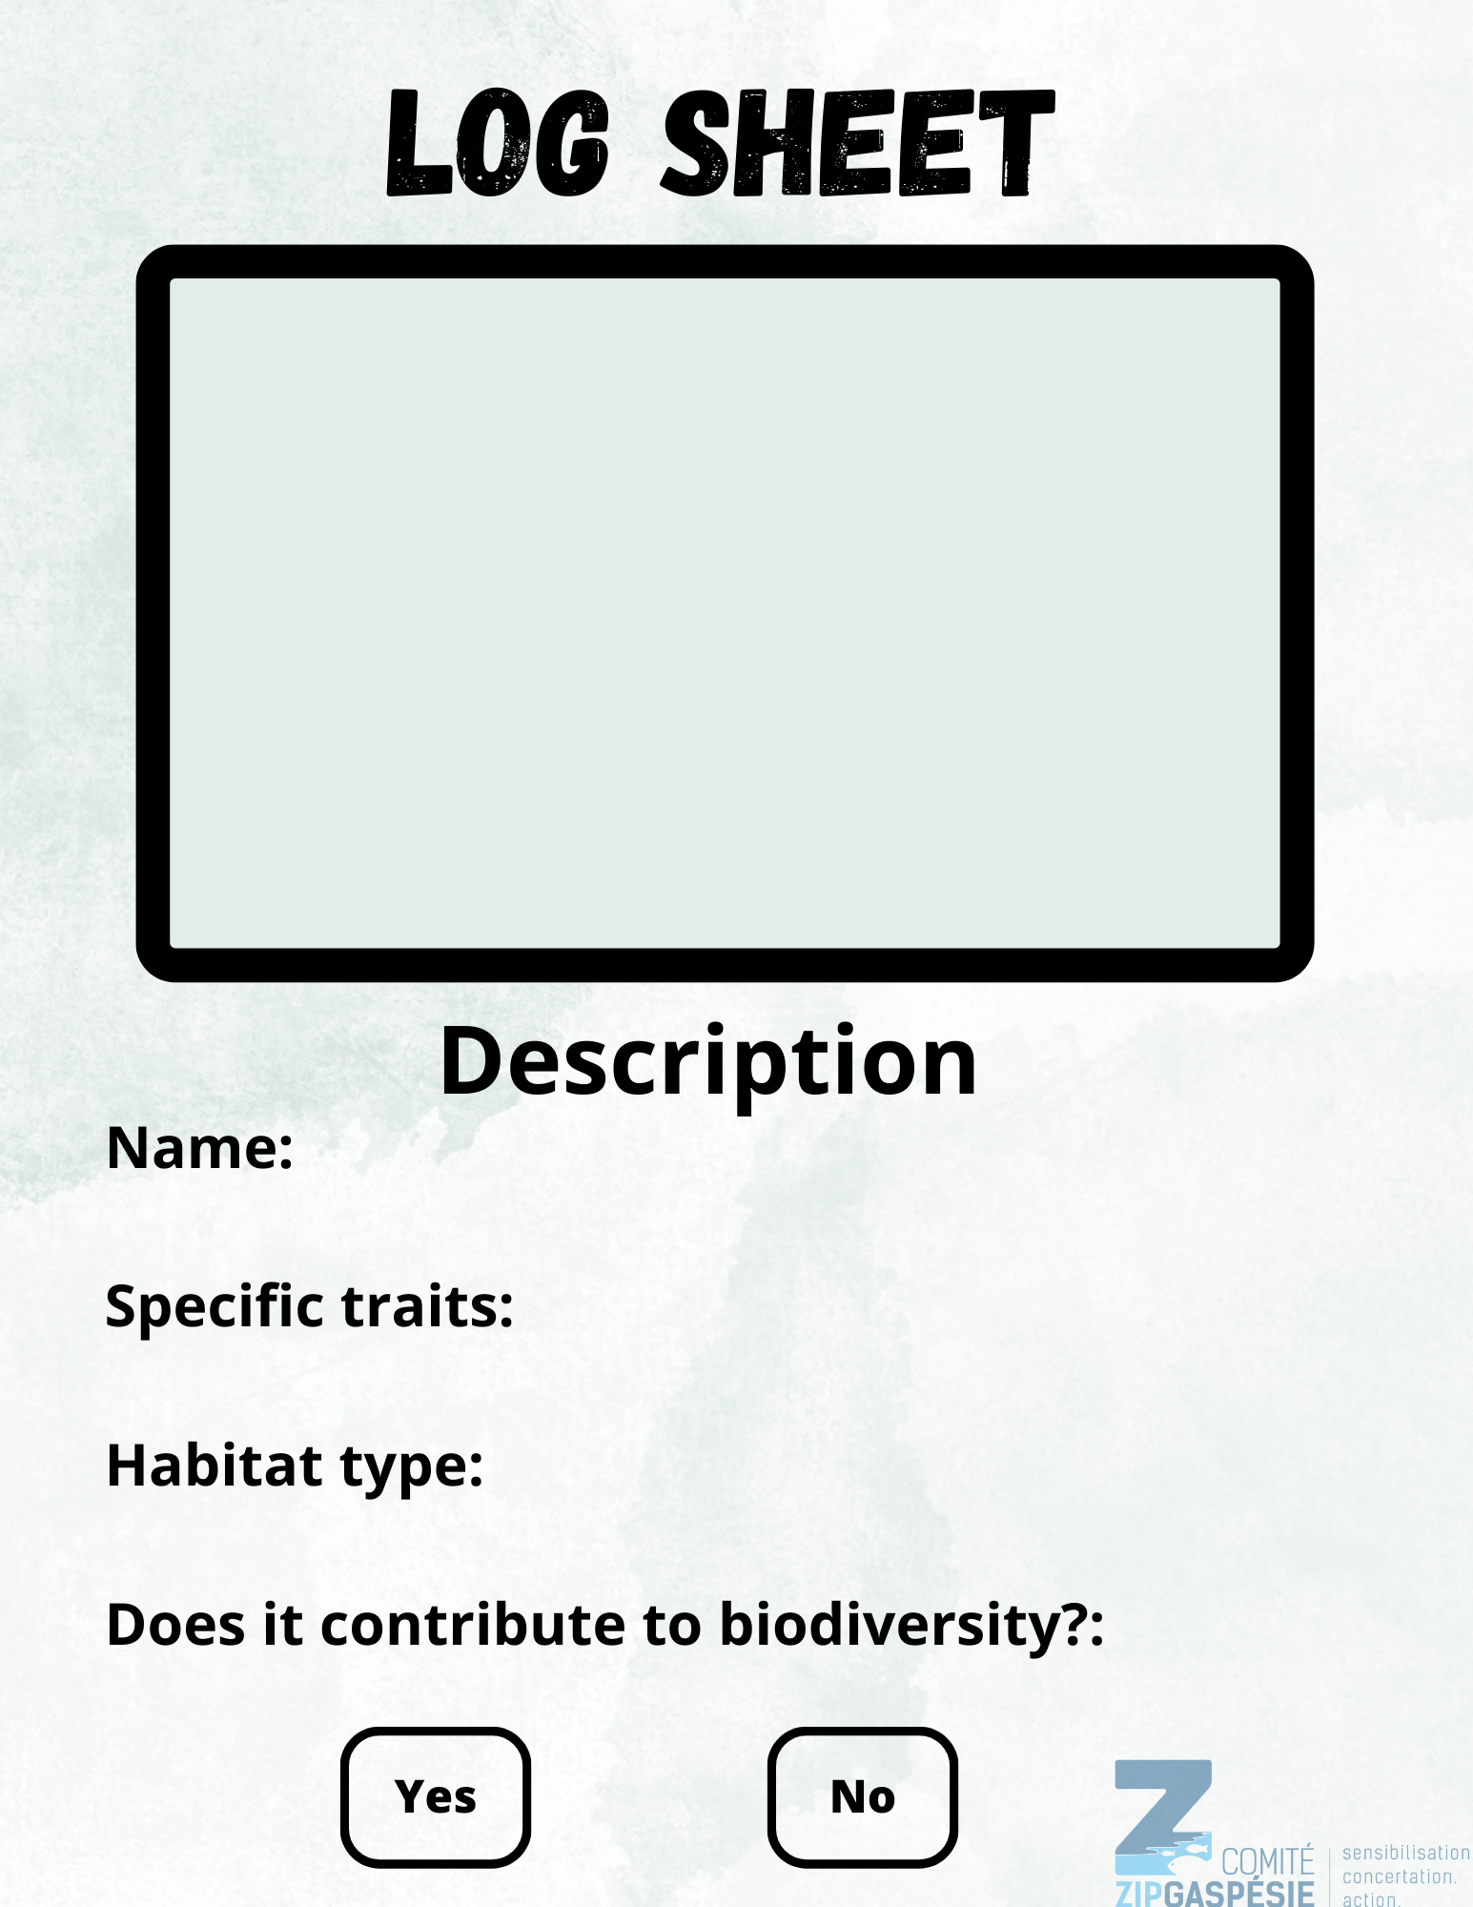
Biodiversity scavenger hunt!
Notes:
The next activity focuses on identifying species and determining if they’re invasive or not. On the left is an example of one of the stations, and on the right is a log sheet on biodiversity to fill out.
You can refer to page 11 in the comic book when the characters come across the “wanted” poster for the common reed. Students can be sheriffs just like Bob and Milo!
8 stations
Each station features a species found in its natural environment. Use the description at each station to fill out your log sheet. Is the species in front of you invasive?
At each station, you need to write on your log sheet:
The name of the species;
Its specific traits. For instance, large shrub-like branches, white flowers, woody stem, etc. What things help you to identify this species?
Its habitat type. Where can we find this species? In what types of environments does this species thrive?
Based on the description of the ecology, determine if the species at that station contributes to the coastal biodiversity or not.
You also have space to sketch what you think this species looks like.
Among the eight stations, there are three species that are beneficial to the biodiversity. Can you tell the difference between invasive species and those that are beneficial?
During the activity, visit each station to make sure the students understand the exercise. Answer their questions and explain any words they don’t understand (grass bed, temperate, etc.).

Slide 16
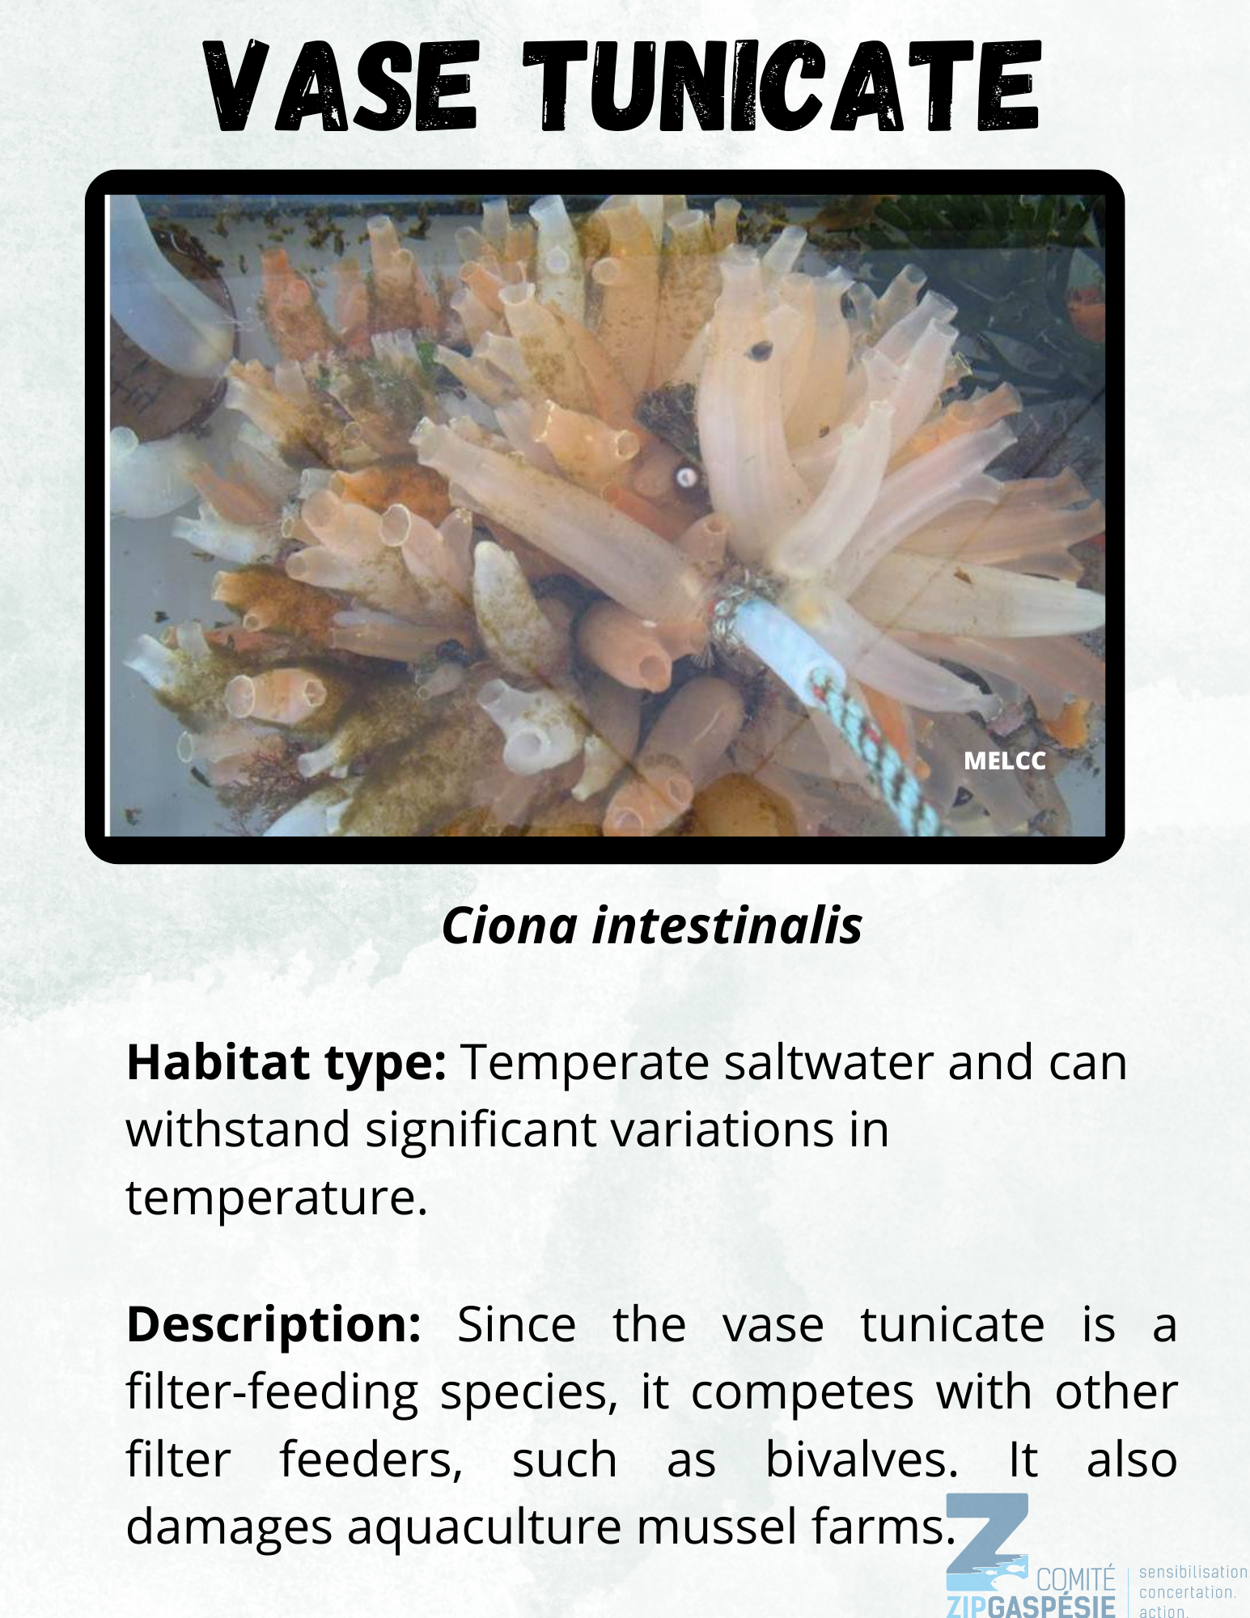
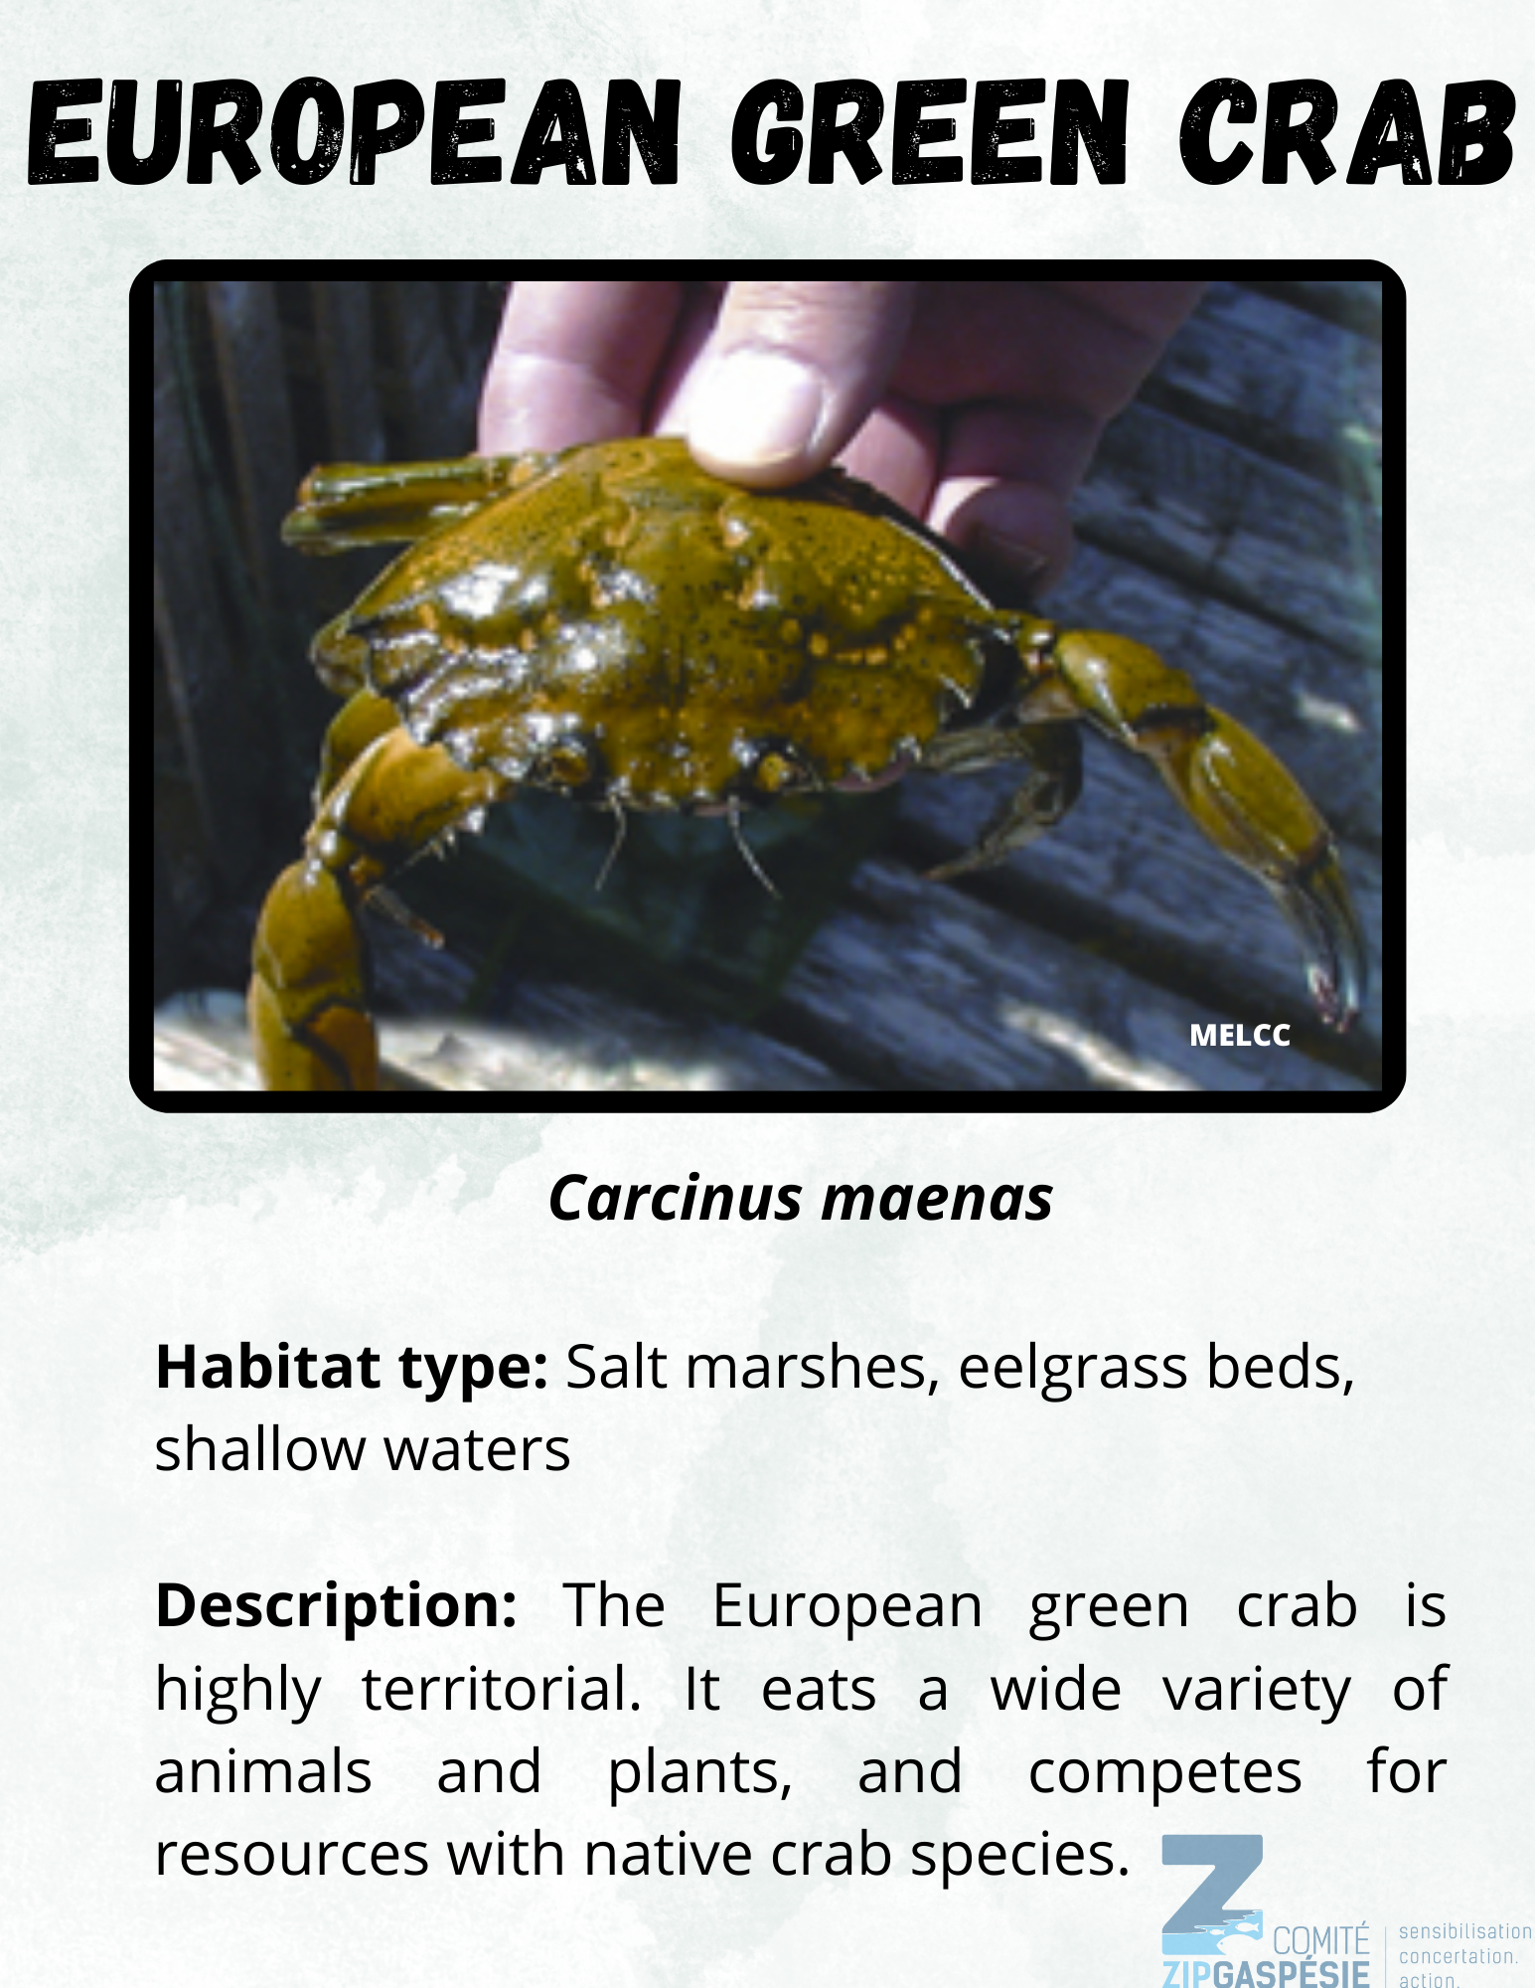
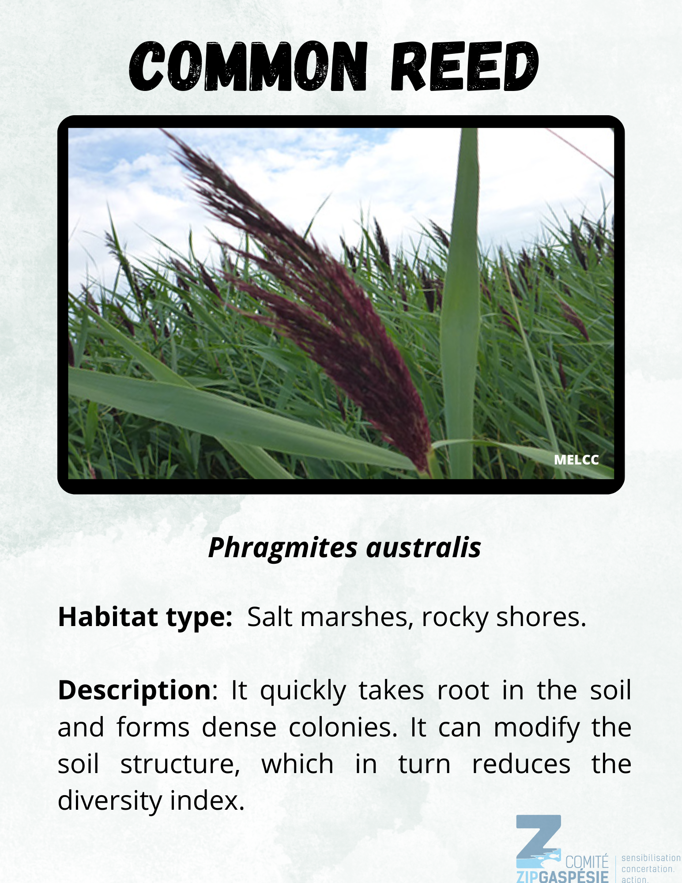
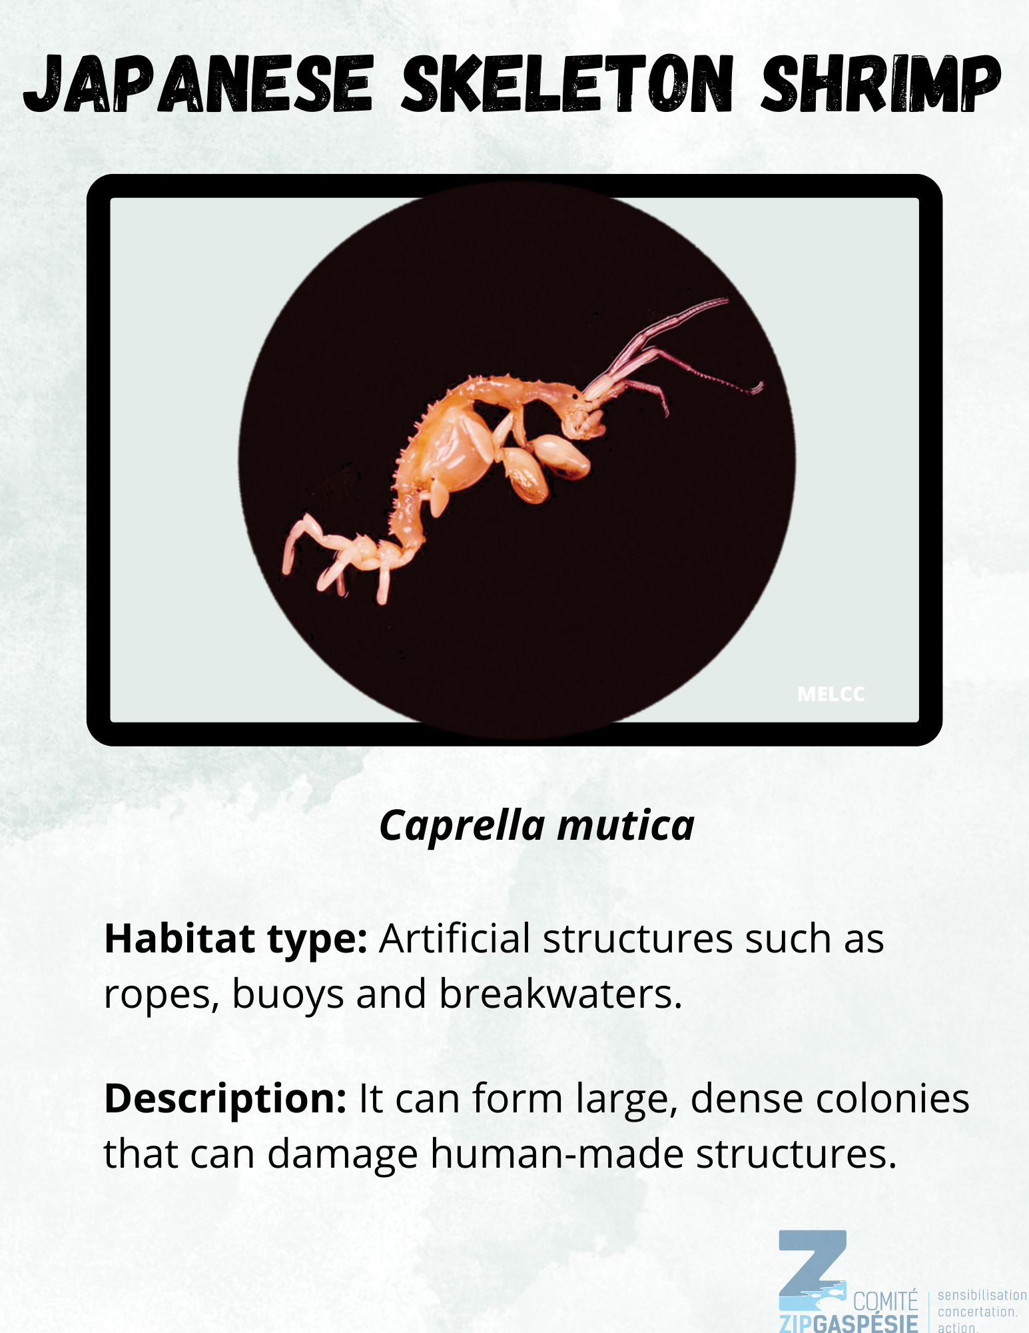
Which were invasive species?
Notes:
Answer!
Among the eight stations,five species are invasive :
Vase tunicate, Japanese knotweed, European green crab, common reed and Japanese skeleton shrimp

Slide 17
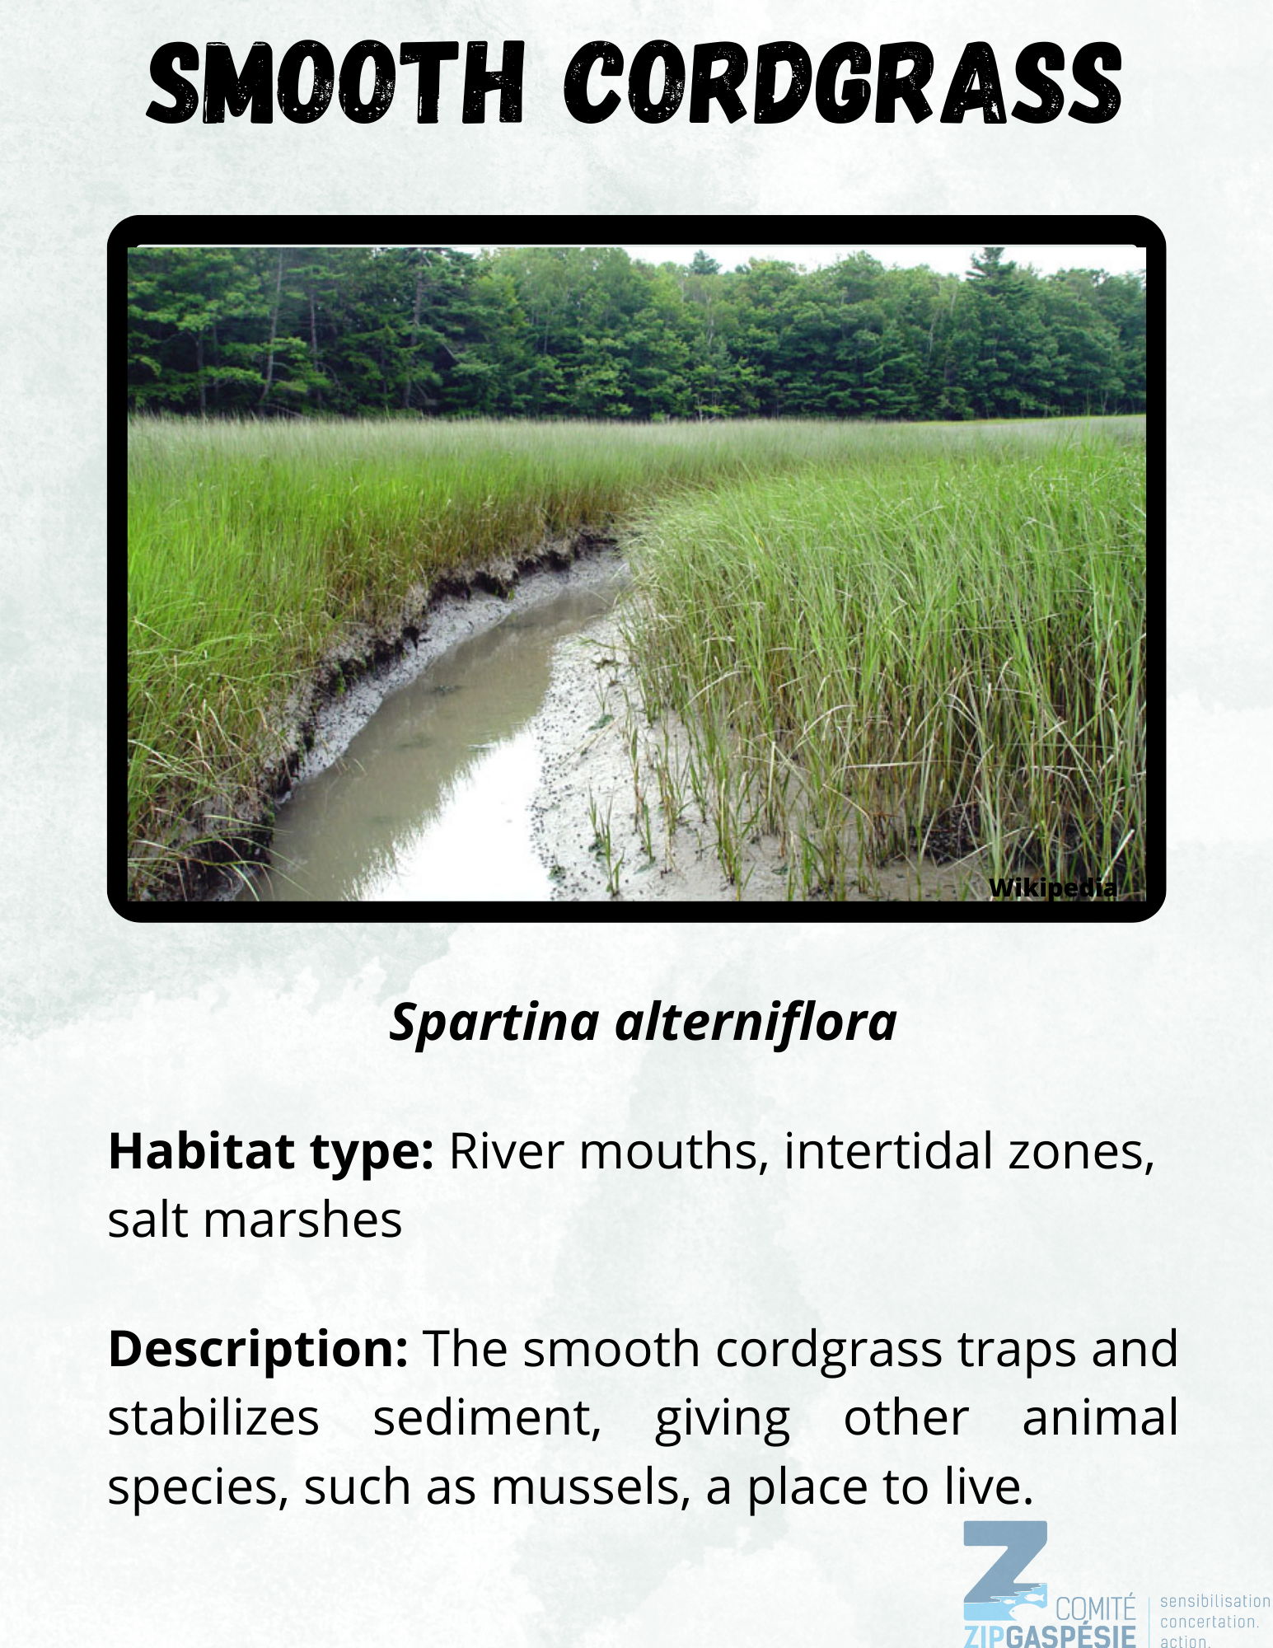
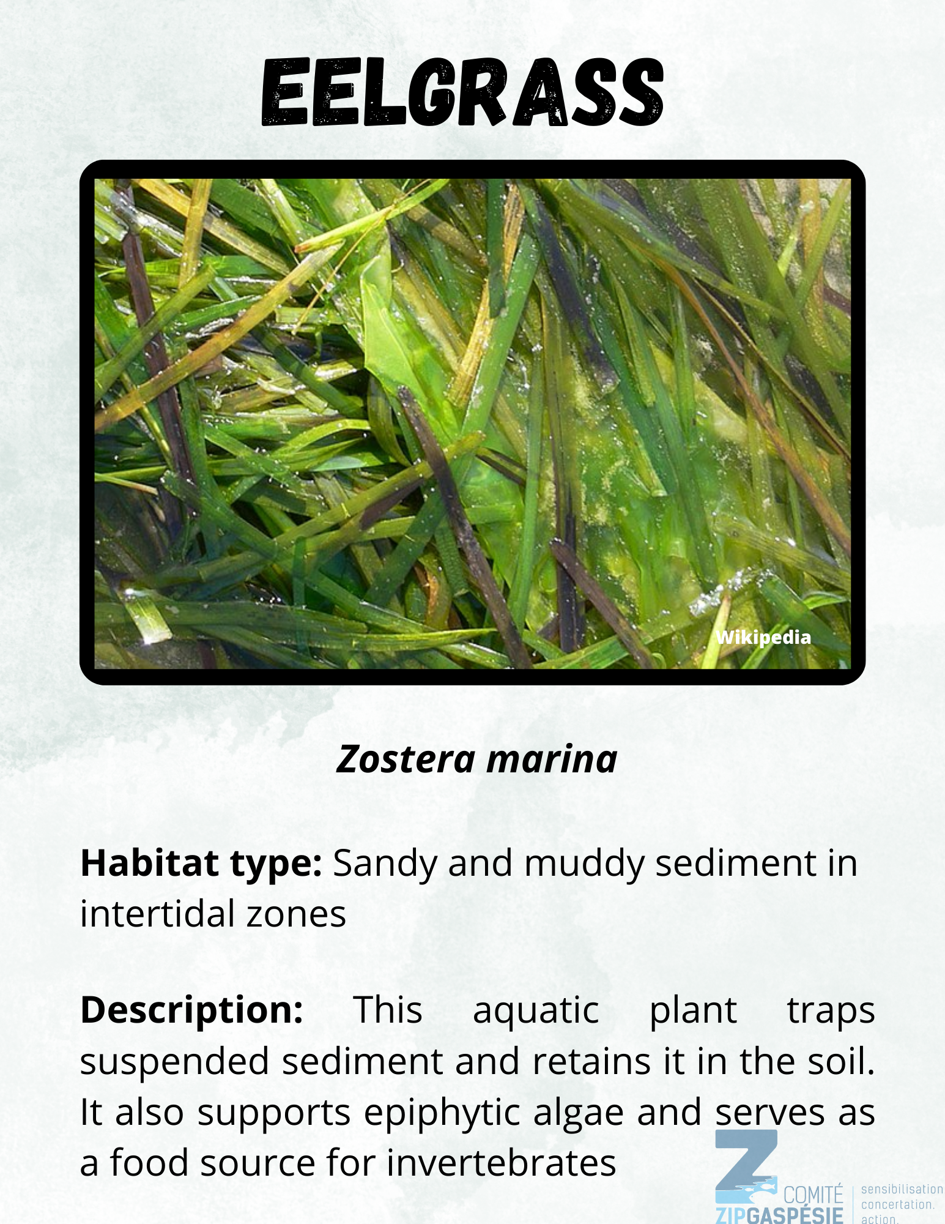
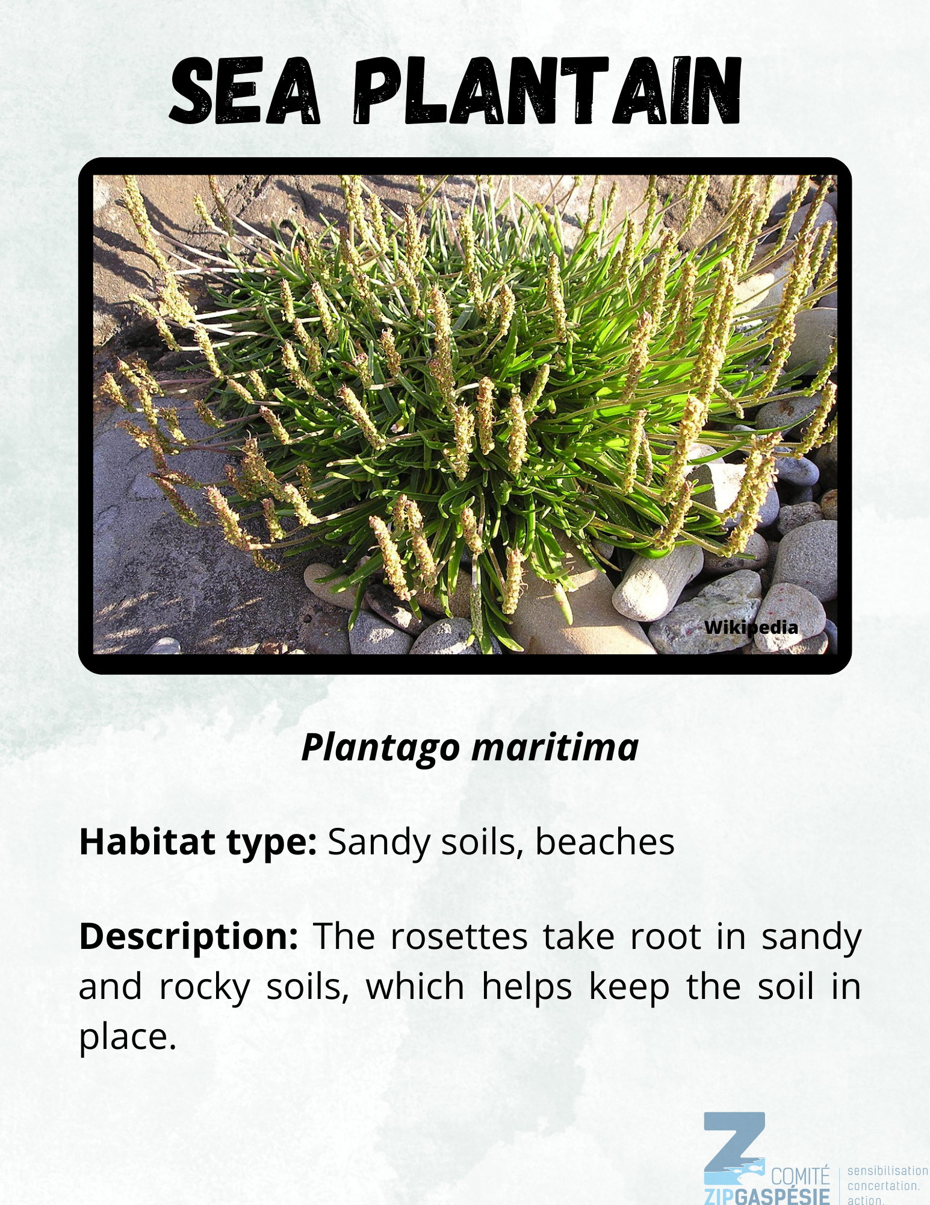
Which species contribute to the biodiversity ?
Notes:
Among the eight stations, three species contribute to a healthy biodiversity :
Oyster leaf, eelgrass and sea plantain
Smooth cordgrass (Spartina alterniflora) helps bind large quantities of sediment at an accelerated rate.
Eelgrass creates large aquatic grass beds that are home to a wide variety of algae and invertebrates and serve as a rich food source for many species such as fish and birds.
Sea plantain is also edible. Its rhizomes cling to beaches, helping to protect the shoreline from erosion.

Slide 18
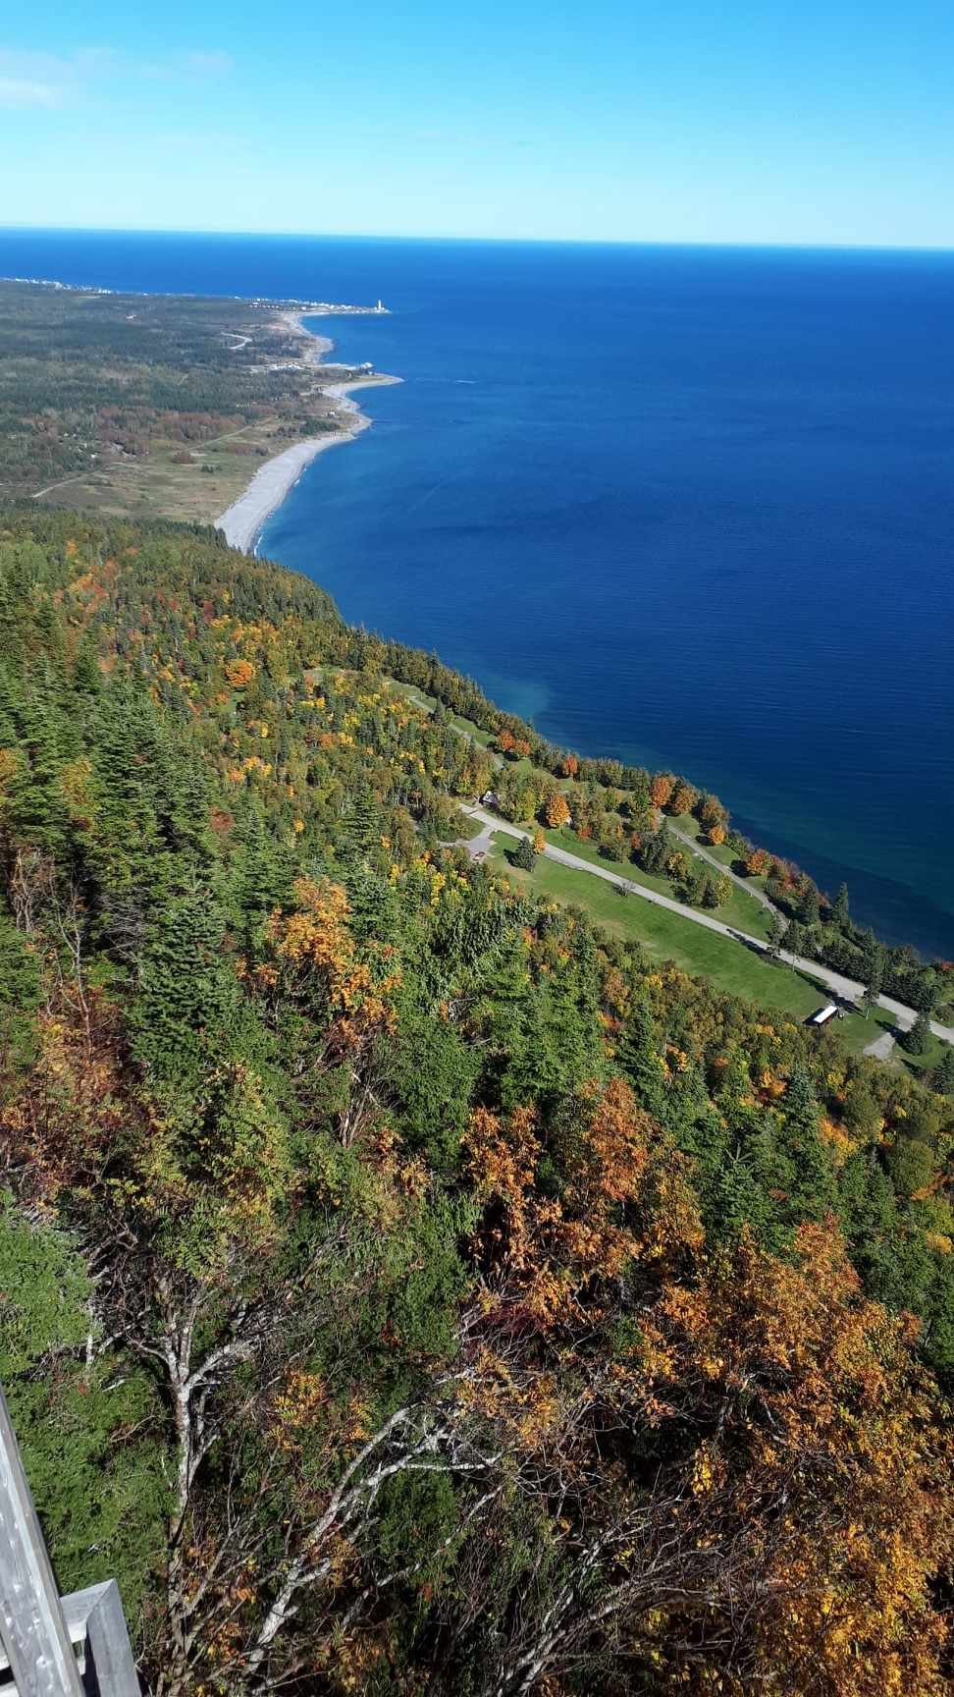
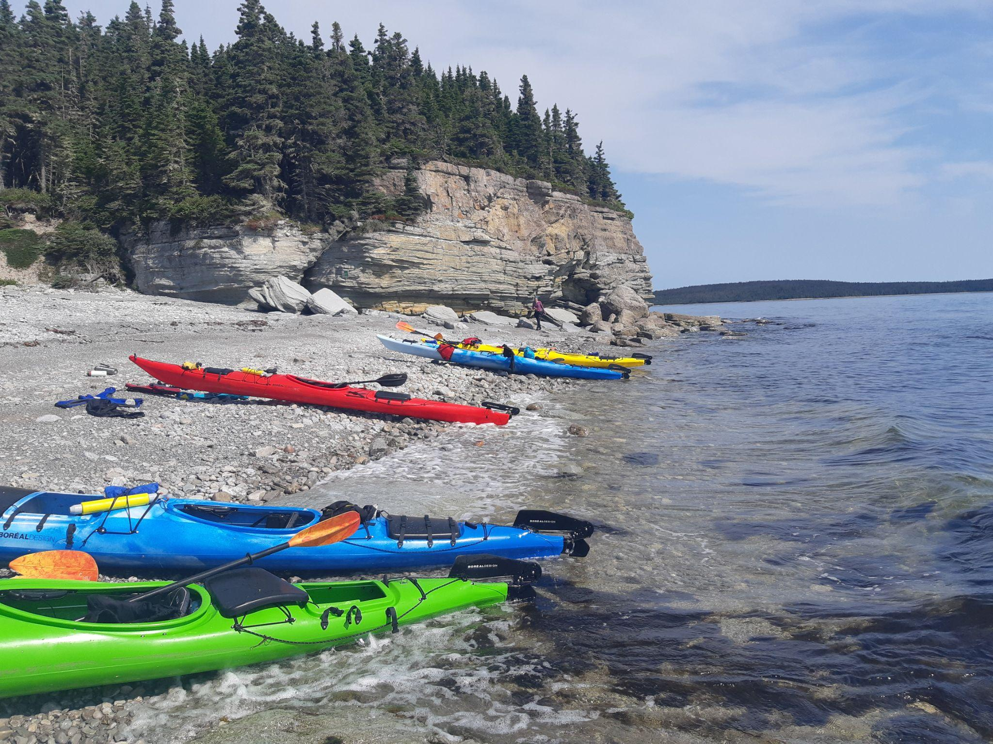
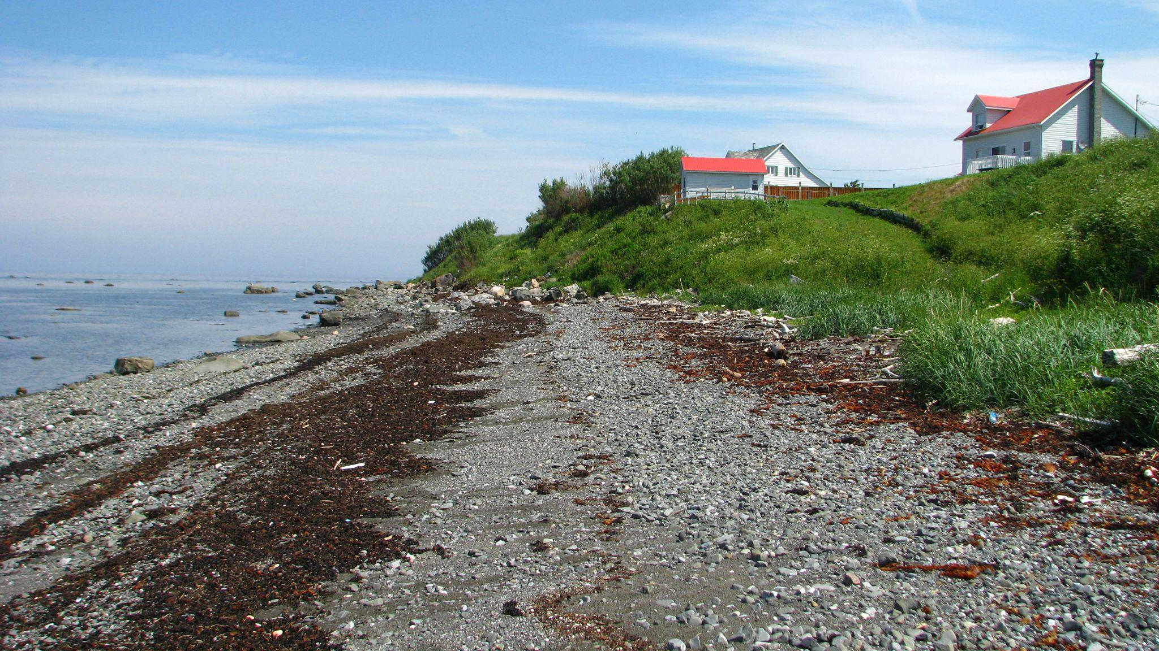
Questions ?
Notes:
Thanks, everyone!
Congratulations, you know how to identify an environment with high biodiversity and how to take care of it!
Don’t forget that our actions have an impact on these natural environments. That’s why we need to make sure our visits leave no trace, so wildlife can enjoy these spaces, too!
Encourage your family and friends to follow these rules so more people can help protect coastal areas!

