Slide 1
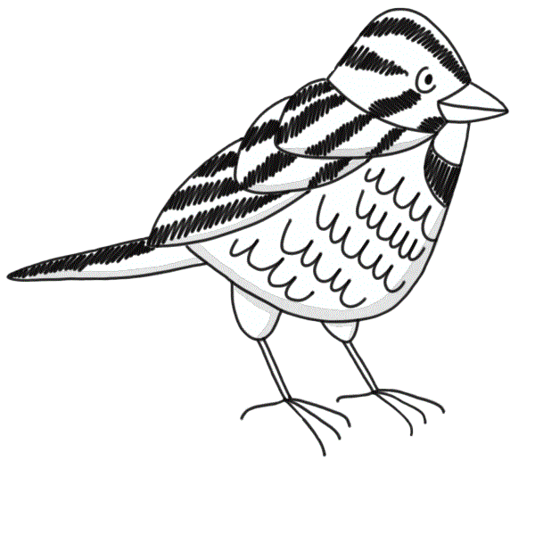
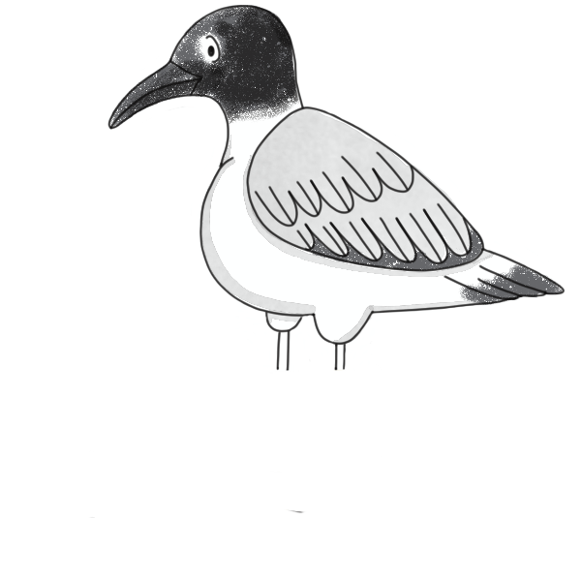
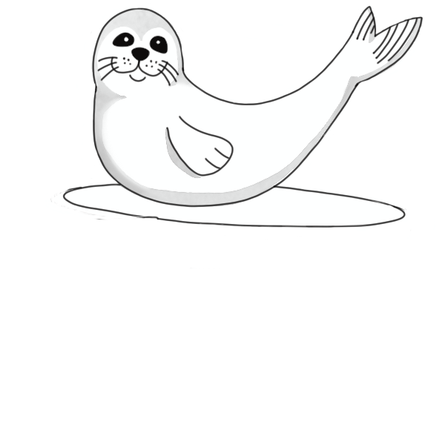
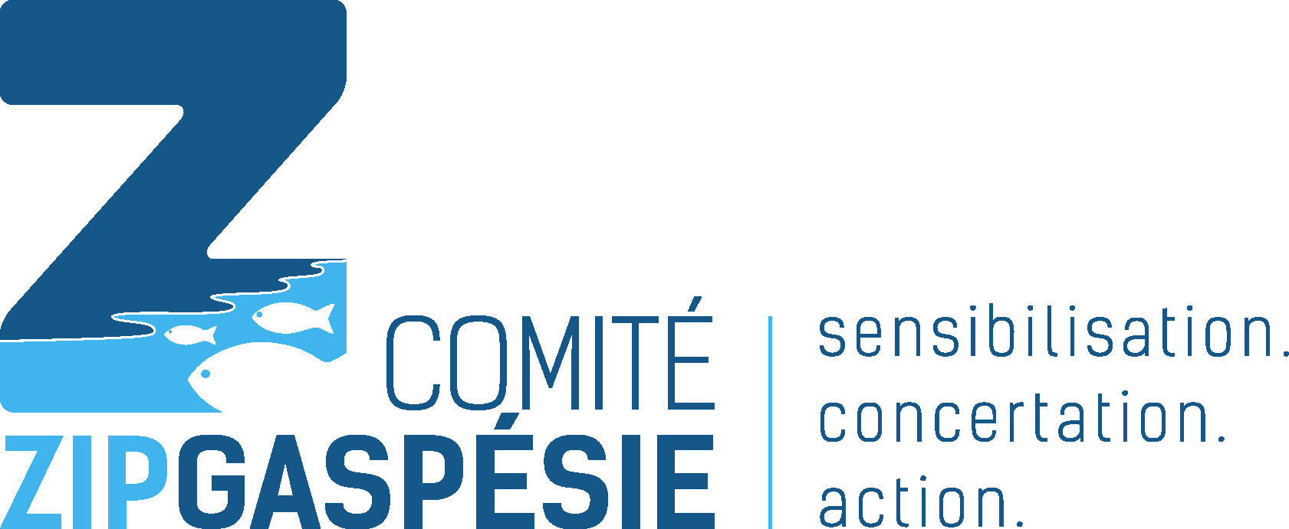
Coastal Erosion
What is it ?
Notes:
What is erosion? Was it mentioned in the comic book?
*Write students’ answers on the board*
Today, we’ll be talking about coastal erosion. It’s something that’s always been there and that we notice every day. Erosion has shaped our beaches and shorelines for millions of years. Erosion is currently on the rise in our part of the world, and that’s why it’s so important to understand it. Since our shorelines are teeming with all kinds of life, we need to know how to protect the shore from erosion. Today we’ll be looking at the causes and impacts of erosion, and how we can help shore up the shoreline.

Slide 2
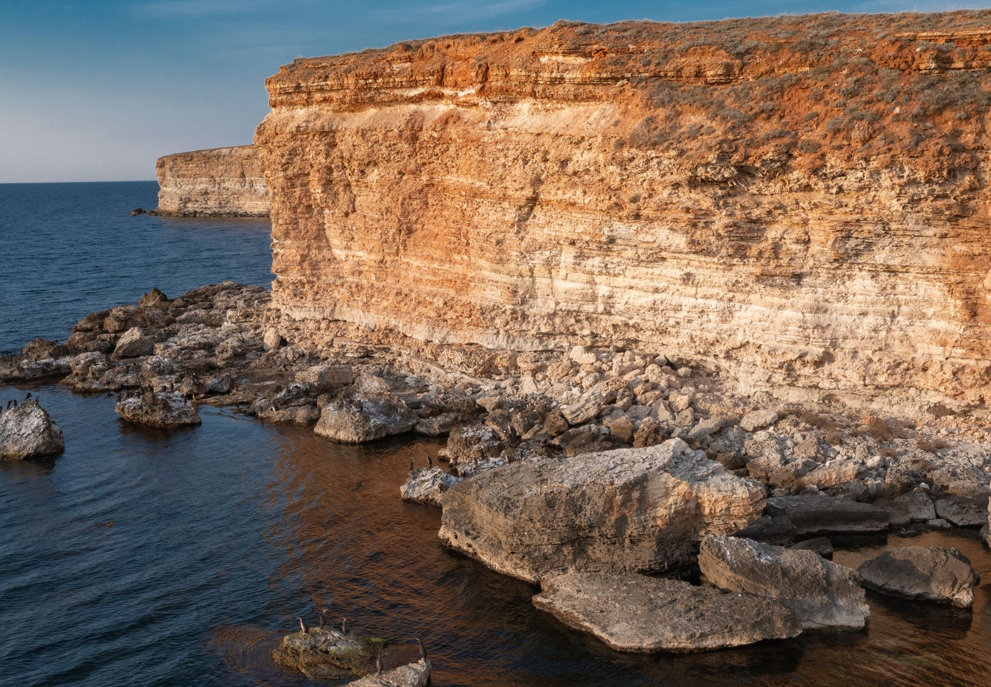
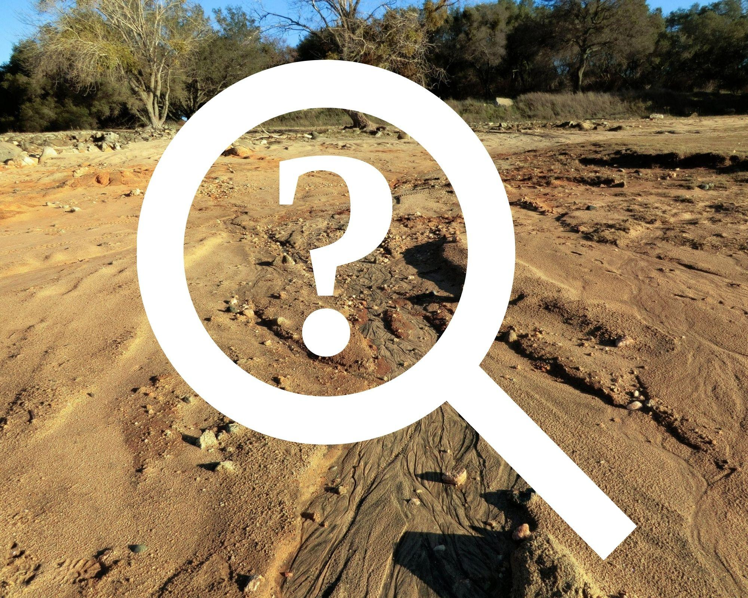
Let’s start by defining it…
What is erosion?
Notes:
Part 1: Understanding erosion
Raise your hand if you’ve heard the word “erosion” before.
What do you think coastal erosion is?
Erosion: Coastal erosion is a natural process that involves the breakdown of soil and rocks on the shoreline and beneath the water’s surface¹ (e.g., sand blowing off the beach from strong winds, rocks worn down by the waves like Percé Rock). However, erosion isn’t a new concept. In fact, it’s been happening for thousands of years. An environment is said to be balanced when the sediment lost to erosion equals the sediment accumulated by plants, waterways, wind, tides and so on. An environment is said to be imbalanced when the inflow and outflow of sediment are no longer equal, meaning more sediment is lost than gained. Just like a scale!
The natural process of erosion is caused by wind, tides, rain and storms, but can be accelerated by certain human interventions.
Human activities impact the rate at which sediment accumulates. Infrastructure near the coast, such as houses, riprap, retaining walls and dams, disrupt the balance of sediment, leaving certain areas vulnerable to erosion. River dams cut off the supply of sediment to waterways, reducing the amount naturally transported to shorelines downstream. Also, vehicles and visitors trampling the riparian buffer strip also has an effect on the shoreline vegetation. A diversified riparian buffer strip retains sediment better, which helps protect the beach from erosion.
Although we have little impact on the natural causes of erosion, we can help the shoreline by focusing our attention on the human causes.
The next slides show examples of places with high erosion and others prepared to withstand it. Can you tell them apart?
¹Davidson-Arnott, R., & Ollerhead, J. (2011). Coastal erosion and climate change.

Slide 3
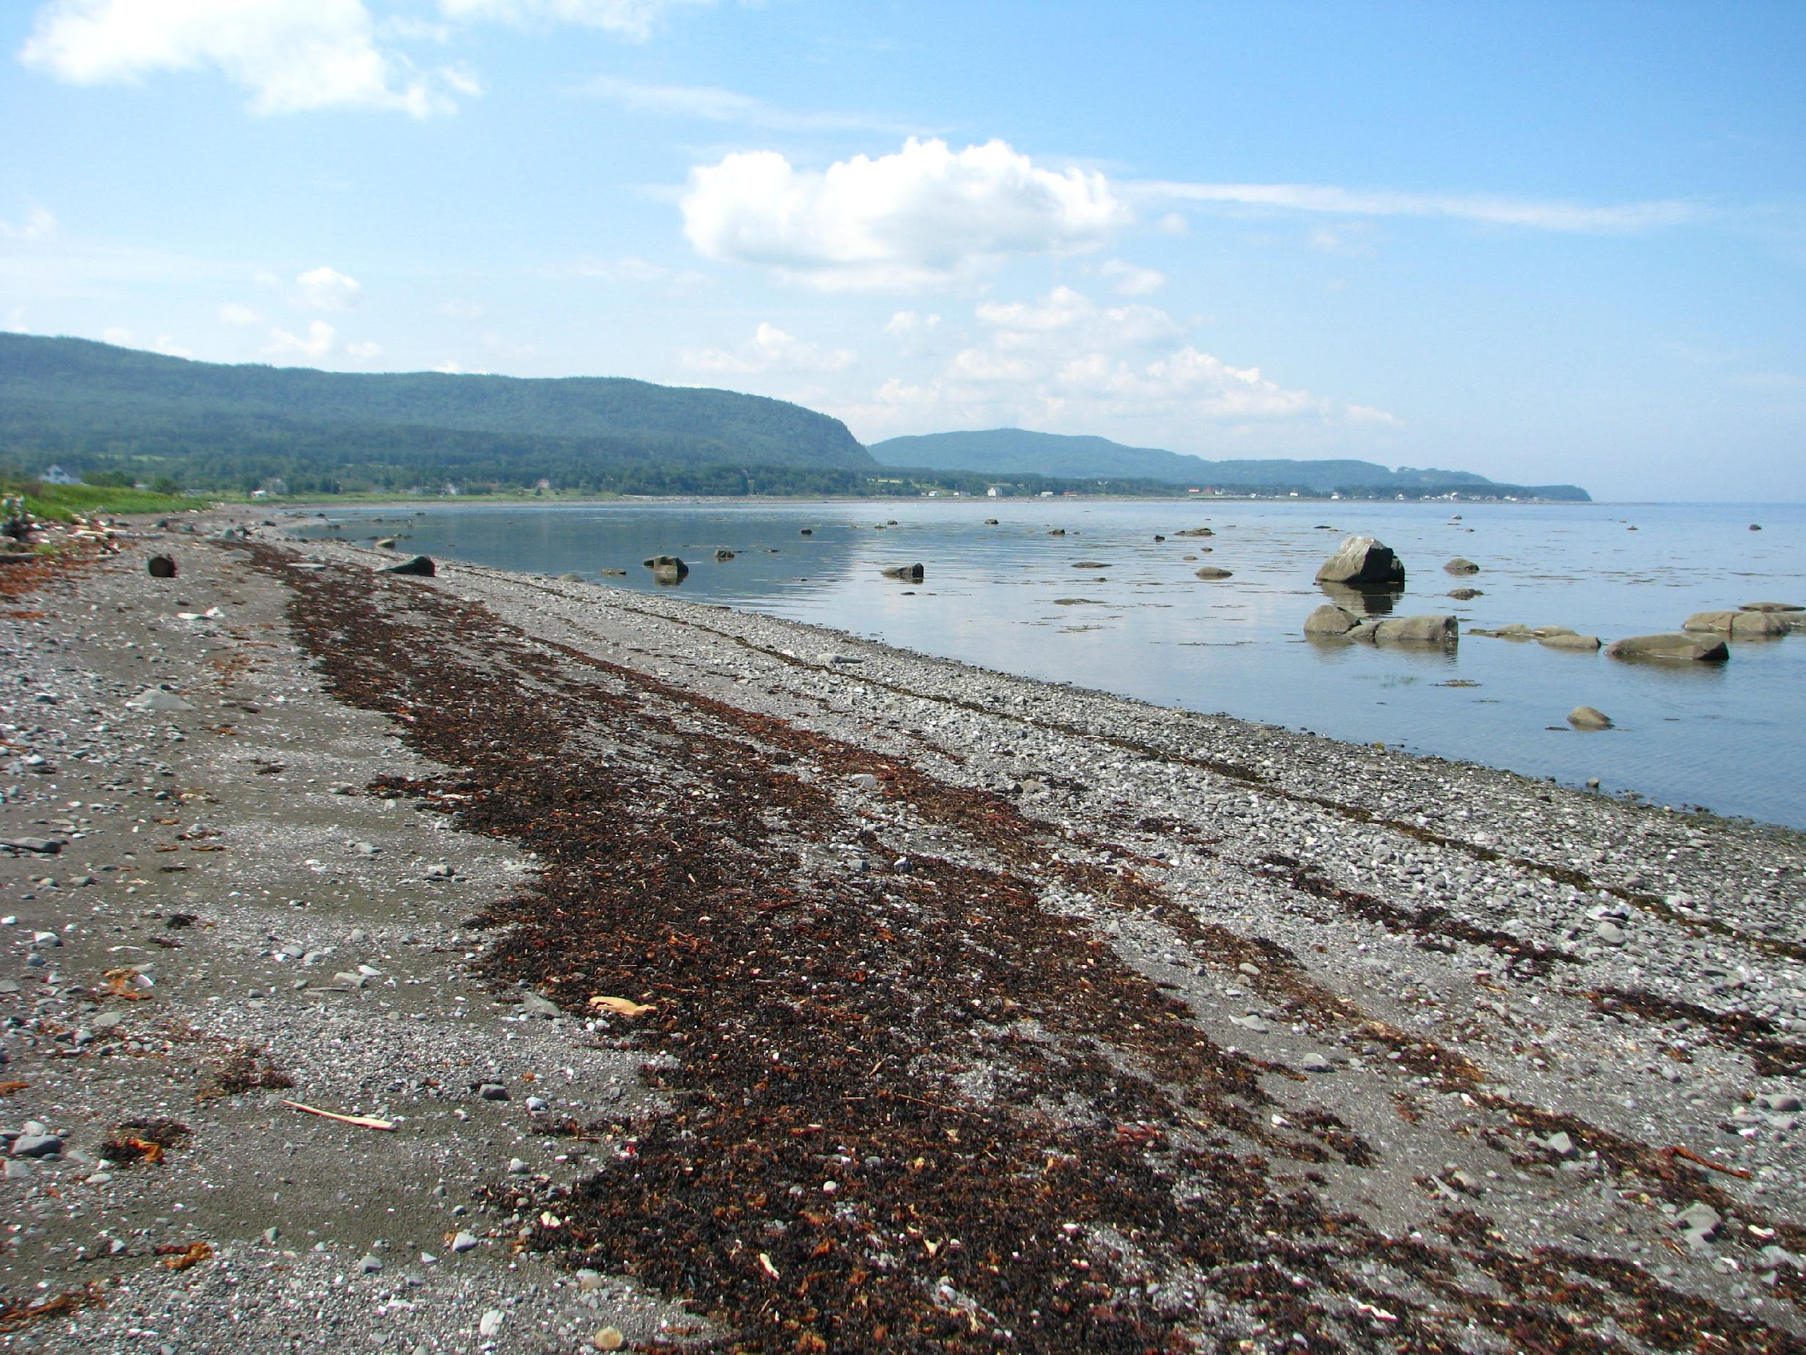
Do you see signs of erosion?
Notes:
Here, we have a stable environment that can effectively withstand erosion. We also see a line of “debris” along the beach.
Do you know what it’s called?
Beach wrack is composed of algae, shells and other natural debris washed up on the shore by the tides. It’s an essential food source for coastal wildlife. This debris eventually breaks down and releases nutrients into the soil, helping future vegetation take root. Beach wrack also retains the soil and prevents sediment from being carried away by the wind and tides.
We also see some pieces of wood. What do we call these dead tree trunks that are washed up by the tides?
Driftwood! It helps keep the soil in place, which in turn helps plants take root. It can travel hundreds of kilometres before washing up on the shore. Driftwood is saturated with sea salts that give off toxic fumes when burned. Which is why we should use locally cut firewood for bonfires and leave driftwood on the beach so it can keep the soil in place!

Slide 4
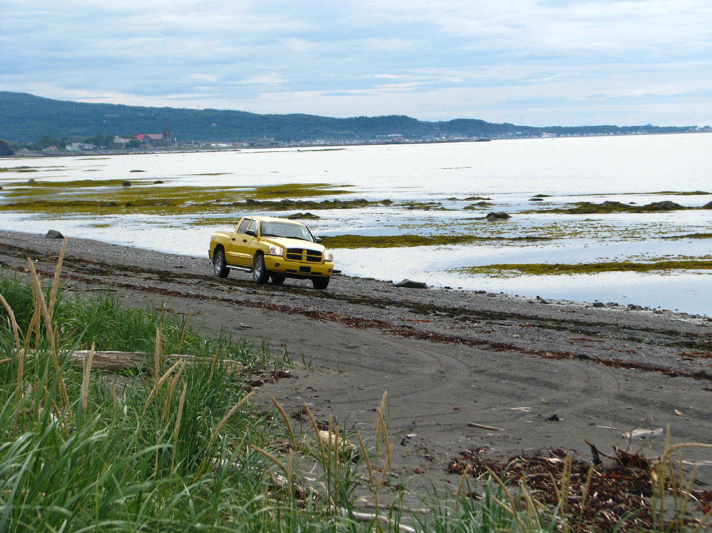
Do you see signs of erosion?
Notes:
Here, the environment is stable. However, we can see a vehicle trampling the shoreline. This type of action prevents plants in the riparian buffer strip from taking root. The root system of plants like sand ryegrass keeps sediment in place and allows other plants to take root (like a large net).
When vehicles stay off the vegetation, the beach has a better chance of withstanding erosion in the future!

Slide 5
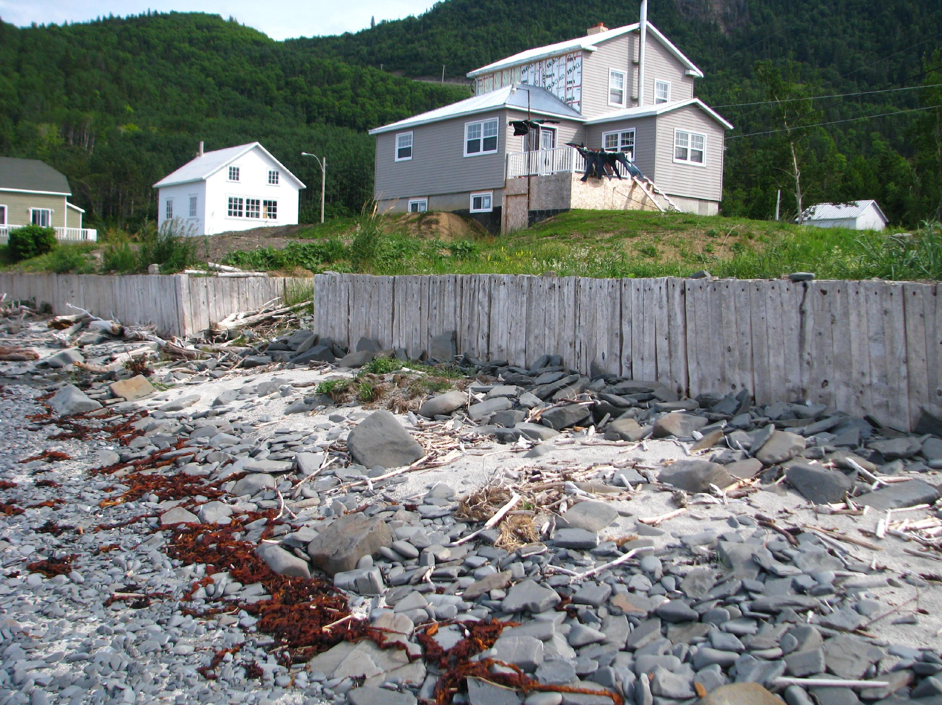
Do you see signs of erosion?
Notes:
Here, we see an unstable environment (imbalanced) with accelerated erosion. The retaining wall is preventing terrestrial sediment from nourishing the beach. This means that sediment on the beach carried away by the wind, tides and storms isn’t being replaced with enough new sediment.

Slide 6
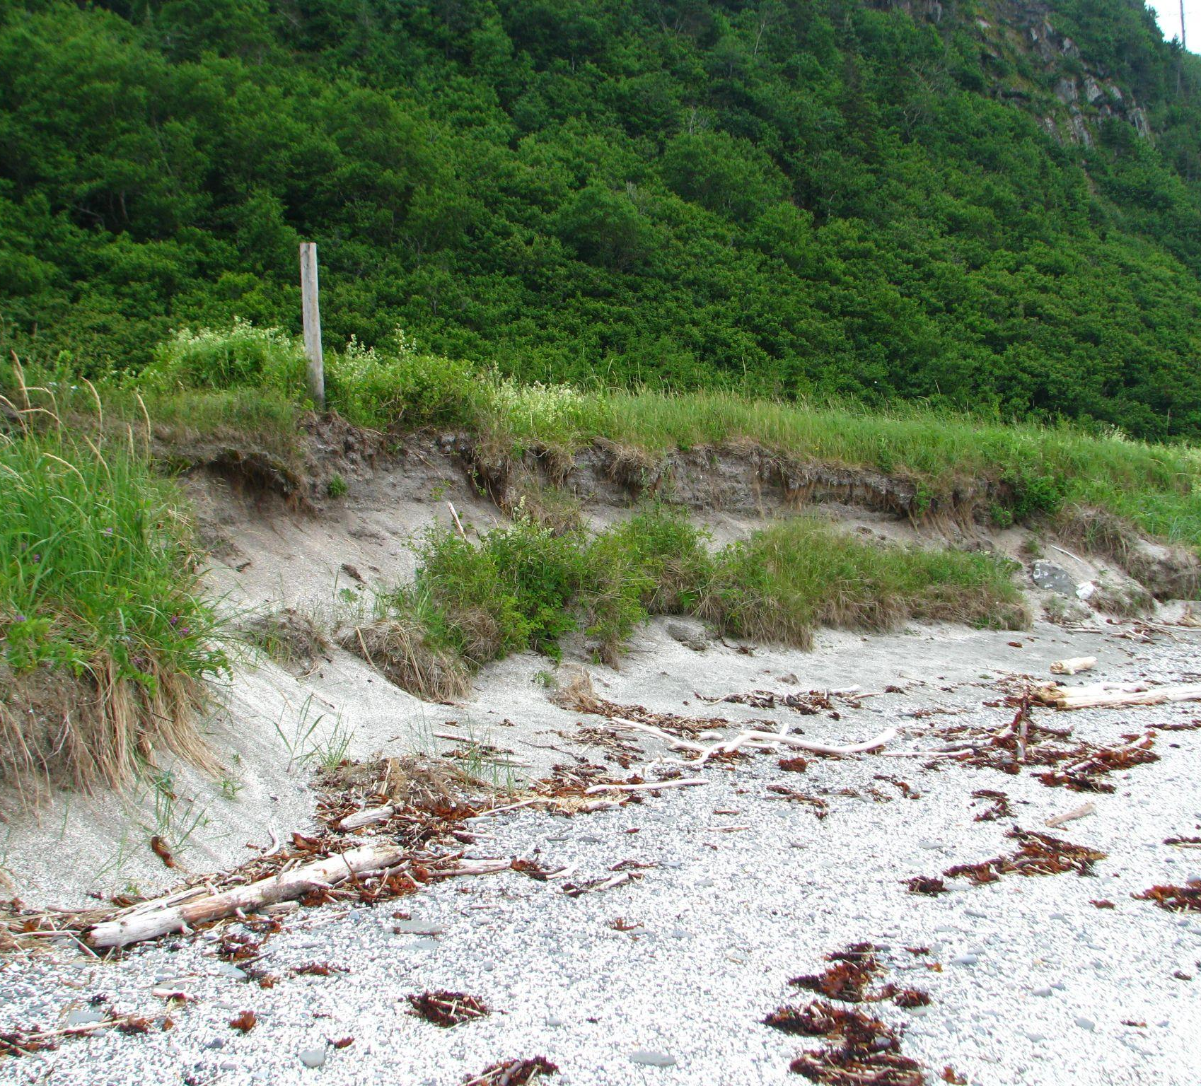
Do you see signs of erosion?
Notes:
Here, we see signs of erosion. The sand beneath the vegetation is being washed away by the waves. With the beach no longer supporting it, the vegetation has slid to the bottom of the bank. One way to restore balance to the environment would be to replenish the sediment by adding sand to level out the bank (recreate a beautiful beach with a gentle slope) and plants like Ella the sand ryegrass at the top of the bank to hold everything in place.

Slide 7
What causes erosion?
Notes:
Part 2: Causes
We’re starting to understand erosion a little better. Now, let’s look at what causes erosion.
There are many things that cause erosion, but can you tell us what doesn’t cause it in this next game ?
I’ll show you different causes of erosion, you need to find the one that doesn’t belong in each slide.

Slide 8
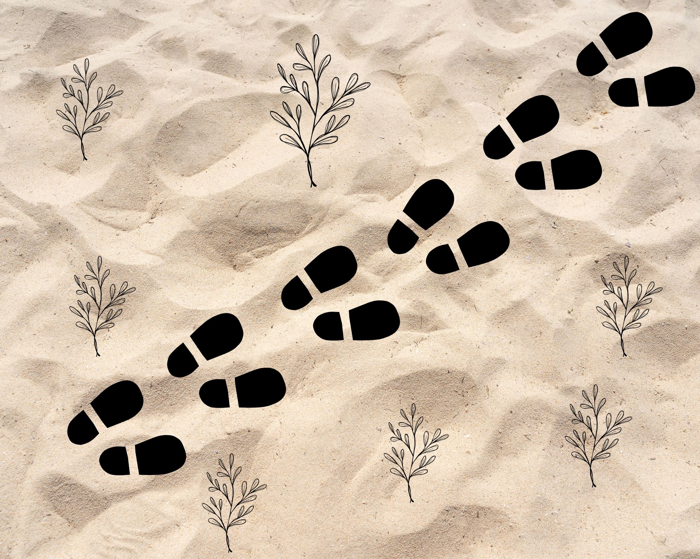
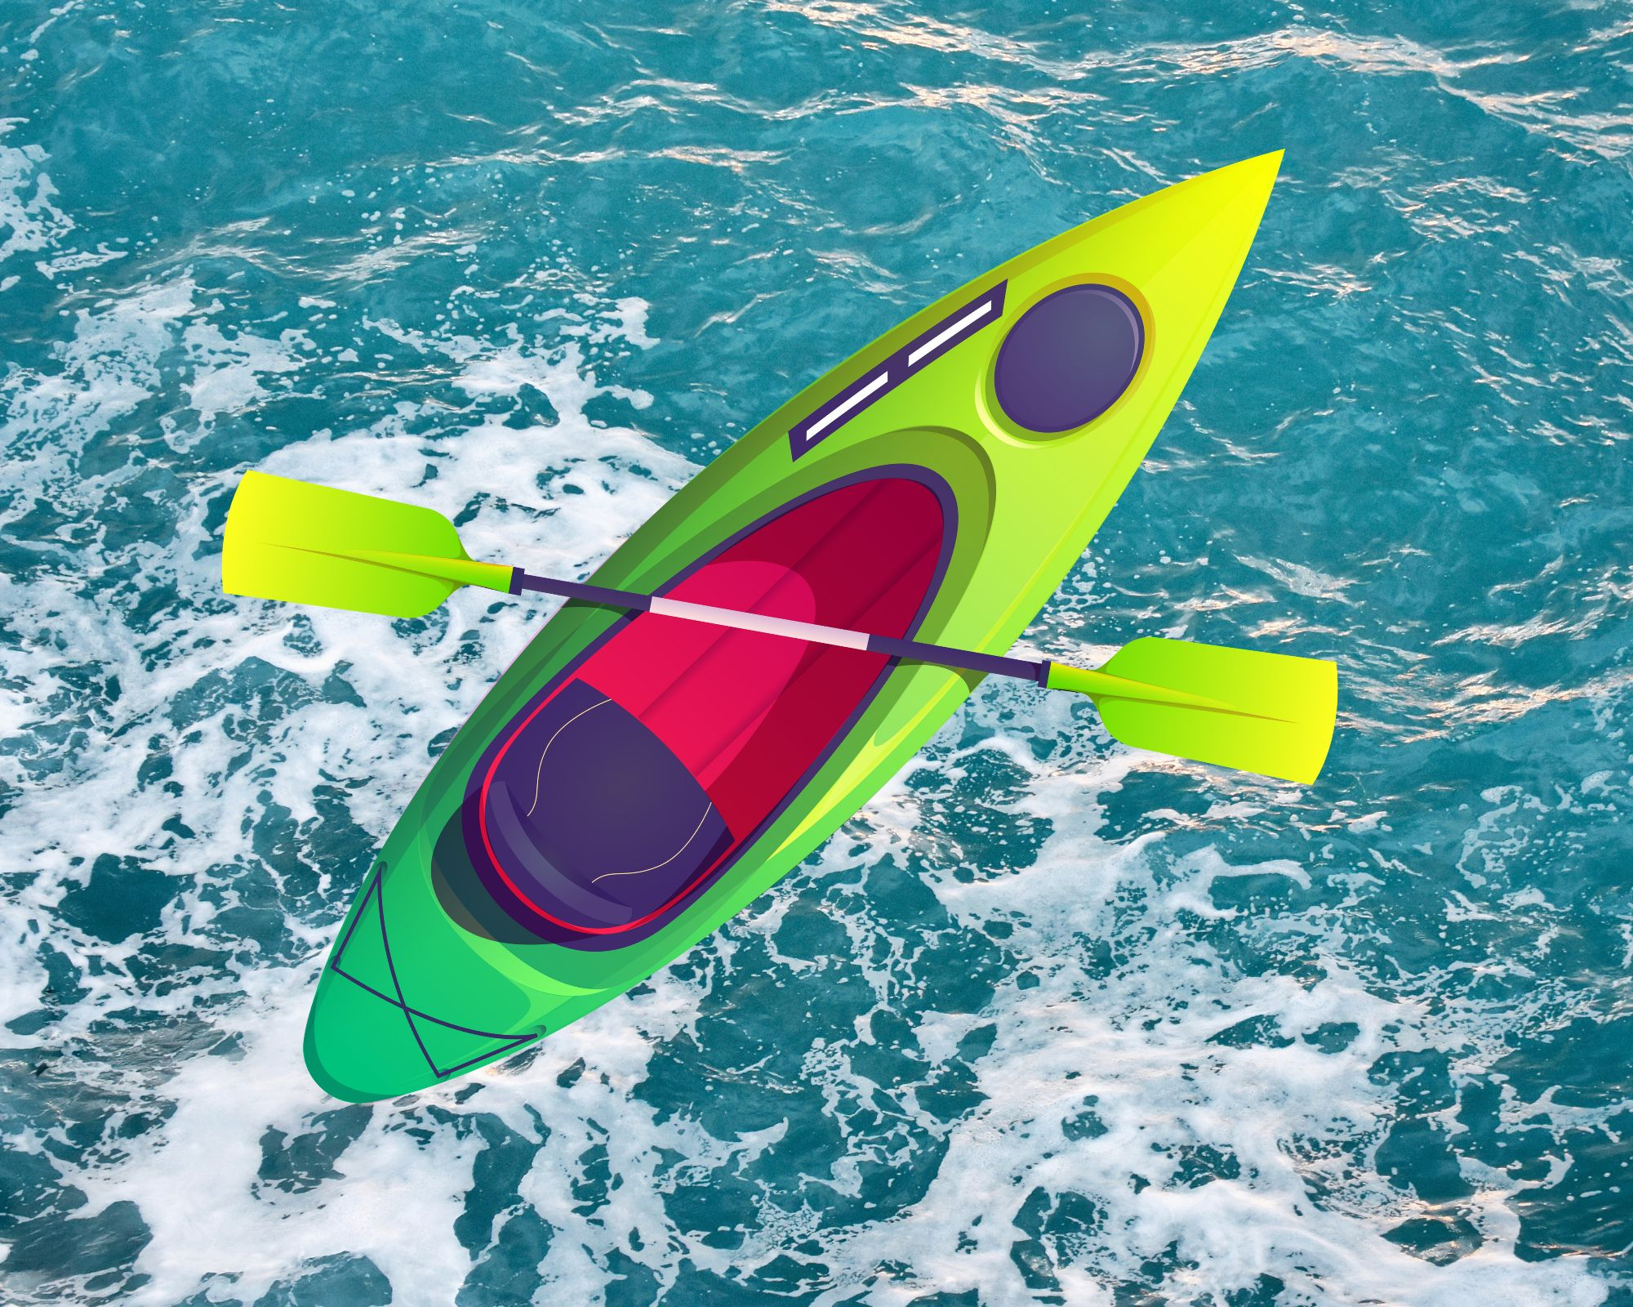
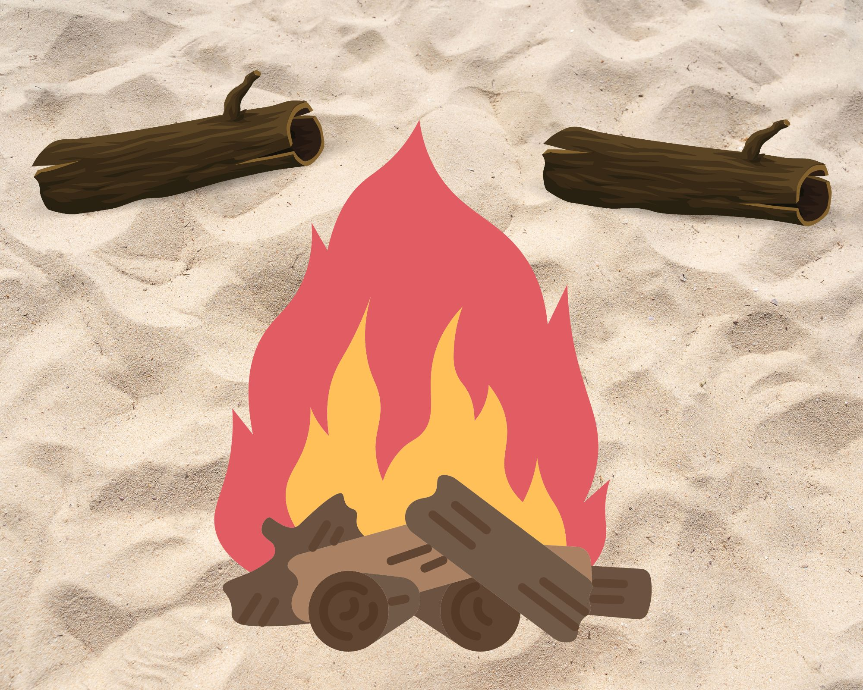
Which one doesn’t belong!
Vegetation is trampled on
Sea kayaking
Driftwood is used for bonfires
Notes:
Which of these images doesn’t cause erosion? Answer : sea kayaking
Why does trampling the riparian buffer strip cause erosion?
Plants hold the soil in place with their root system (like a huge net, with roots sometimes measuring several metres long!), which protects the beach from erosion. When vegetation is trampled by vehicles or people, the plants can become uprooted, which prevents the soil from staying in place and in turn, makes the beach vulnerable to erosion. Be careful of Ella the sand ryegrass next time you’re at the beach!
Does sea kayaking cause erosion?
No! However, it’s important that we don’t disturb the wildlife. You might come across animals like Fiona the seal along the way! And be sure to wash the boat properly to avoid spreading invasive alien species (see Workshop 2).
Why is it a bad idea to use driftwood for bonfires?
Driftwood is saturated with sea salts and releases harmful toxins when burned.
Driftwood also helps keep the soil in place, which in turn helps plants take root.

Slide 9
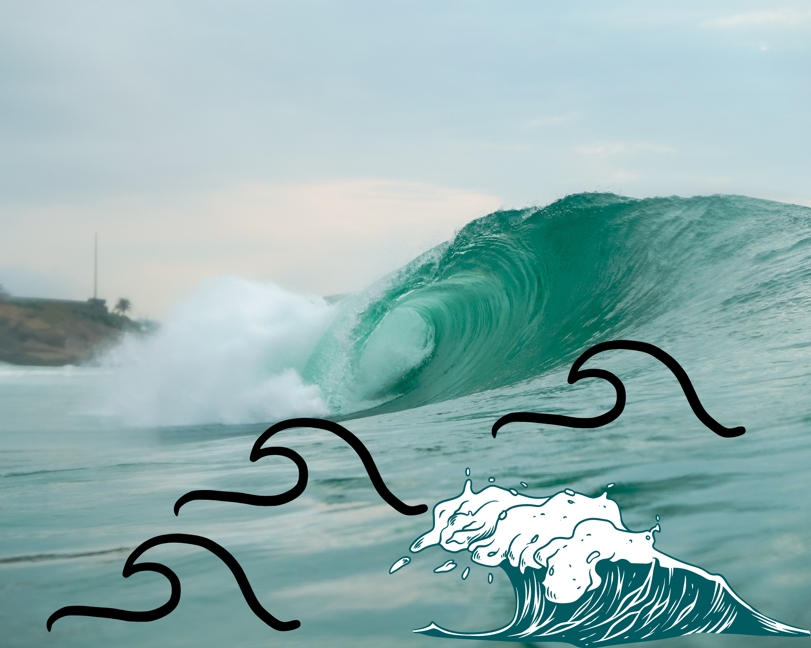
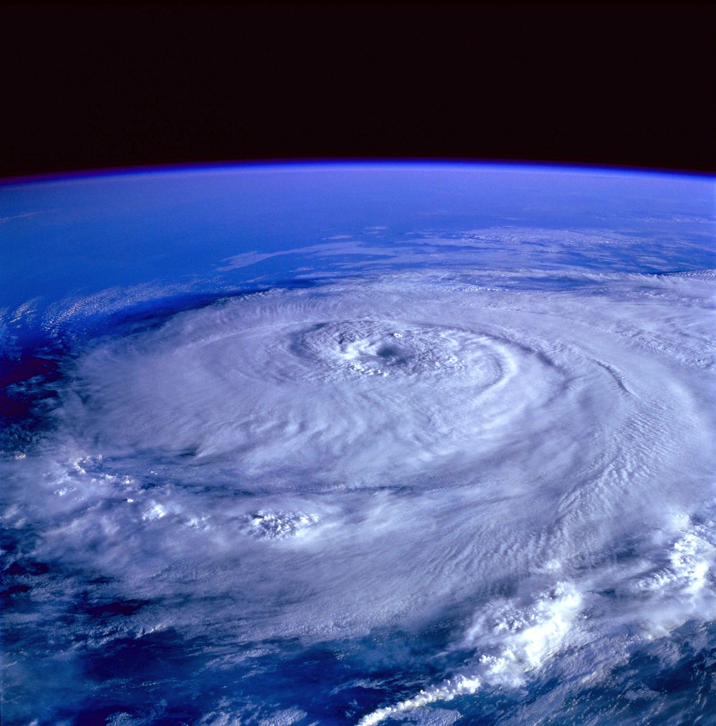
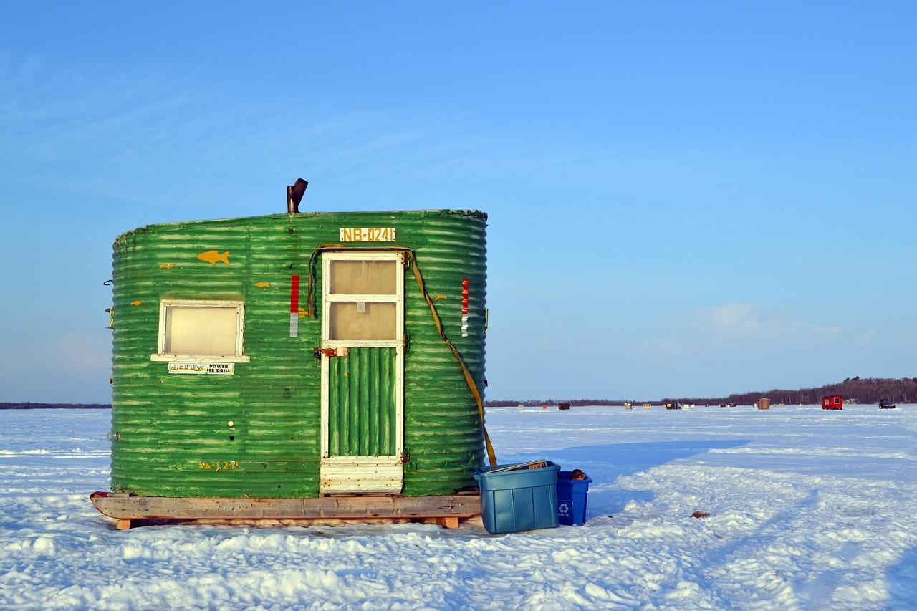
Which one doesn’t belong!
Climate change
Storm
Ice fishing
Notes:
Which of these images doesn’t cause erosion? Answer : Ice fishing
How does climate change impact erosion?
Climate change is affecting the stability of coastal environments in many ways. For instance, the shrinking ice coverage makes coastal environments vulnerable to damage from waves and wind during winter. The increased intensity and frequency of storms are also disrupting the balance because more sediment is being lost than added to the shoreline.
Why do storms cause erosion?
During storms, waves and winds put shoreline resilience to the test. Sediment is shifted from the shore to the open water, creating an imbalance that promotes erosion.¹ In addition, as the frequency of storms increases, ecosystems have less time to recover between storms.
Does ice fishing cause erosion?
Not necessarily. Most anglers remove all their structures and leave the pack ice untouched, as if no one was ever there. In addition, ice fishing only takes place once there’s a layer of ice covering the shore, which means the chances of shoreline trampling is next to none during winter. So, ice fishing is actually a beach-friendly activity!
¹Davidson-Arnott, R., & Ollerhead, J. (2011). Coastal erosion and climate change.

Slide 10
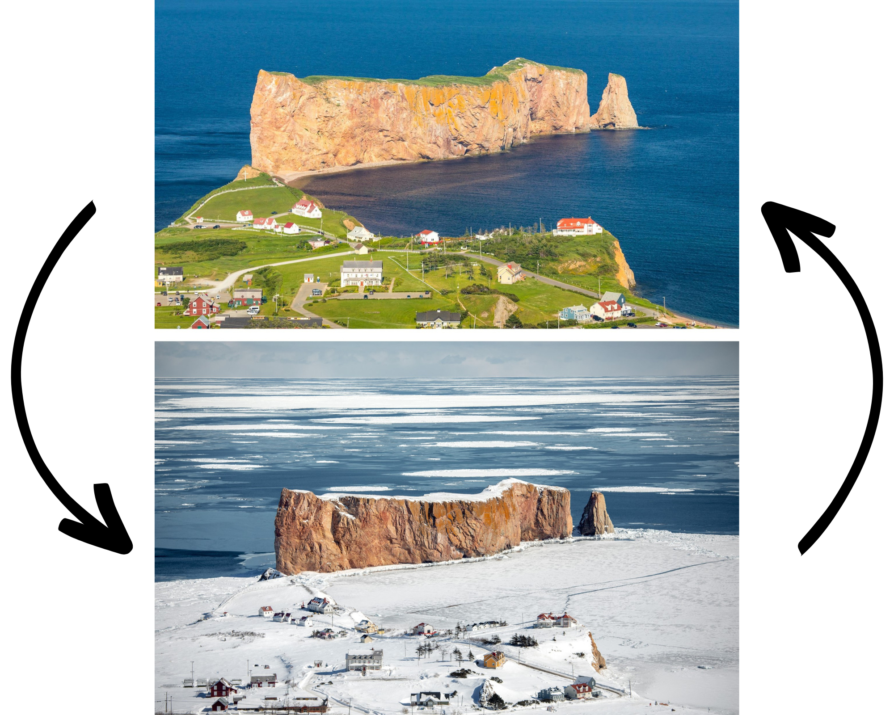
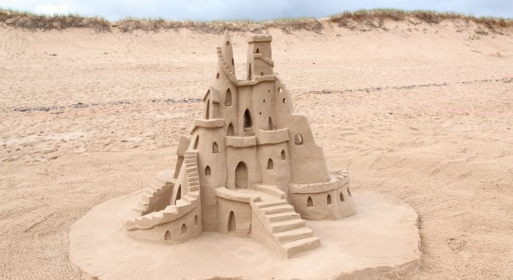
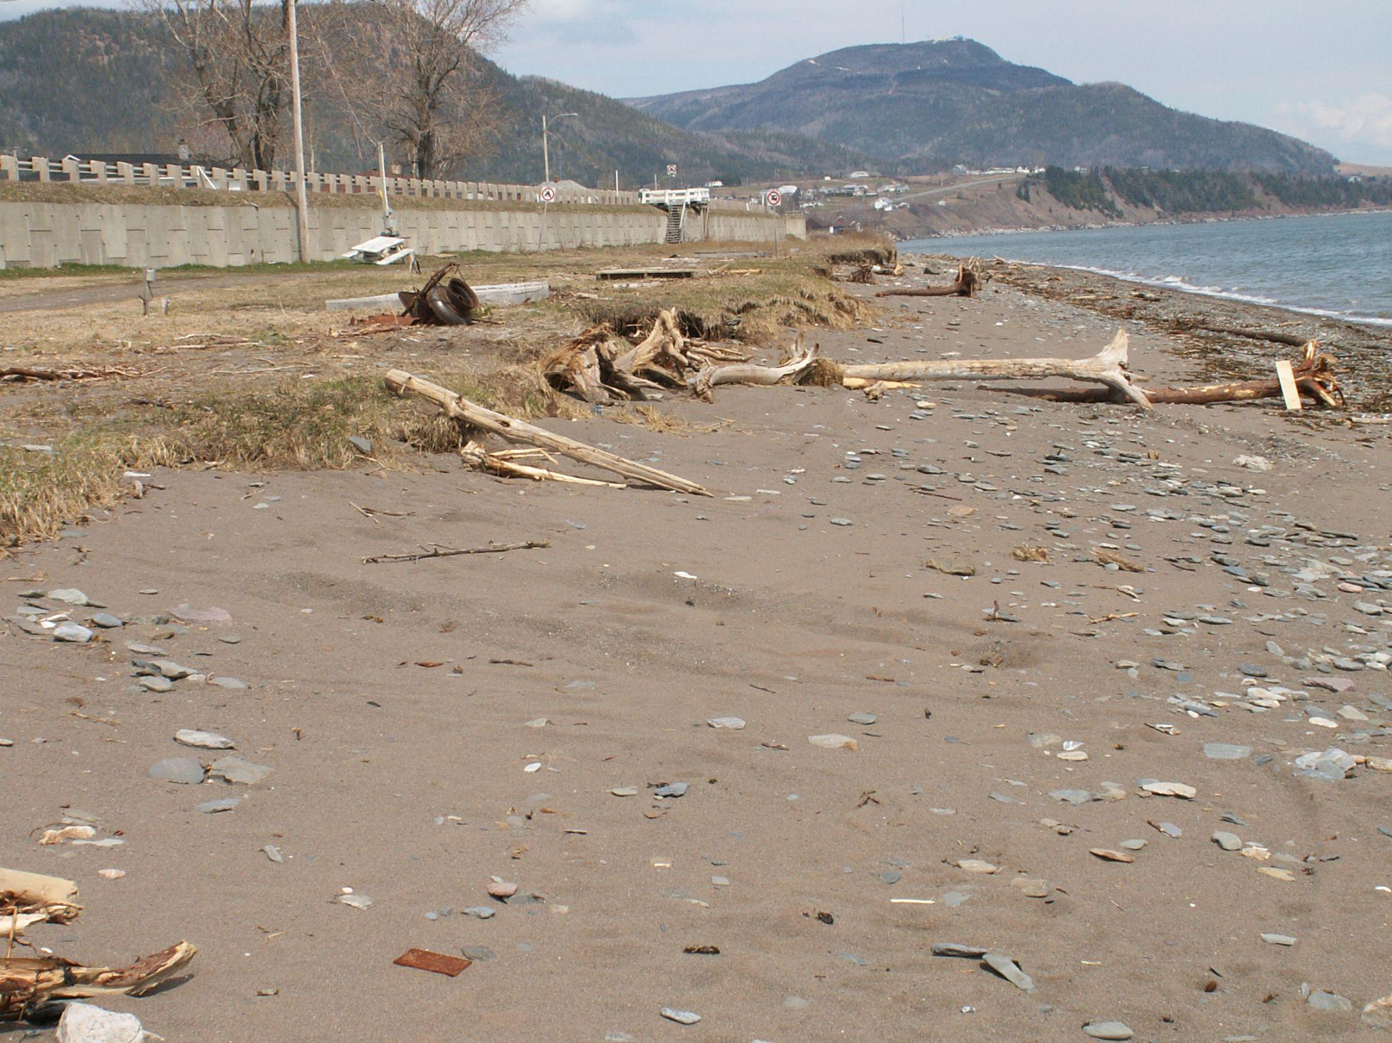
Which one doesn’t belong!
Sandcastles
Urban development
Freeze-thaw cycle
Notes:
Which of these images doesn’t cause erosion? Answer : Sandcastles
Does building sandcastles cause erosion? Should we stop making them?
No. Sandcastles are temporary and are broken down by the wind and tides after you leave the beach. After all, you don’t take your sandcastles home! Building sandcastles is a great way to have fun at the beach, while respecting the coastal environment.
Does urban development accelerate erosion?
Yes! When we make too many changes to the shoreline, we remove important vegetation that holds the soil in place. What’s more, structures such as docks, riprap and retaining walls only contribute to the problem and prevent the inflow of sediment from the mainland. This also creates an “end effect,” where erosion is accelerated on either side of the riprap.
How does the freeze-thaw cycle cause erosion?
The freeze-thaw cycle also increases runoff, which is water that flows over the surface of the land, carrying sediment with it. When there are several thaw periods in winter, runoff constantly moves sediment around, destabilizing the shoreline and making it more vulnerable to erosion.¹
However, it’s worth mentioning that ice plays an important role in protecting the beach from waves and storms! But, if if the coastal ice freezes and thaws several times during the winter, this will increase the phenomenon normally found in spring, chunks of ice tear away sediments and vegetation when they’re swept out to sea. Melting ice carries away large parts of the shoreline, changing the shape of the beach if it’s no longer protected from storms.
¹Davidson-Arnott, R., & Ollerhead, J. (2011). Coastal erosion and climate change.

Slide 11
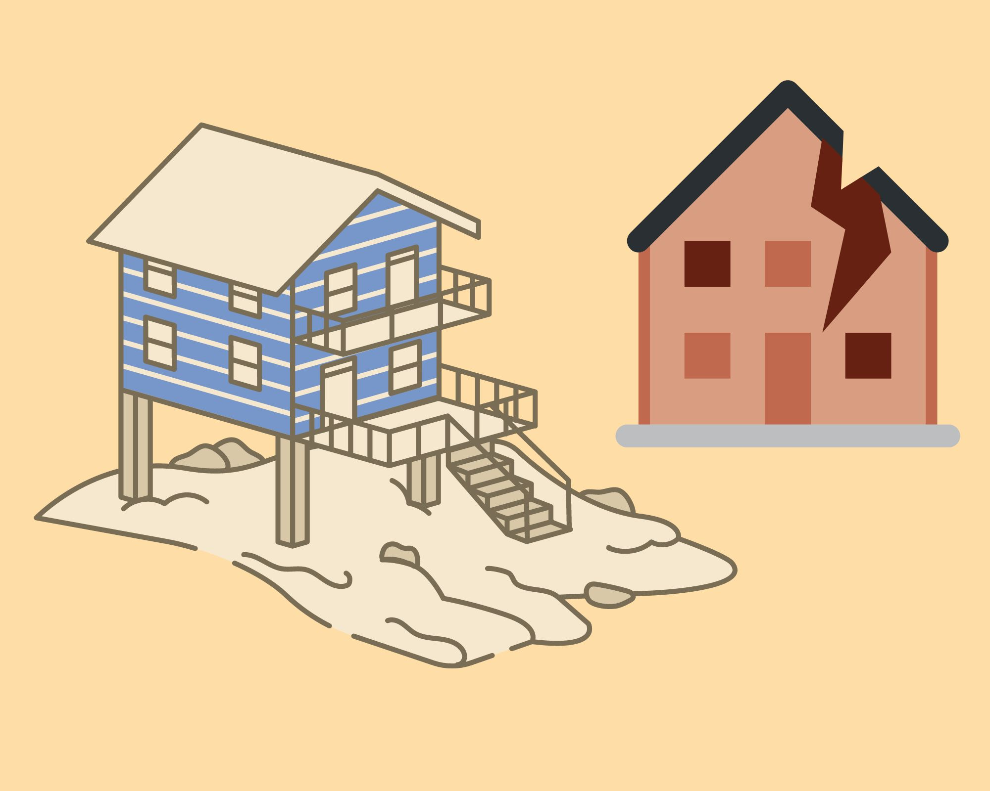
Consequences of erosion
Notes:
Part 3: Consequences
Erosion affects us as much as the animals that we share the shoreline with. An increased vulnerability to climate change and loss of habitat are two consequences of erosion that have a real impact on how we use the land.

Slide 12
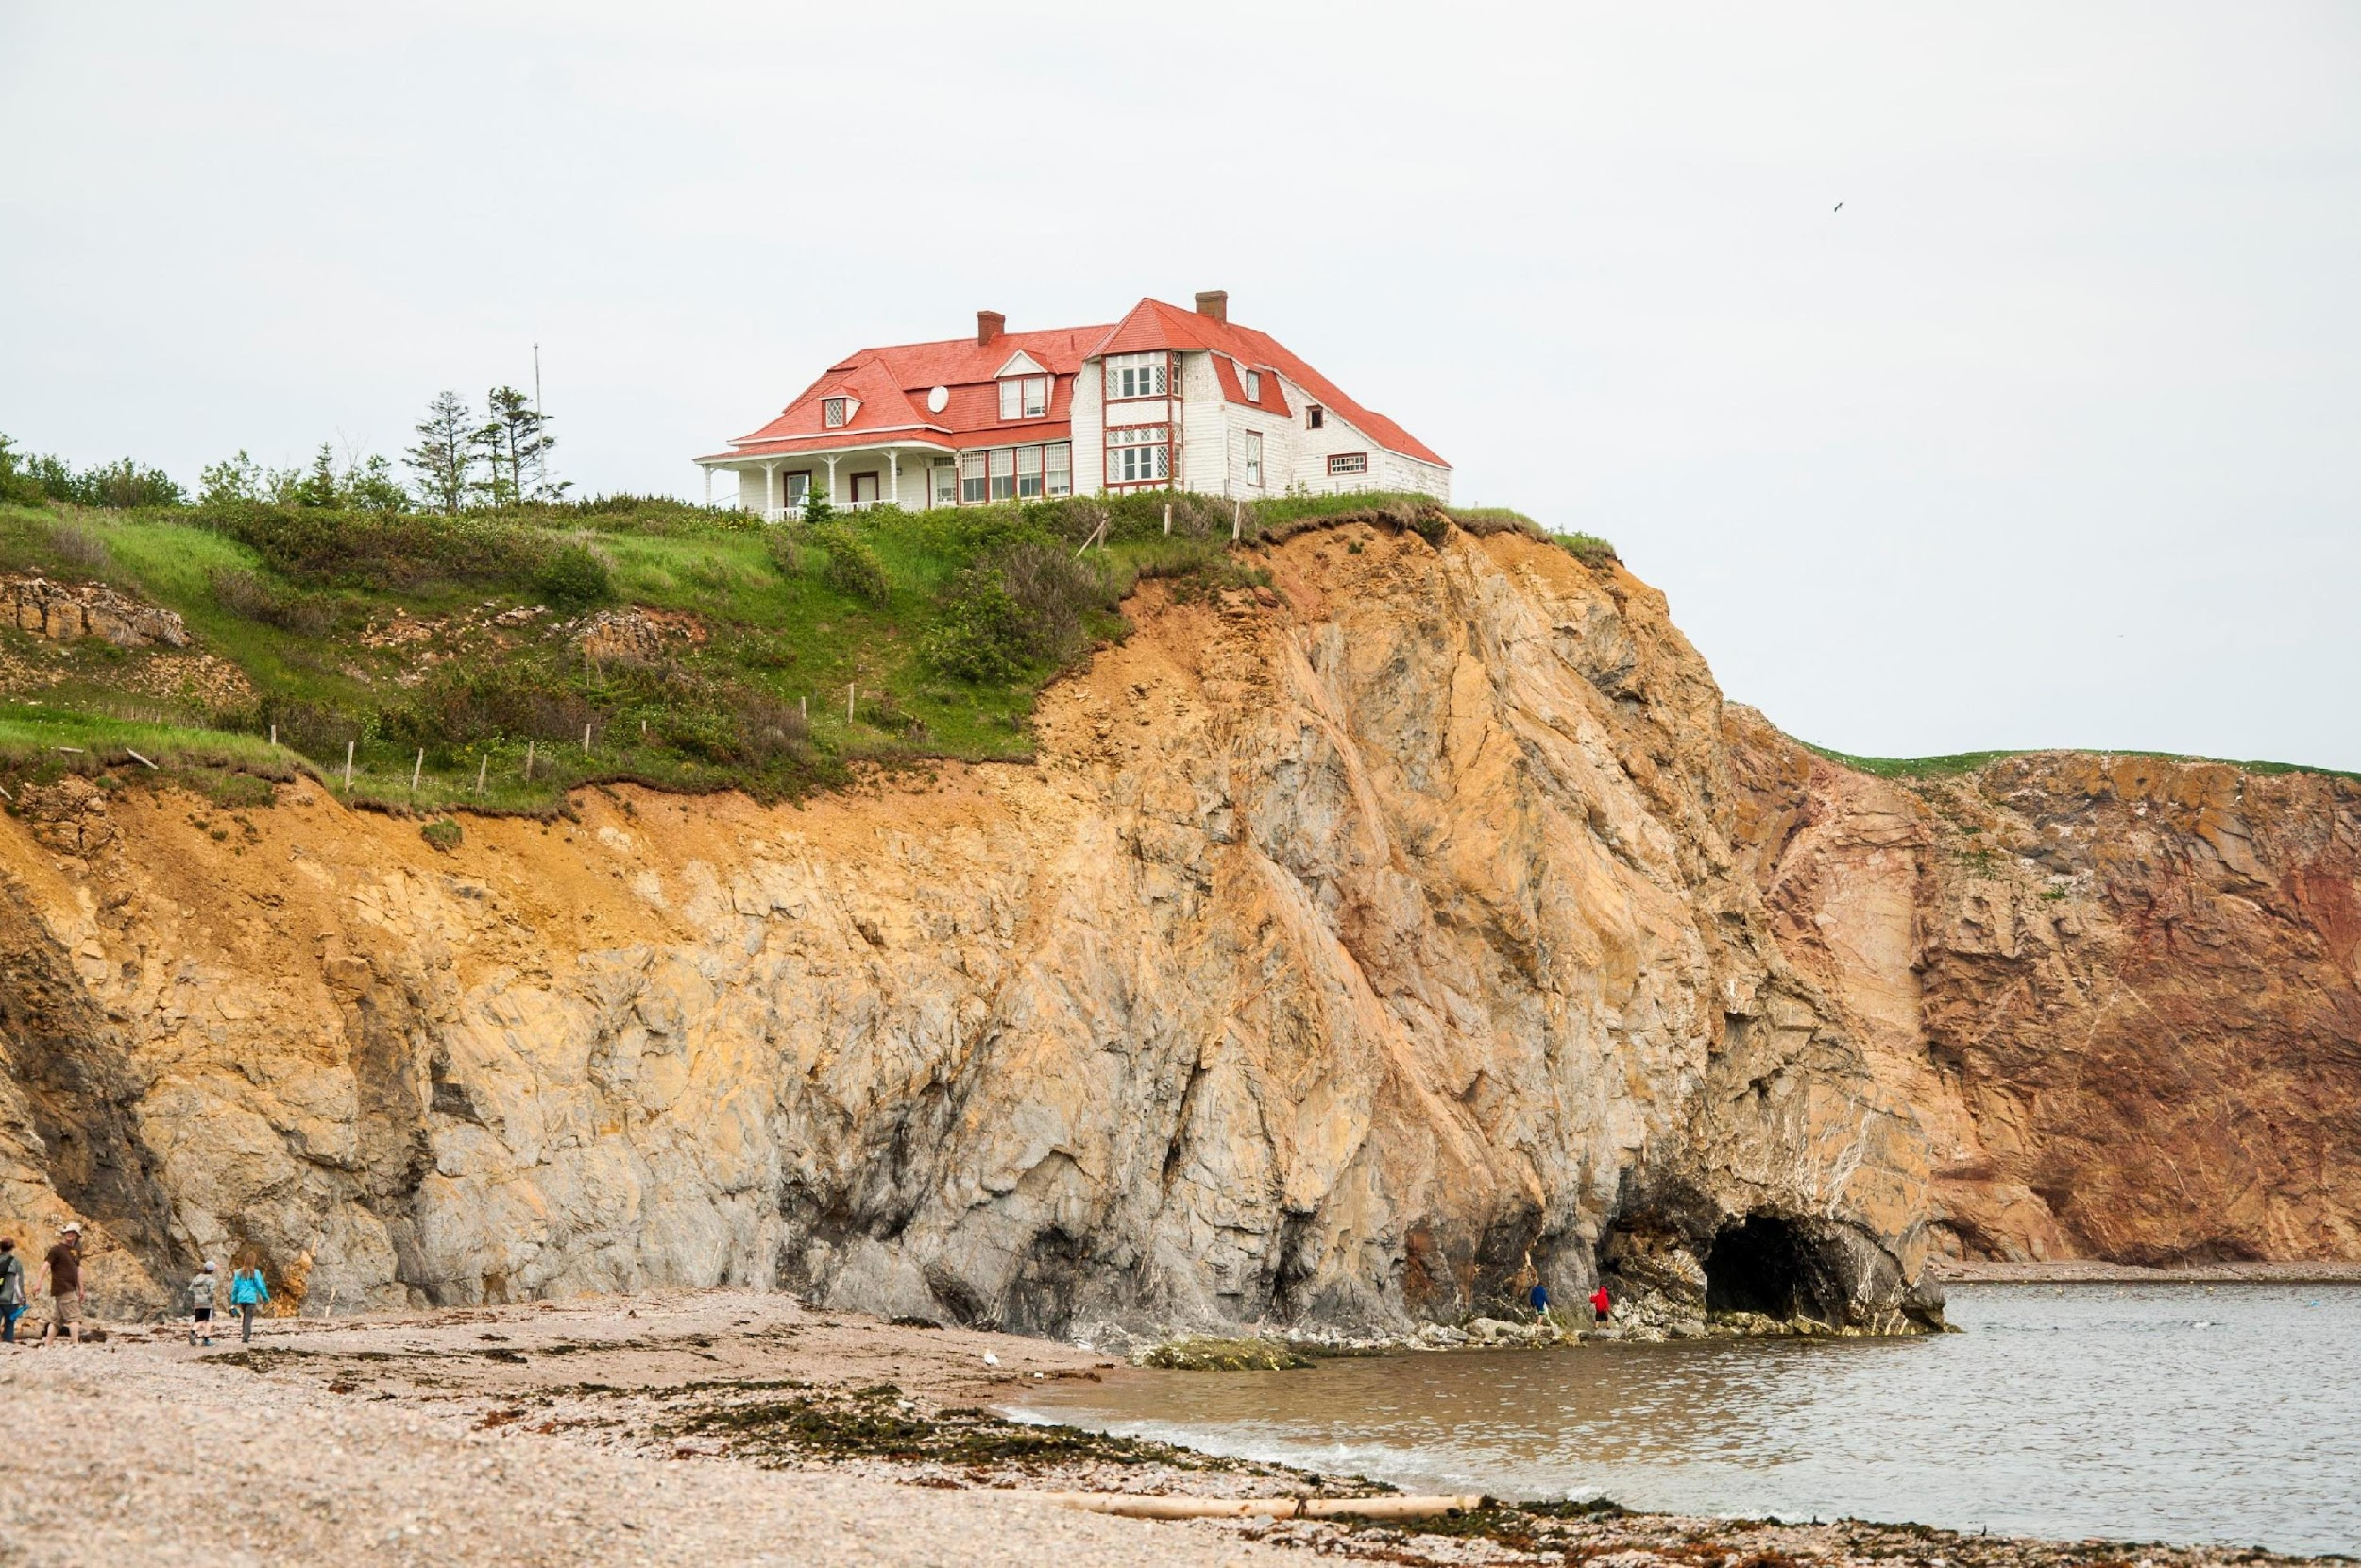
Vulnerability to climate change
Notes:
Vulnerability to climate change:
Erosion makes us more vulnerable to big storms. A healthy shoreline acts as a protective barrier between coastal cities and the sea. When erosion is severe, the shoreline isn’t as healthy, and buildings and infrastructure have a greater chance of being damaged during storms. Think about all the roads that are just metres away from the ocean, like in Gaspésie!

Slide 13
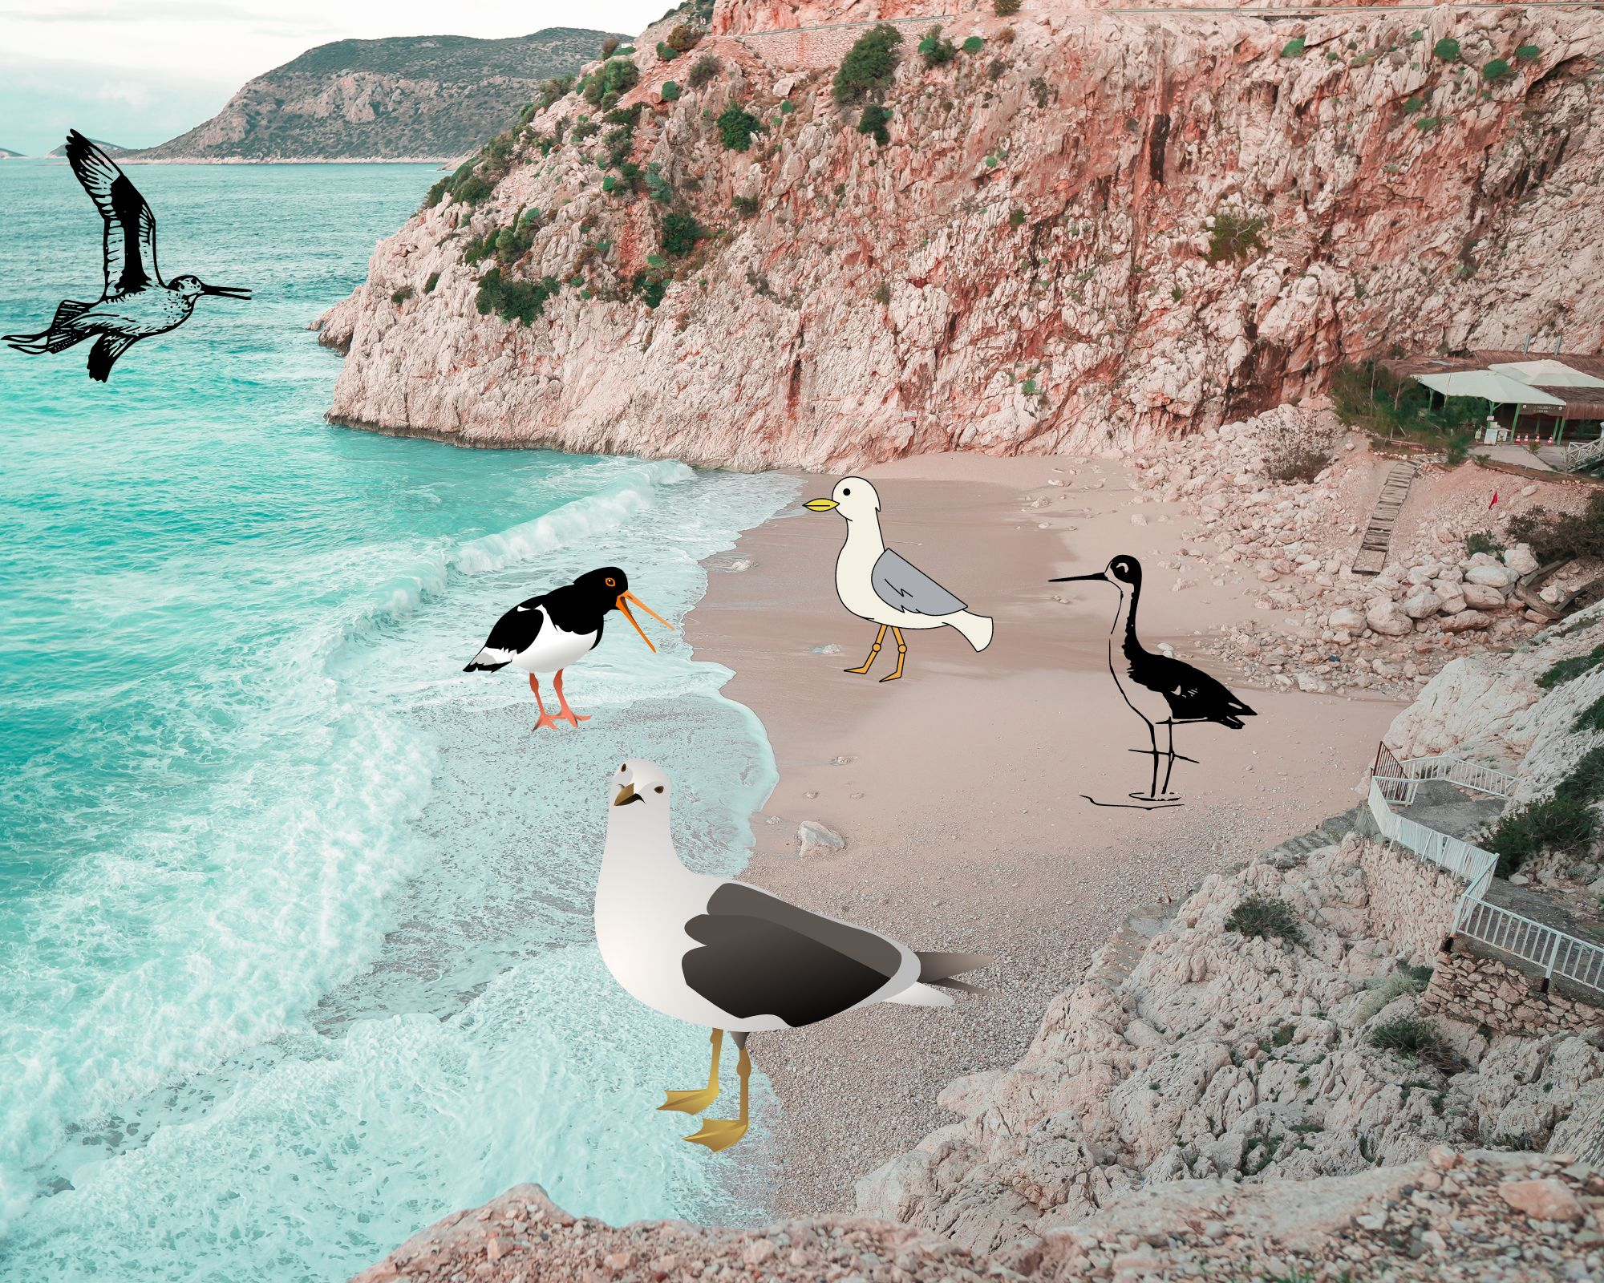
Loss of habitat
Notes:
Loss of habitat
Erosion strips away large stretches of the shoreline that are invaluable to the plants and animals that live there. Every year, thousands of birds stop over here to rest and feed before continuing their migration. When erosion damages the shoreline, there is less food for these birds, and they have to search longer for an ideal place to stop.
Take Milo, for instance, who has to fly to the southern United States for the winter. Along the way, Milo needs to find stopovers so he can rest and continue his journey. However, erosion reduces the quality of these stopovers, making it more difficult for Milo and his migratory friends, like Bob the sparrow, to find places to feed and rest.

Slide 14
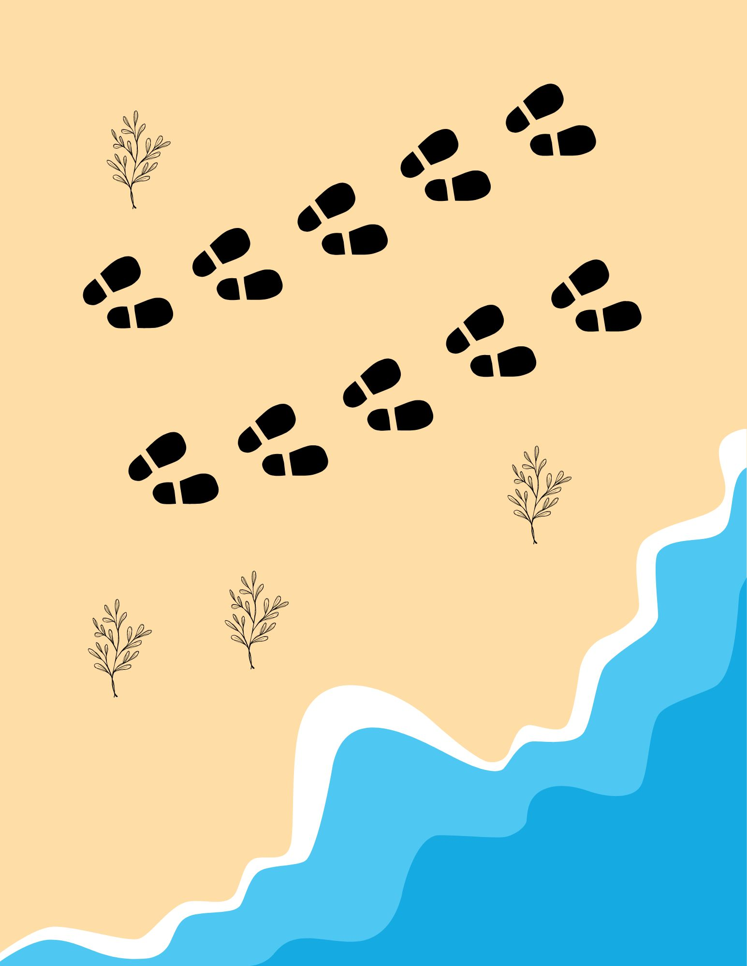
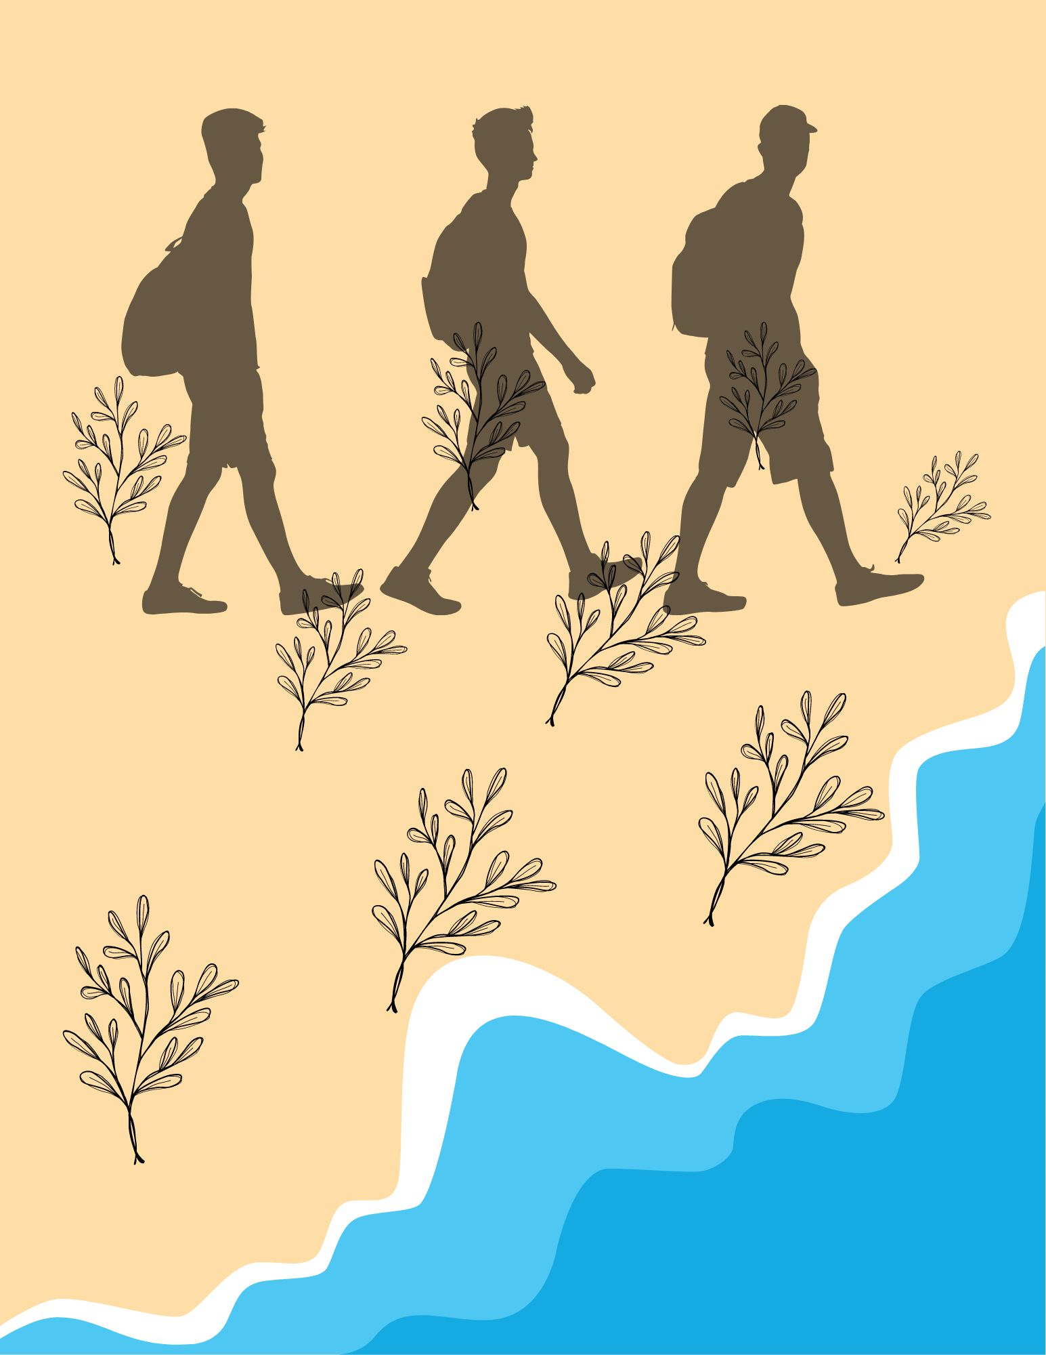
Let’s get to work!
Notes:
Part 4: Integrating knowledge
Game time!
You’ll need to make teams of three or four people. Each team will be given nine images, each one listing a cause, a consequence and a solution to erosion. Your job is to put these images in order to figure out how to fight erosion!
You need to match the right cause with the right consequence and the right solution. Bear in mind that a solution may work with more than one cause.
If students are too young to fully understand the concept of cause and consequence, you can present this activity as a story that needs to be put in order. Just like in a story, there’s a turning point (a pivotal event that’s followed by a problem and ends with a solution).

Slide 15
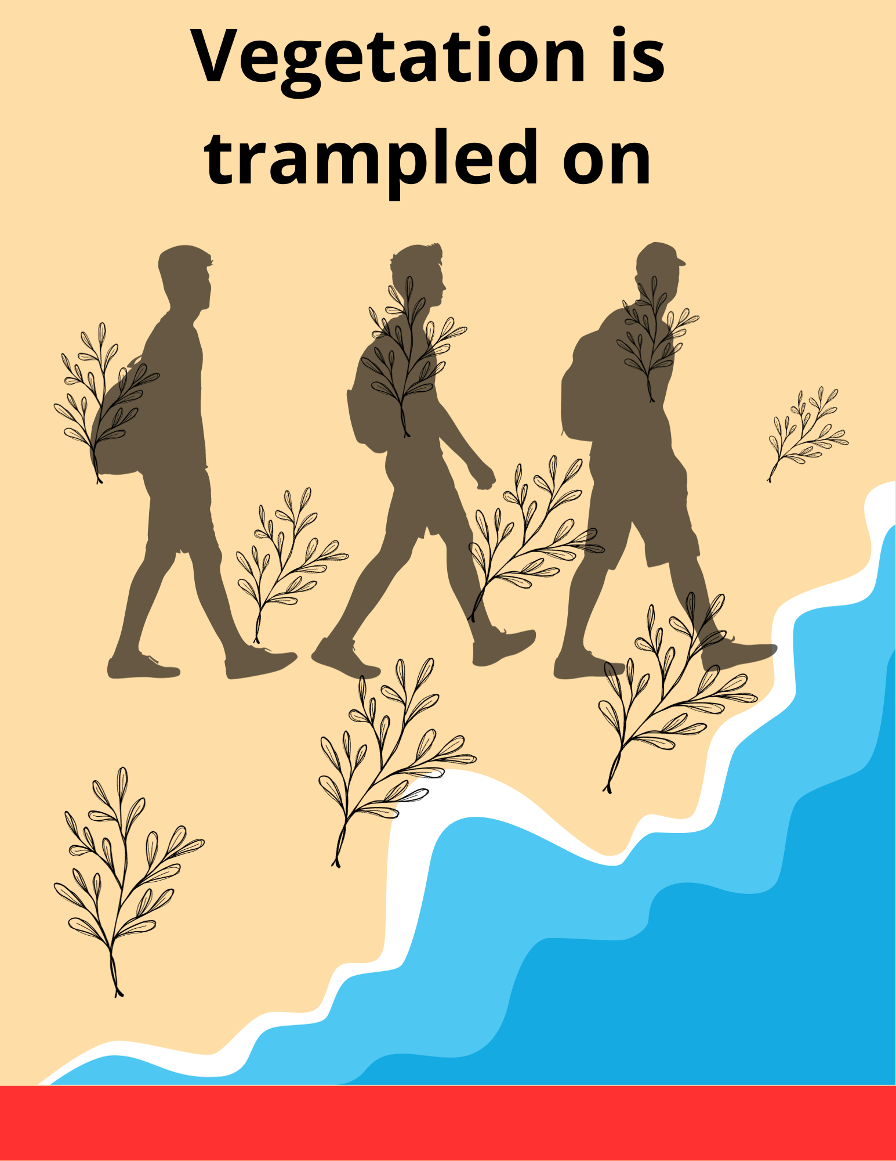
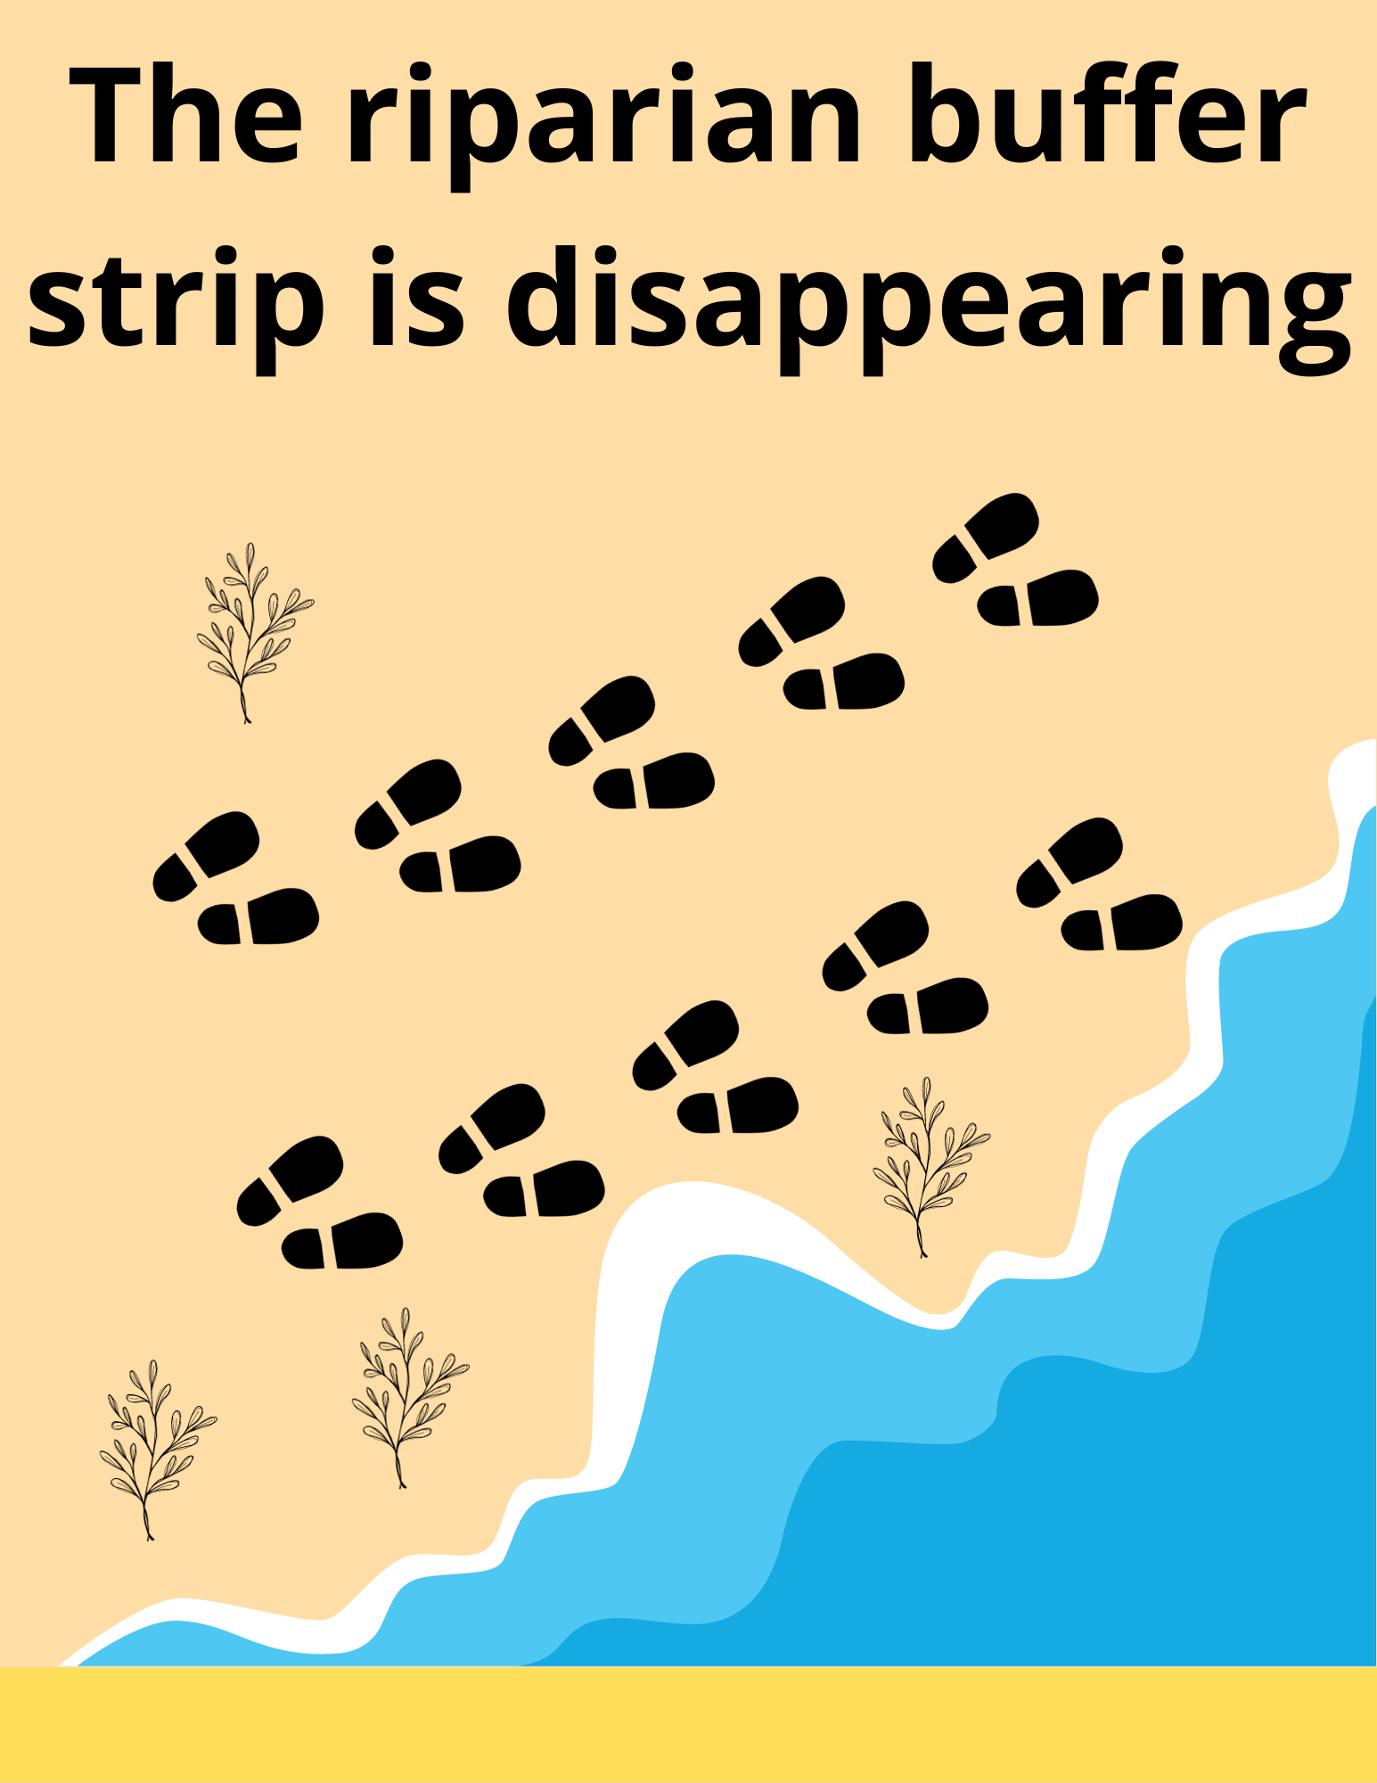
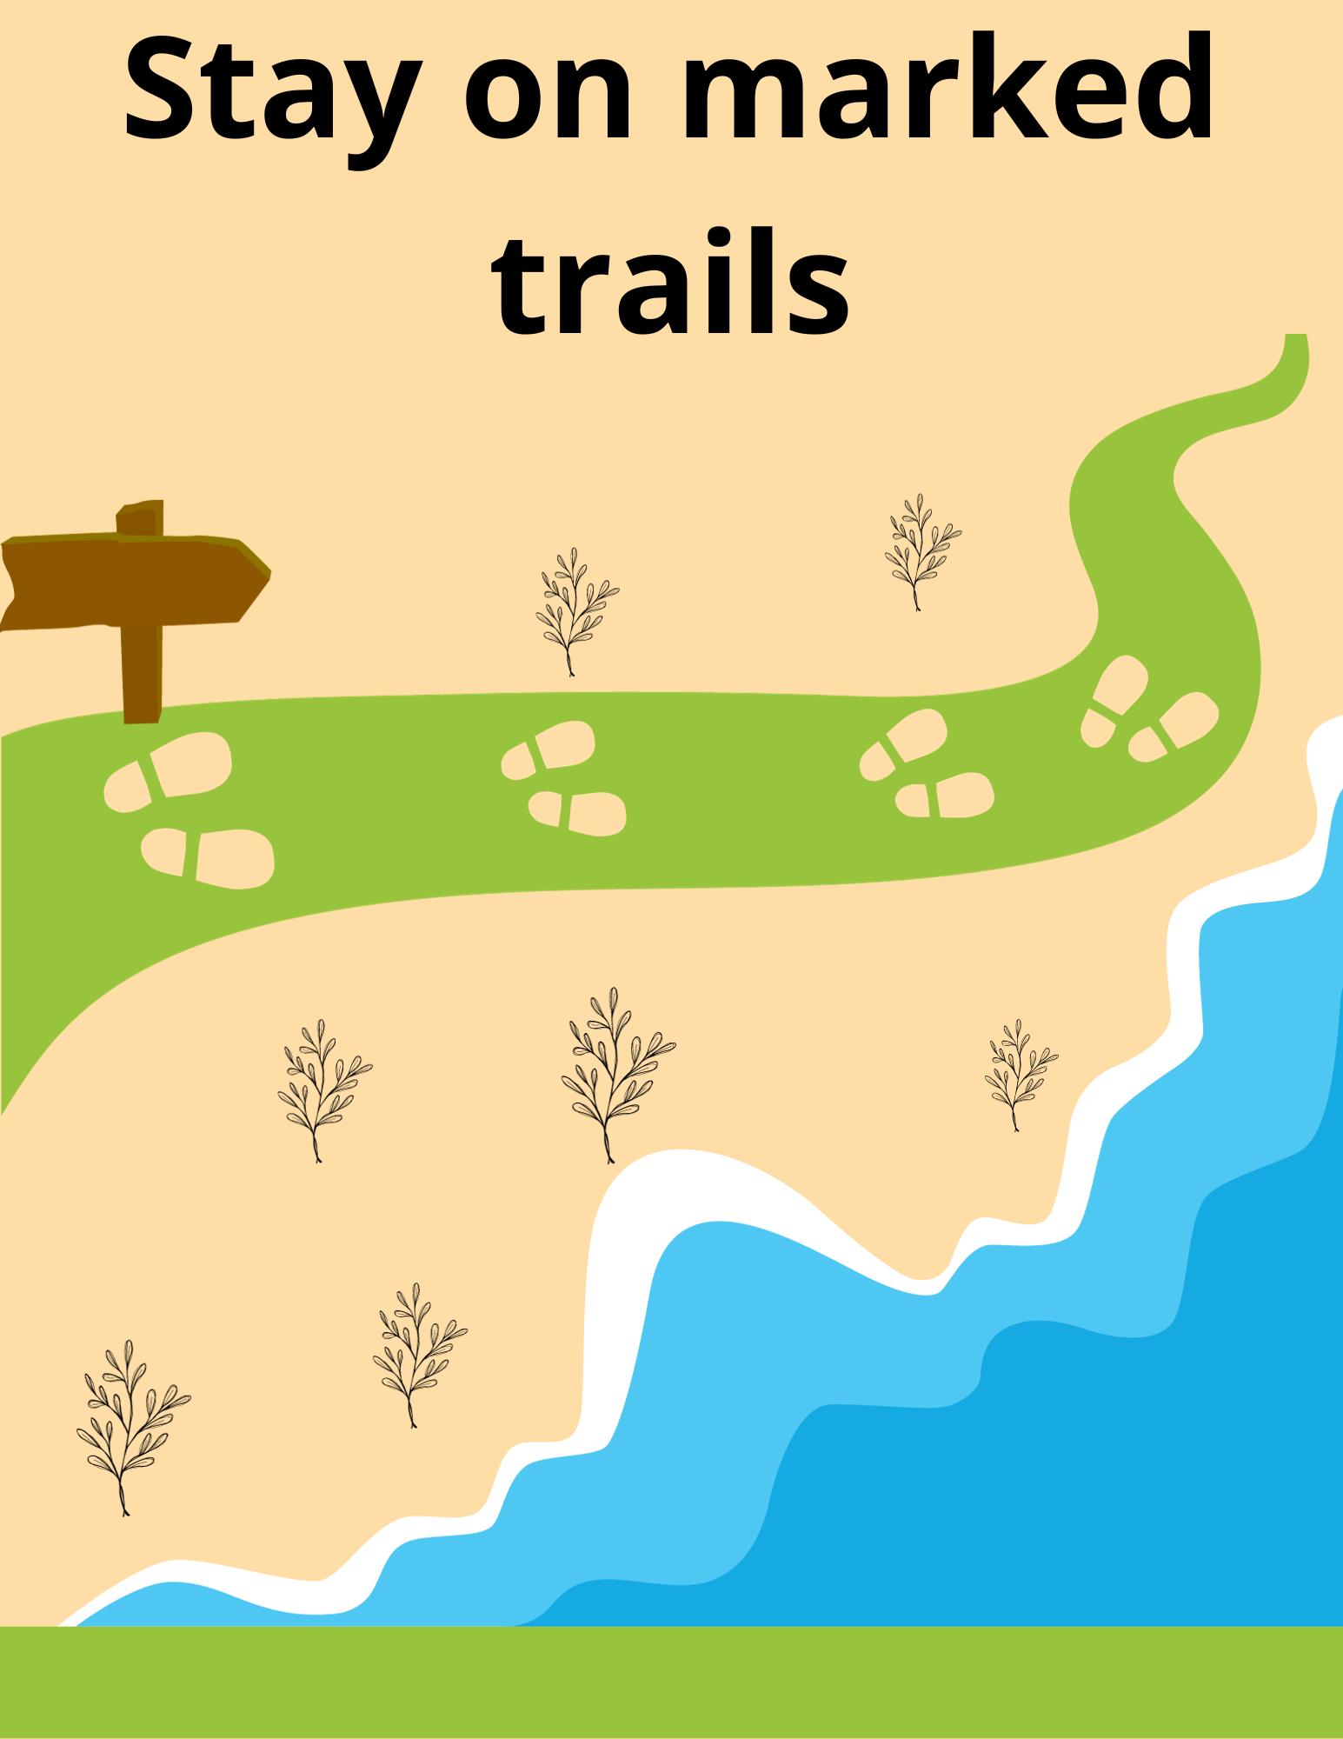
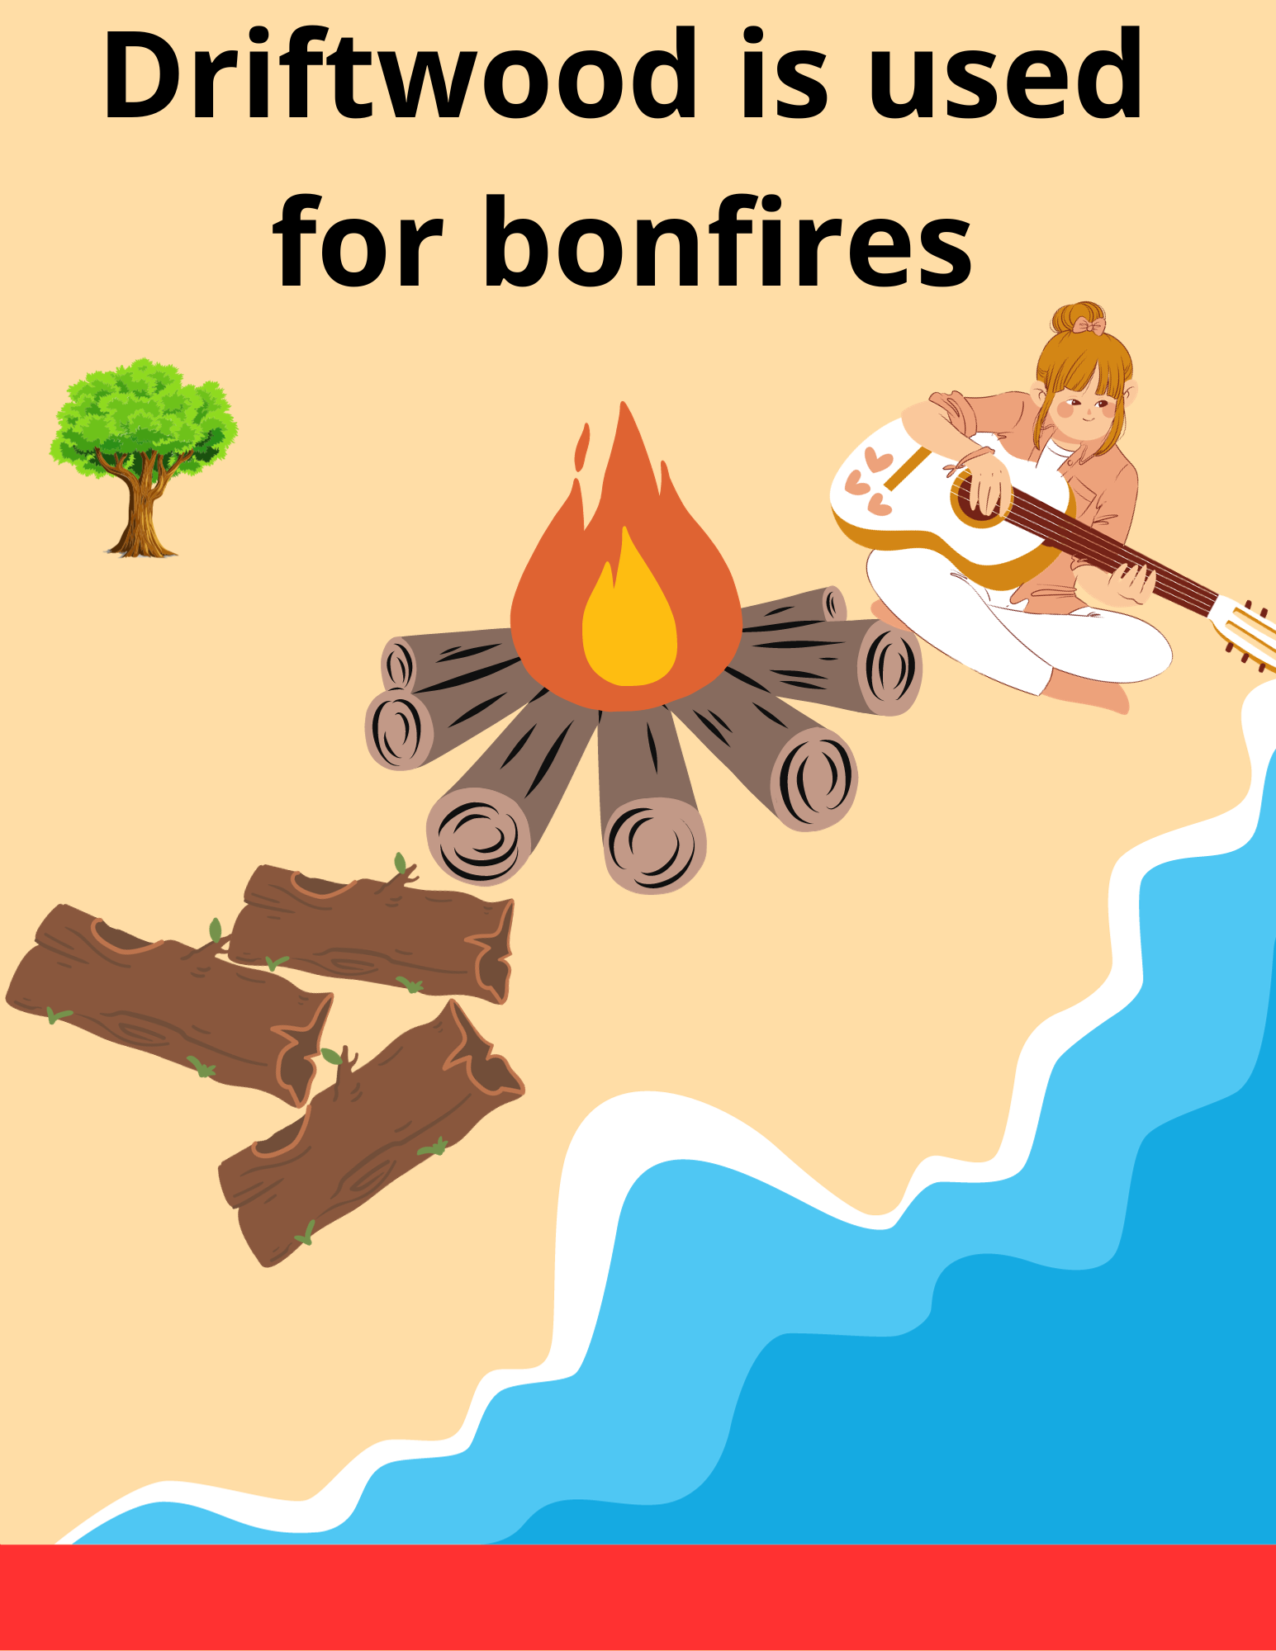
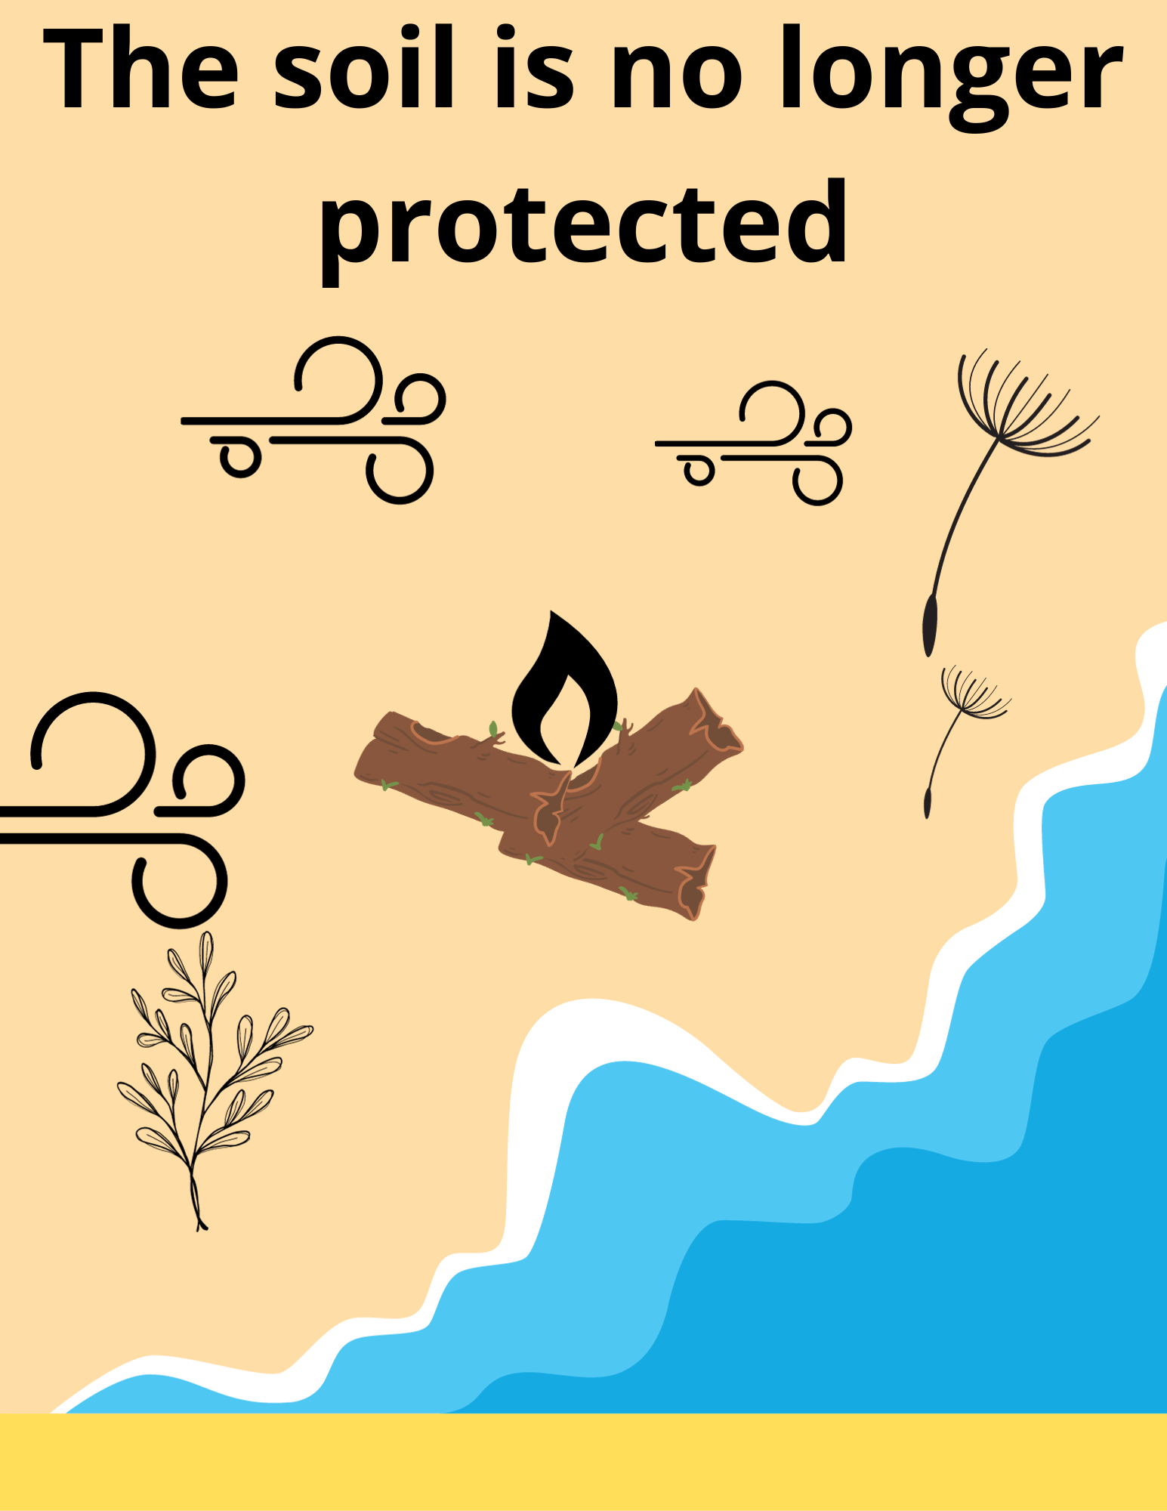
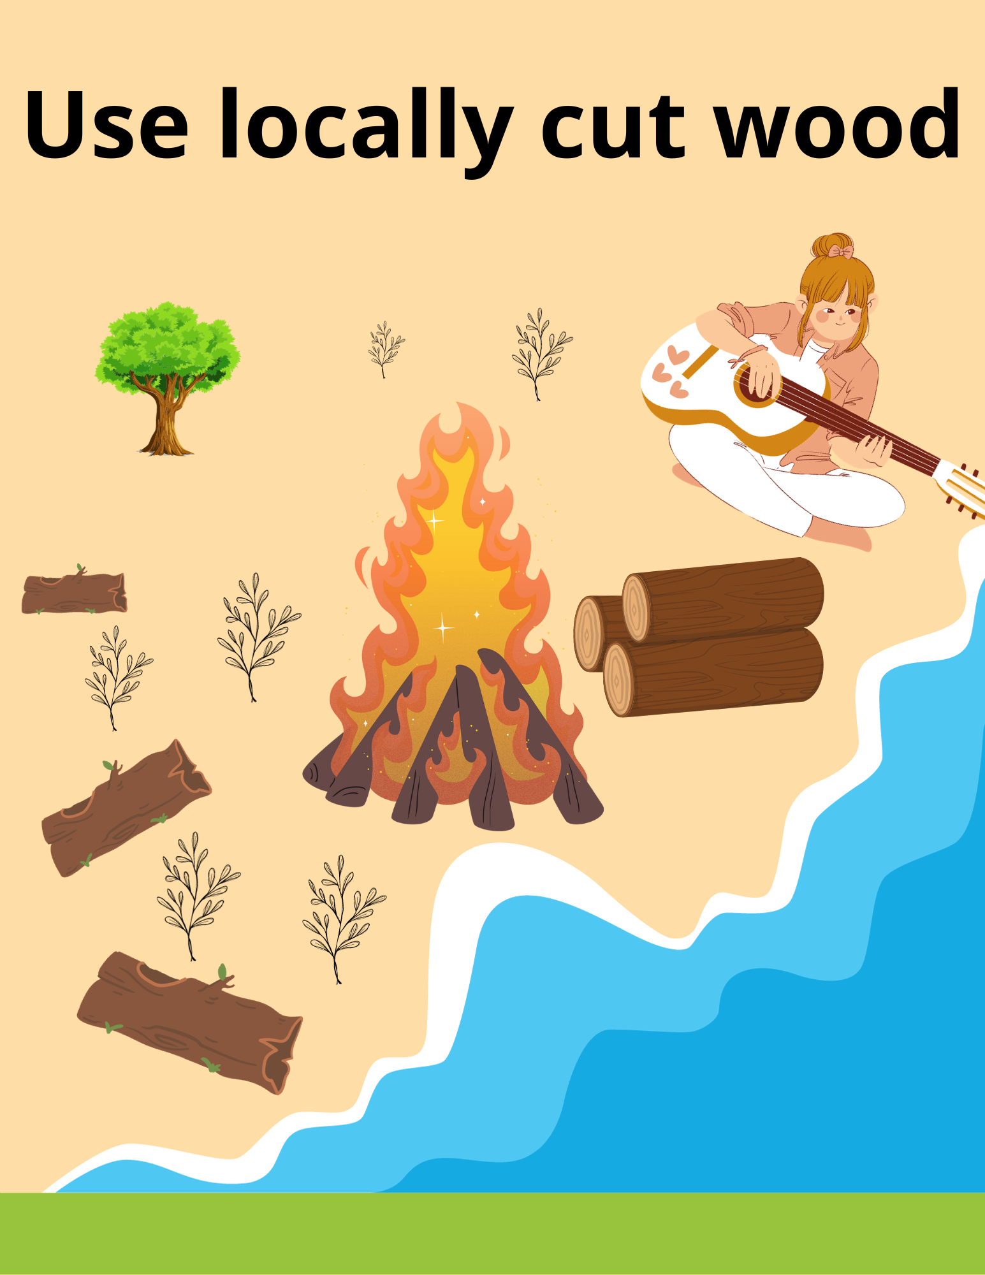
The story of the fight against erosion!
Notes:
Why does walking on marked trails help prevent erosion?
Walking on marked trails prevents plants from being uprooted, which results in a beautiful, vegetated riparian buffer strip that can effectively fight erosion.
Why does using locally cut wood help fight erosion?
By using locally cut wood and leaving driftwood on the beach, we’re helping the soil stay in place so plants can take root.

Slide 16
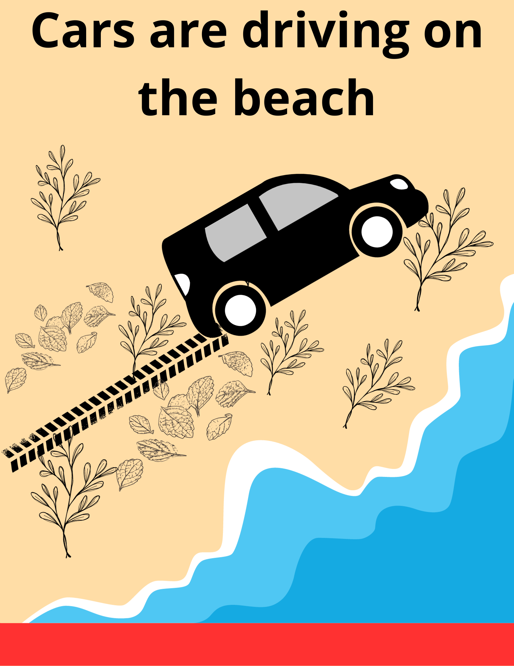
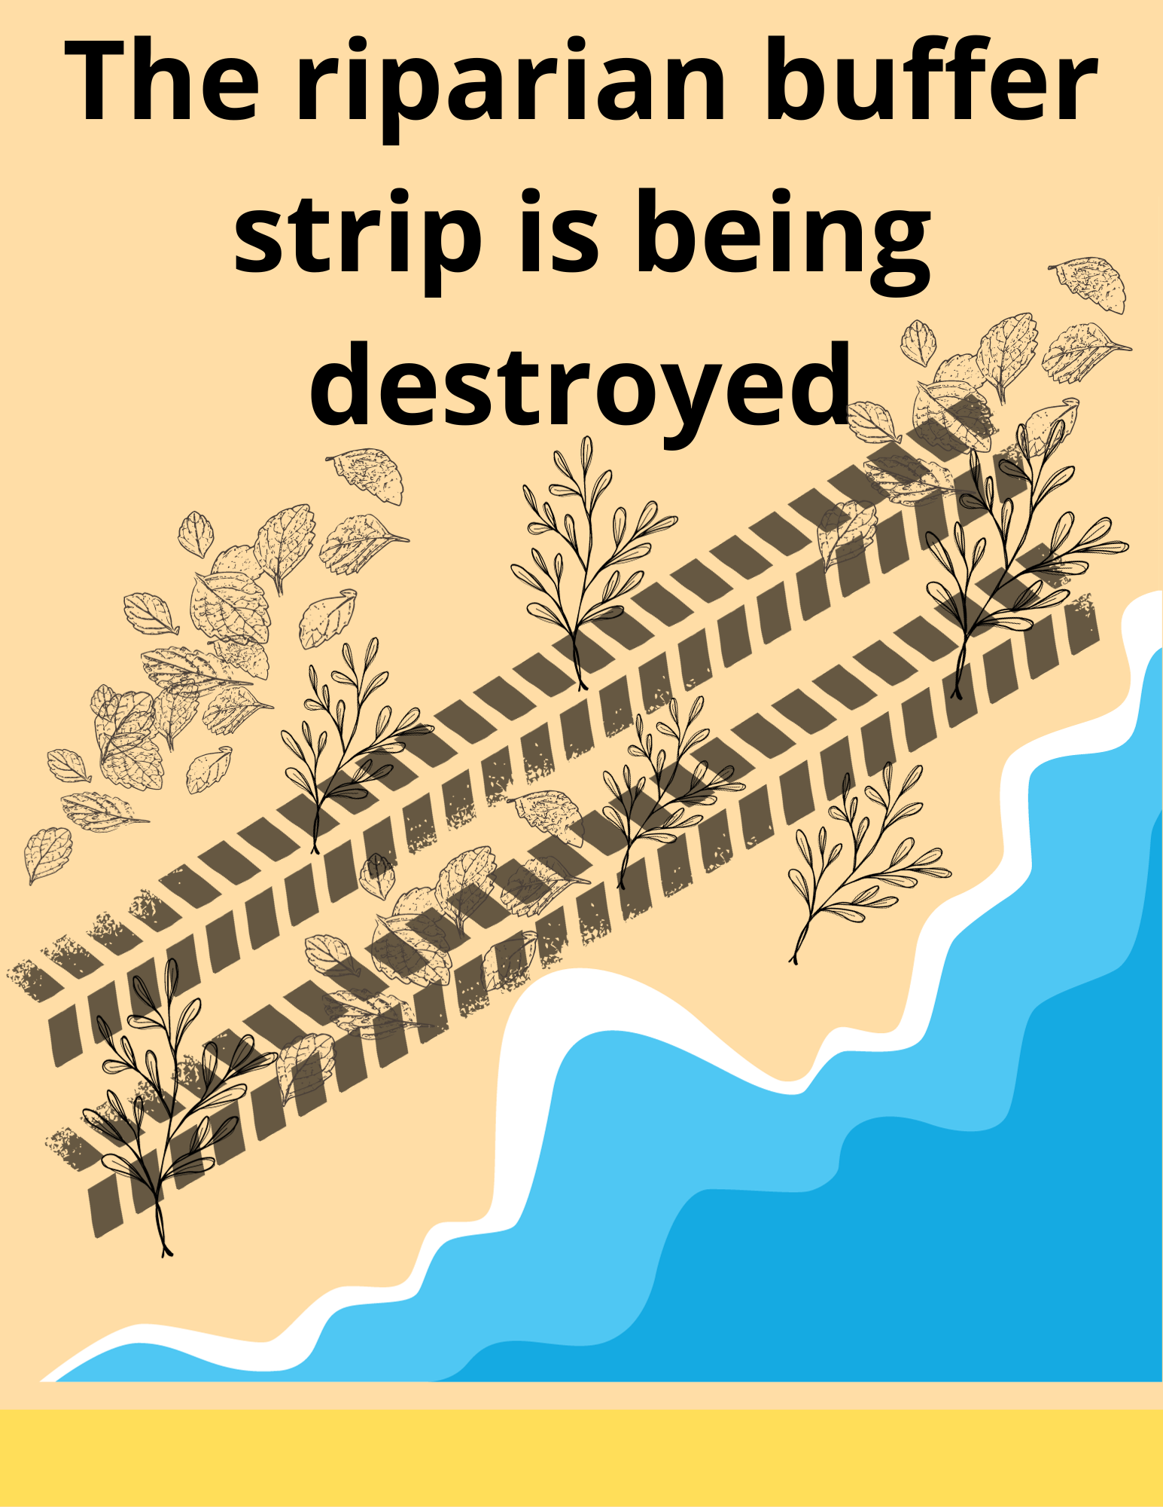
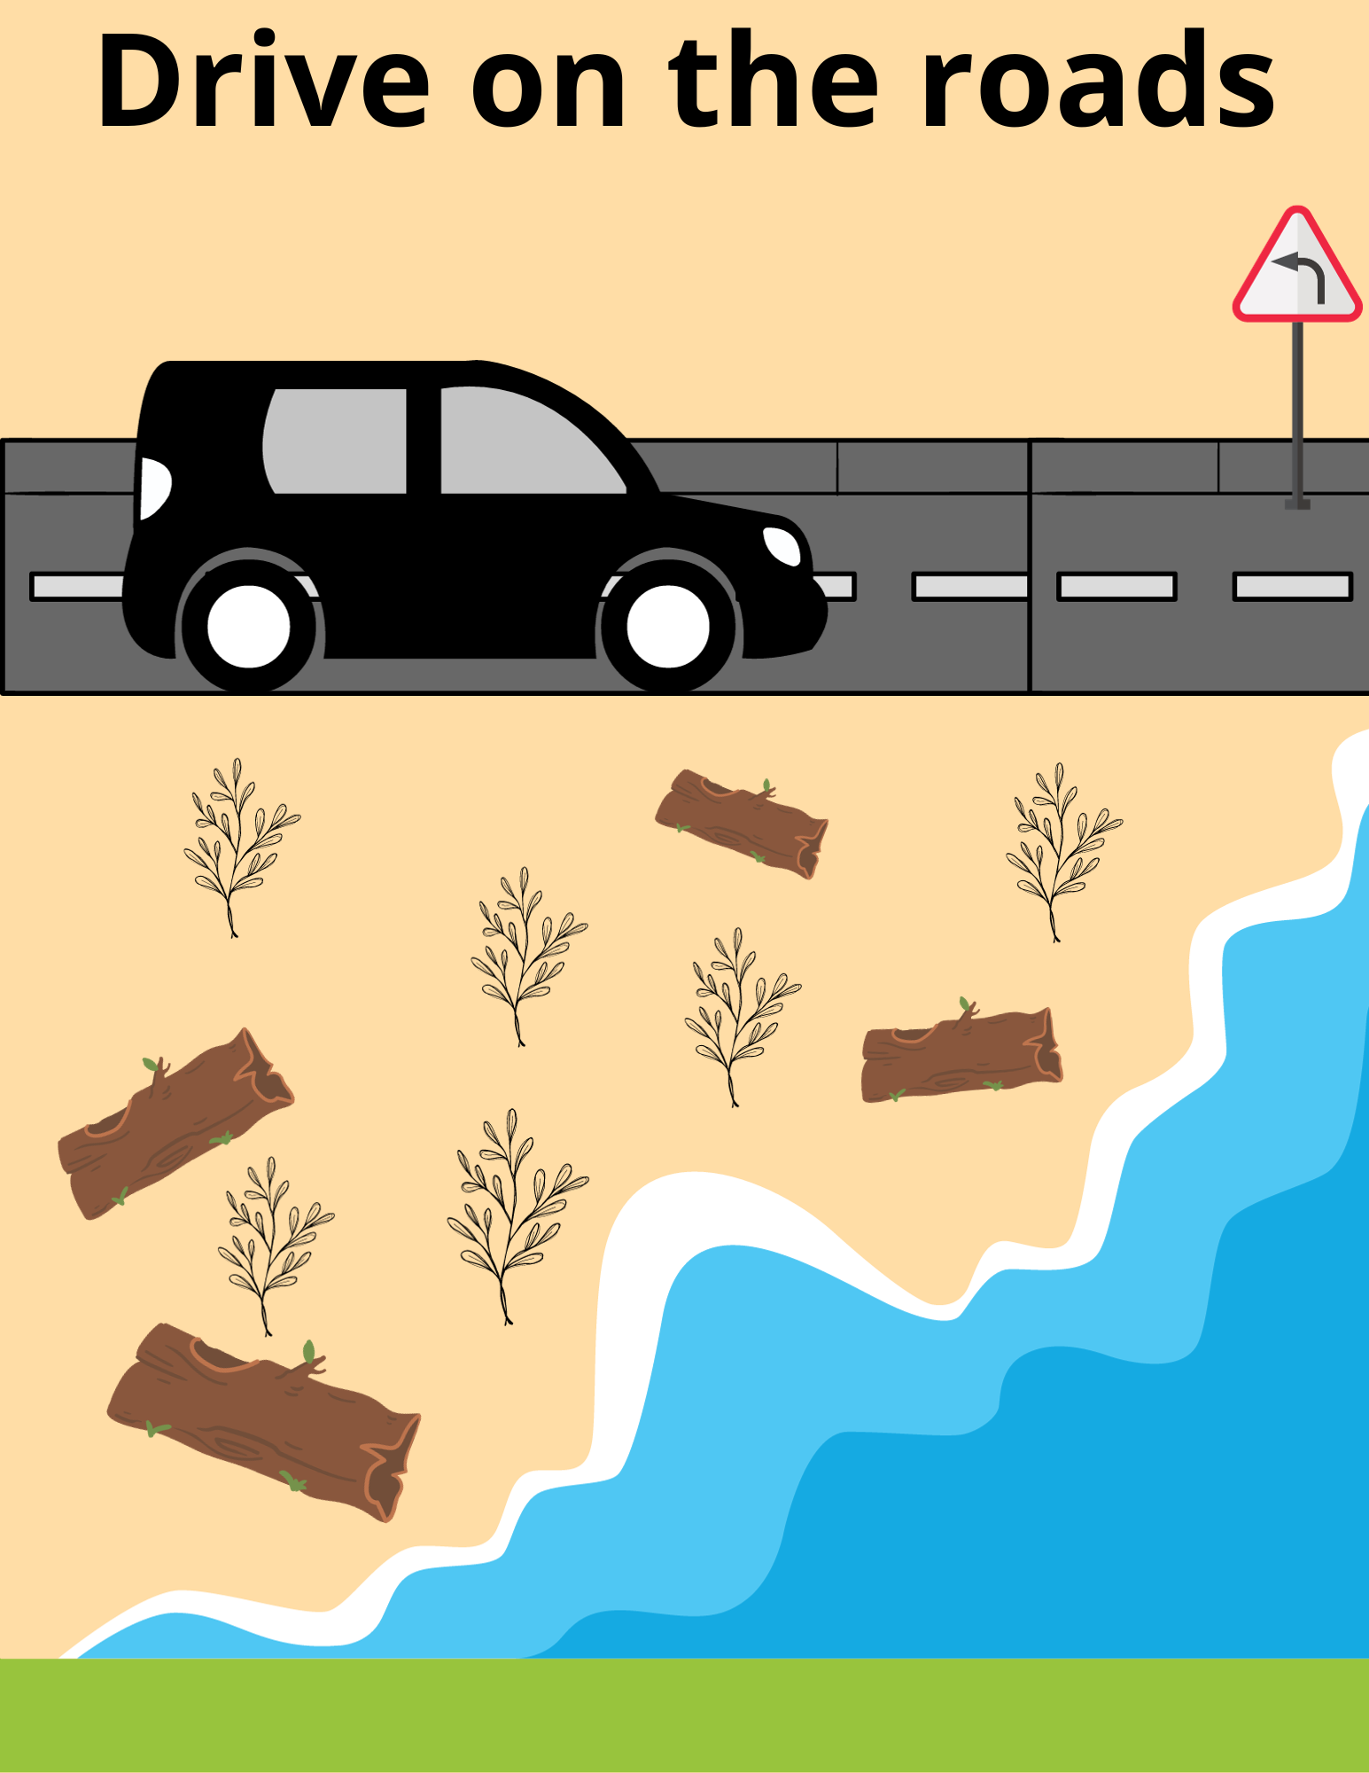
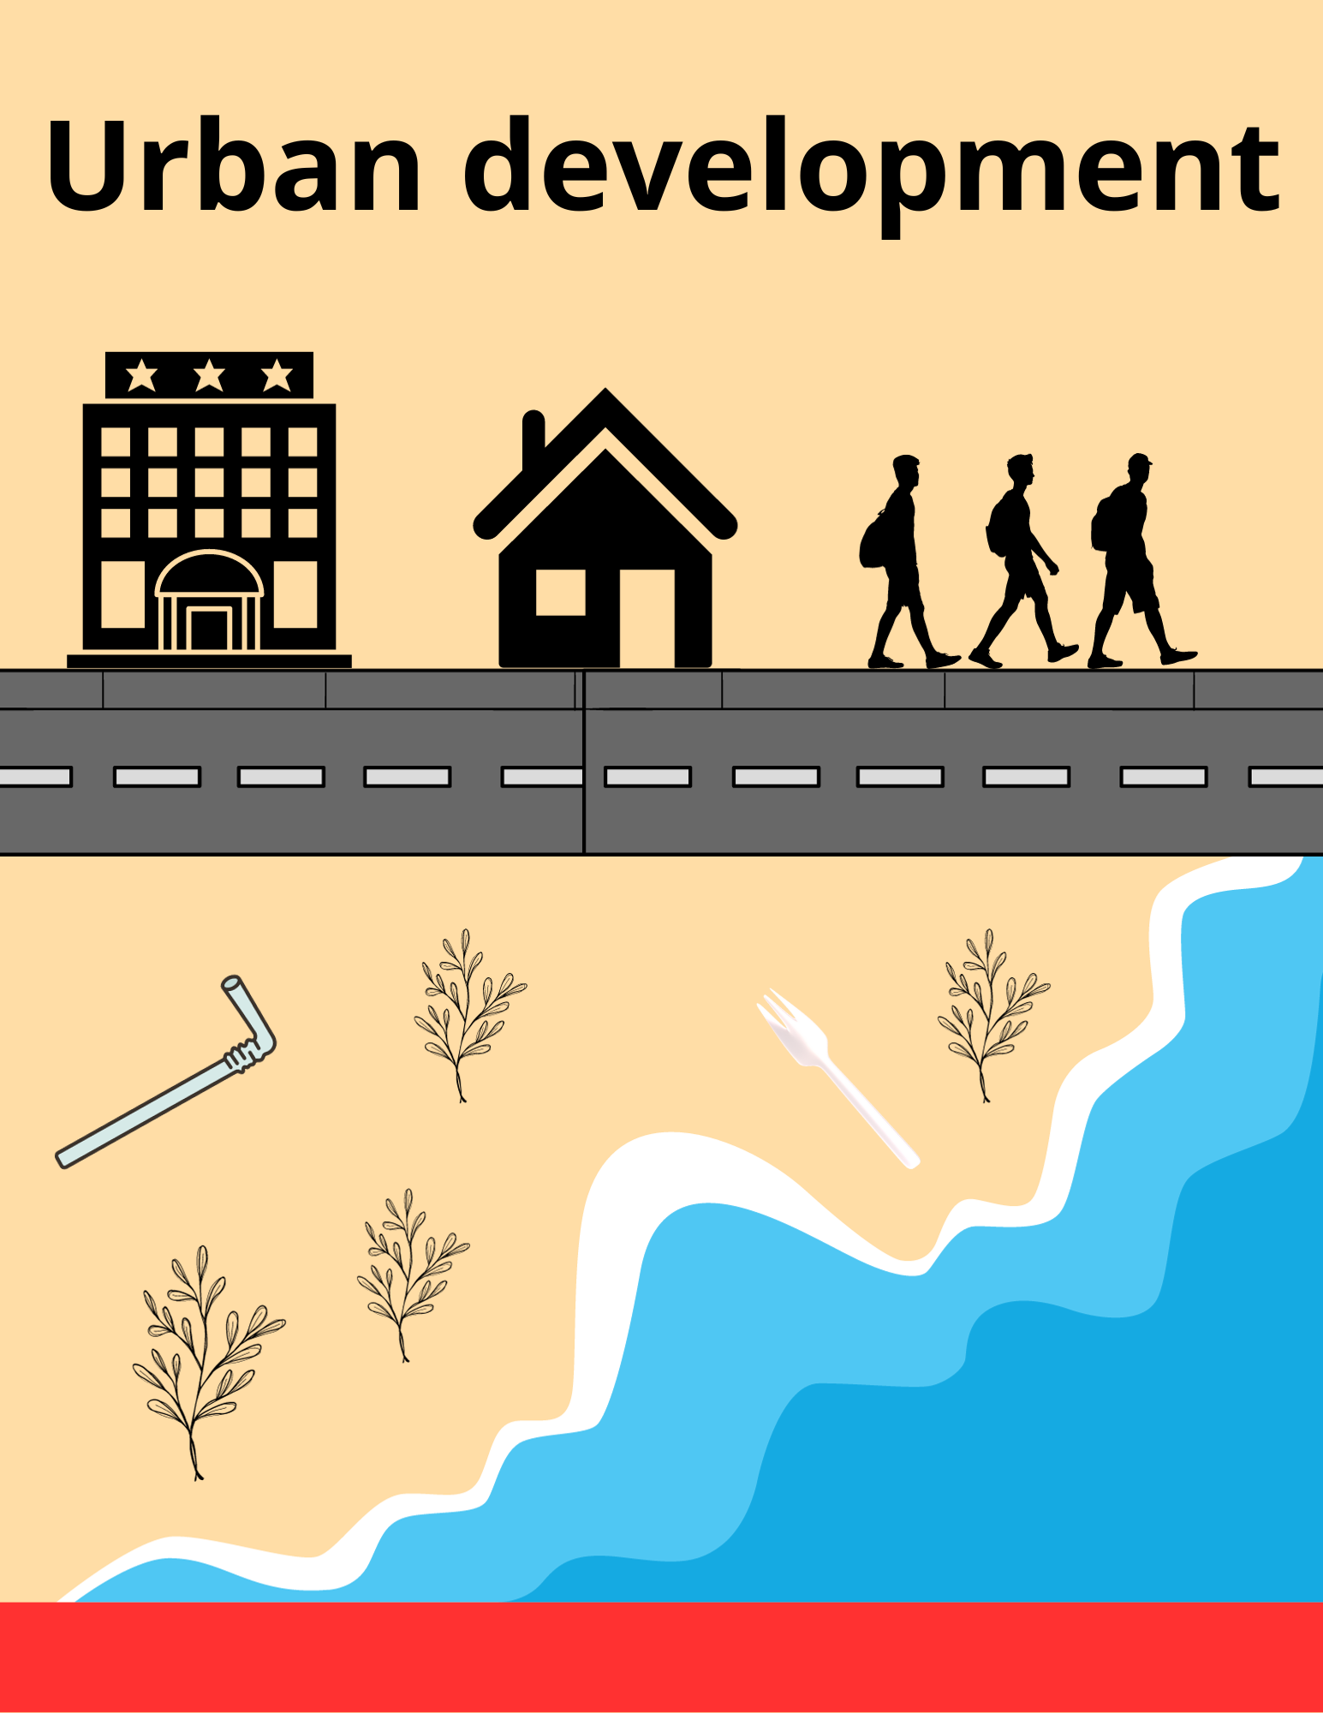
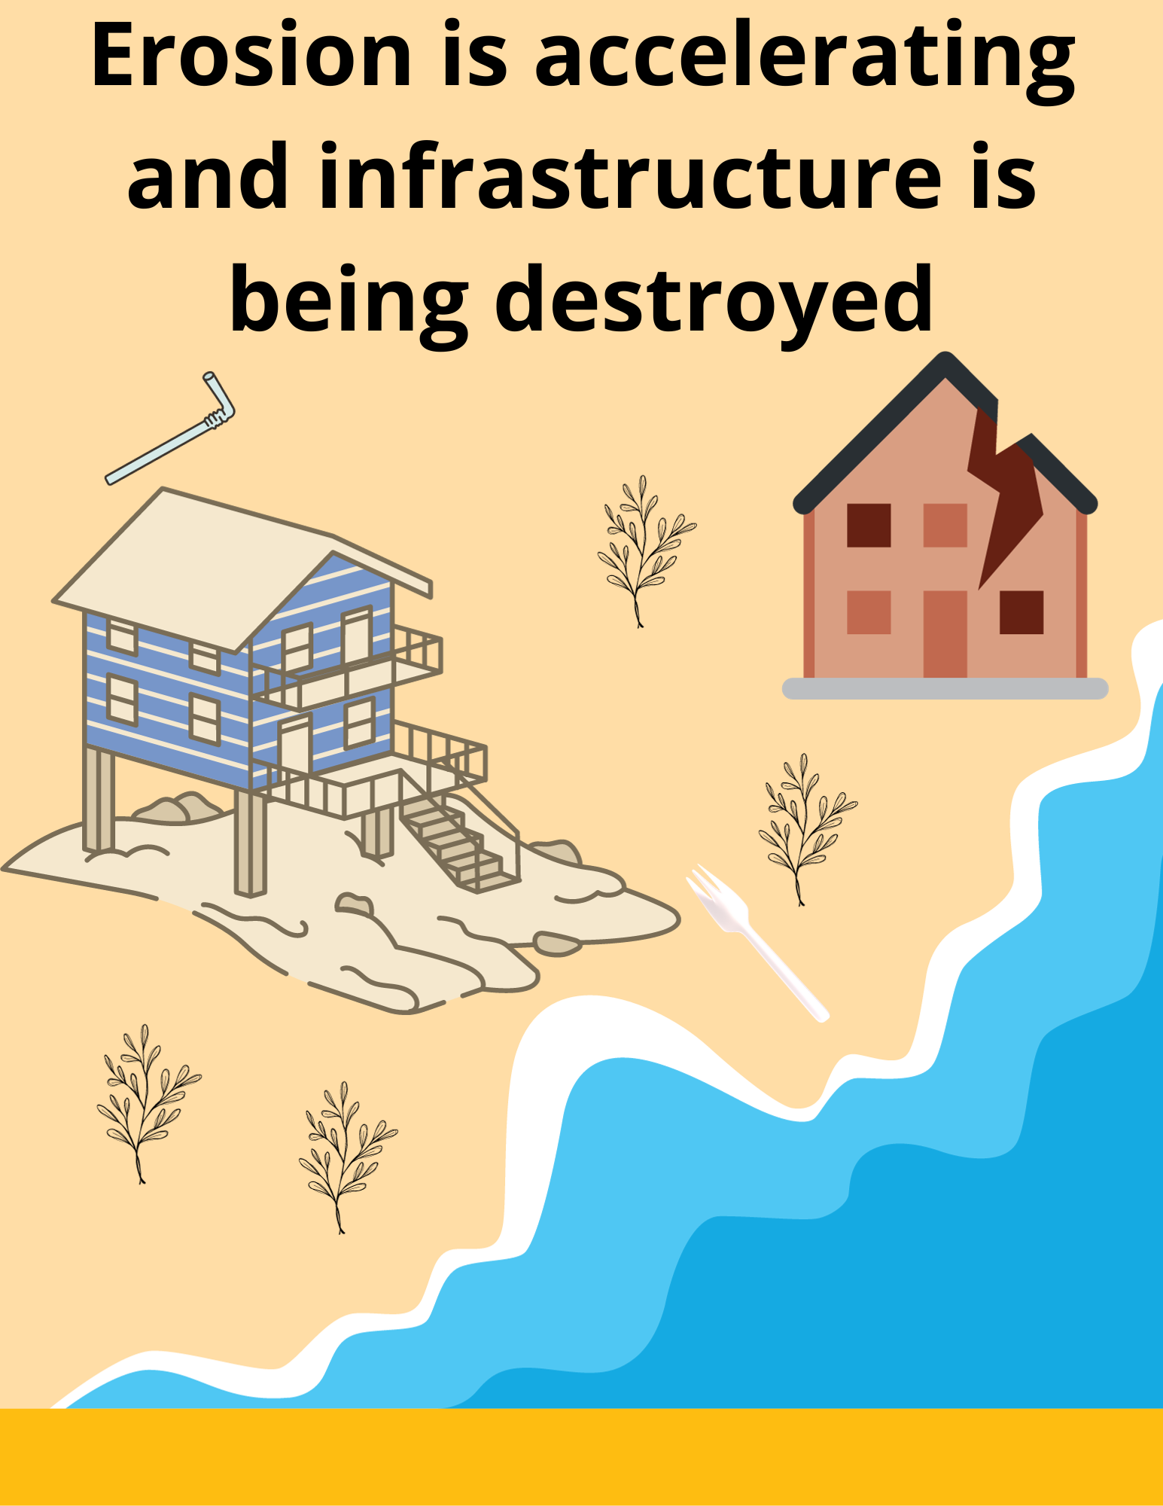
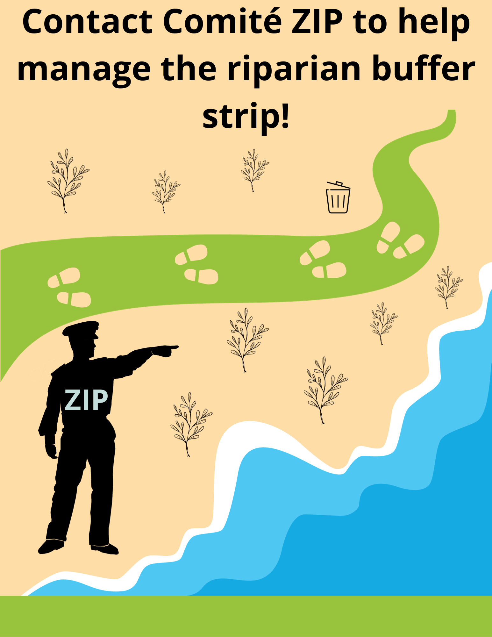
The story of the fight against erosion!
Notes:
How does driving on vehicle-only roads help prevent erosion?
Vehicles harm the riparian buffer strip tremendously. They destroy the root system of plants, like Ella the sand ryegrass, and damage beach wrack along the shore.
Have you ever seen people driving on the beach? What would you say to them?
Urban development jeopardizes coastal environments by disrupting the balance of sediment inflow and outflow. Construction work disrupts the natural flow of sediment. Comité ZIP is committed to ensuring that all shoreline management practices are both sustainable and respectful of the diversity of the area. Don’t hesitate to contact them if you have questions about erosion!

Slide 17
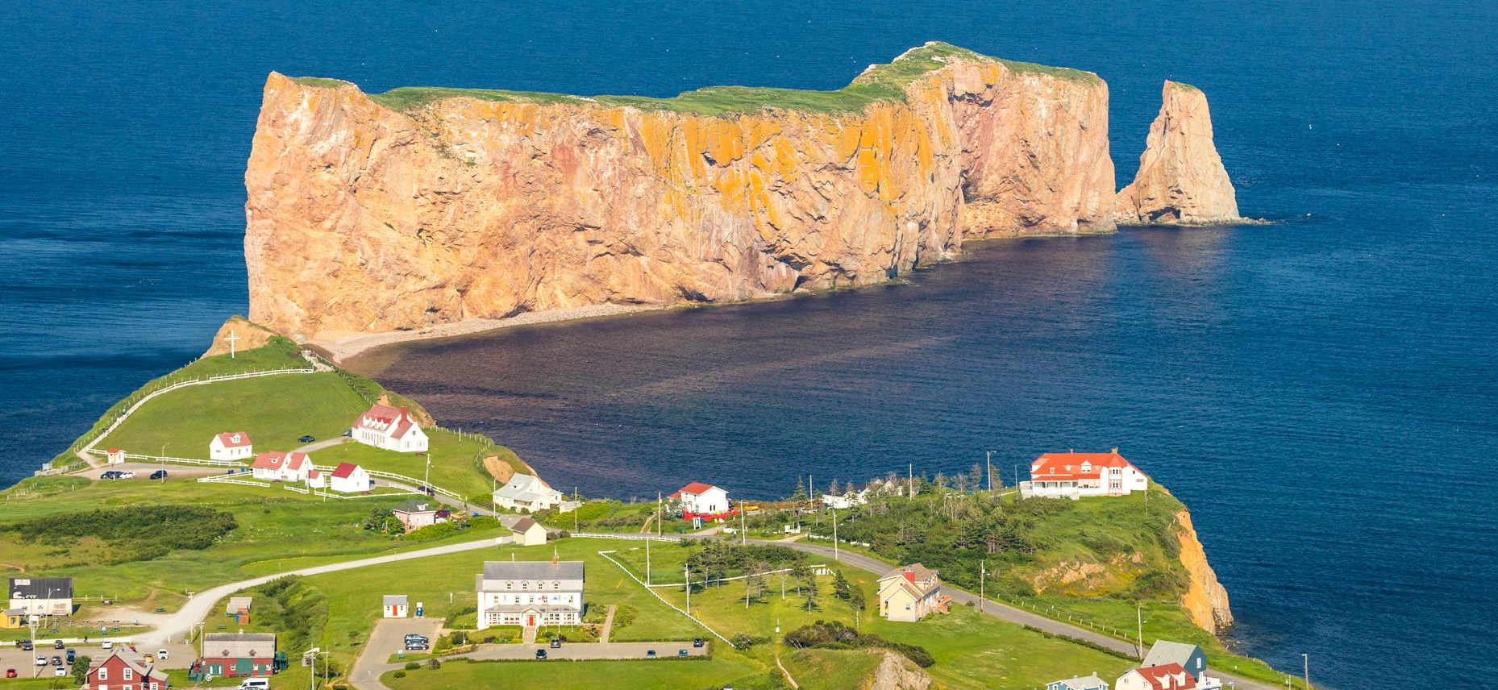
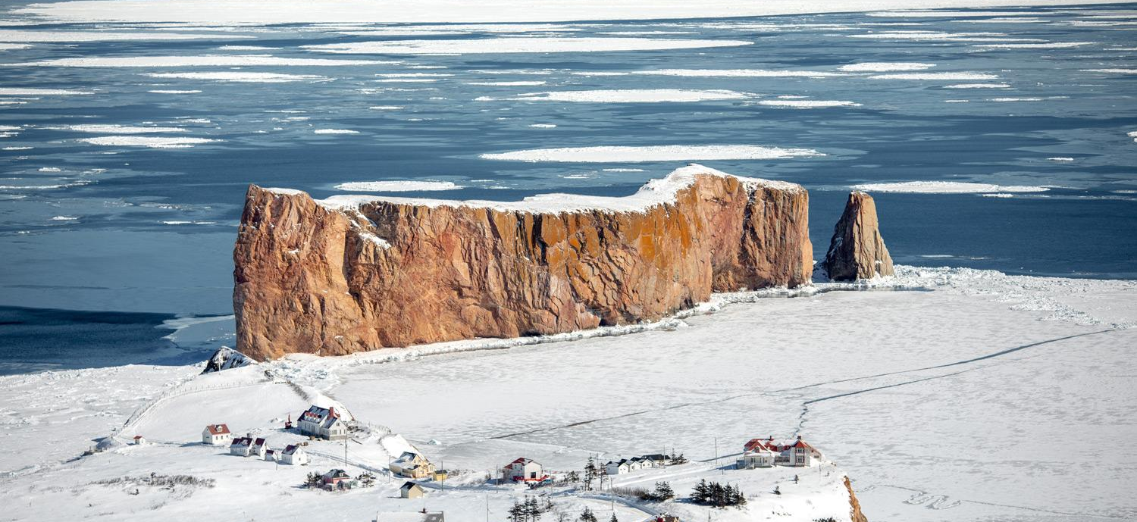
Questions?
Notes:
Conclusion:
Congratulations, you’re all erosion experts! Now that you know how to reduce the impact of erosion in coastal environments, it’s your job to encourage others around you to help keep these environments healthy.
What surprised you about this presentation?
Don’t forget that the best way to encourage your friends and family to help fight erosion is by acting responsibly yourself. You’ll inspire a lot more people that way!
Great work, everyone! You now know how to protect your city/town from erosion!

