Slide 1
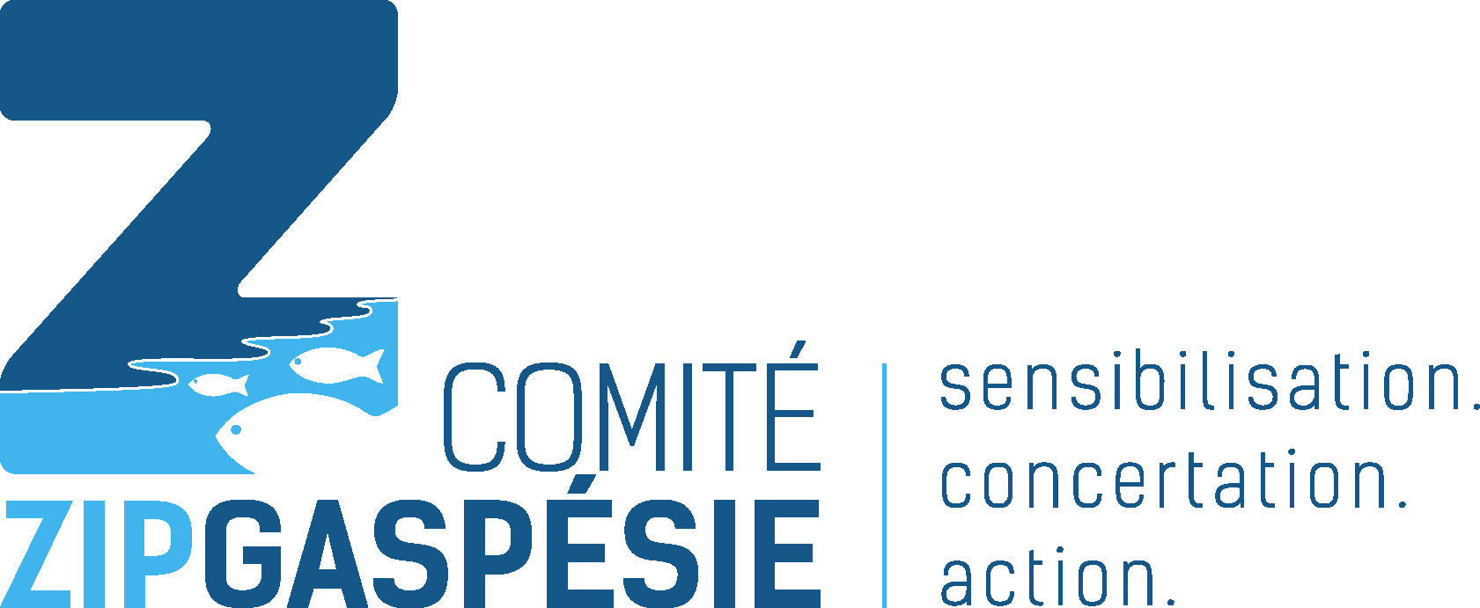
Plastic Waste
What to do about it?
Notes:
We’re finding more and more plastic in the St. Lawrence and on its beaches. But how exactly does it end up there? How does it impact the species that live in and around the St. Lawrence? What can we do to solve this problem?
These are all questions we’ll be answering today!

Slide 2
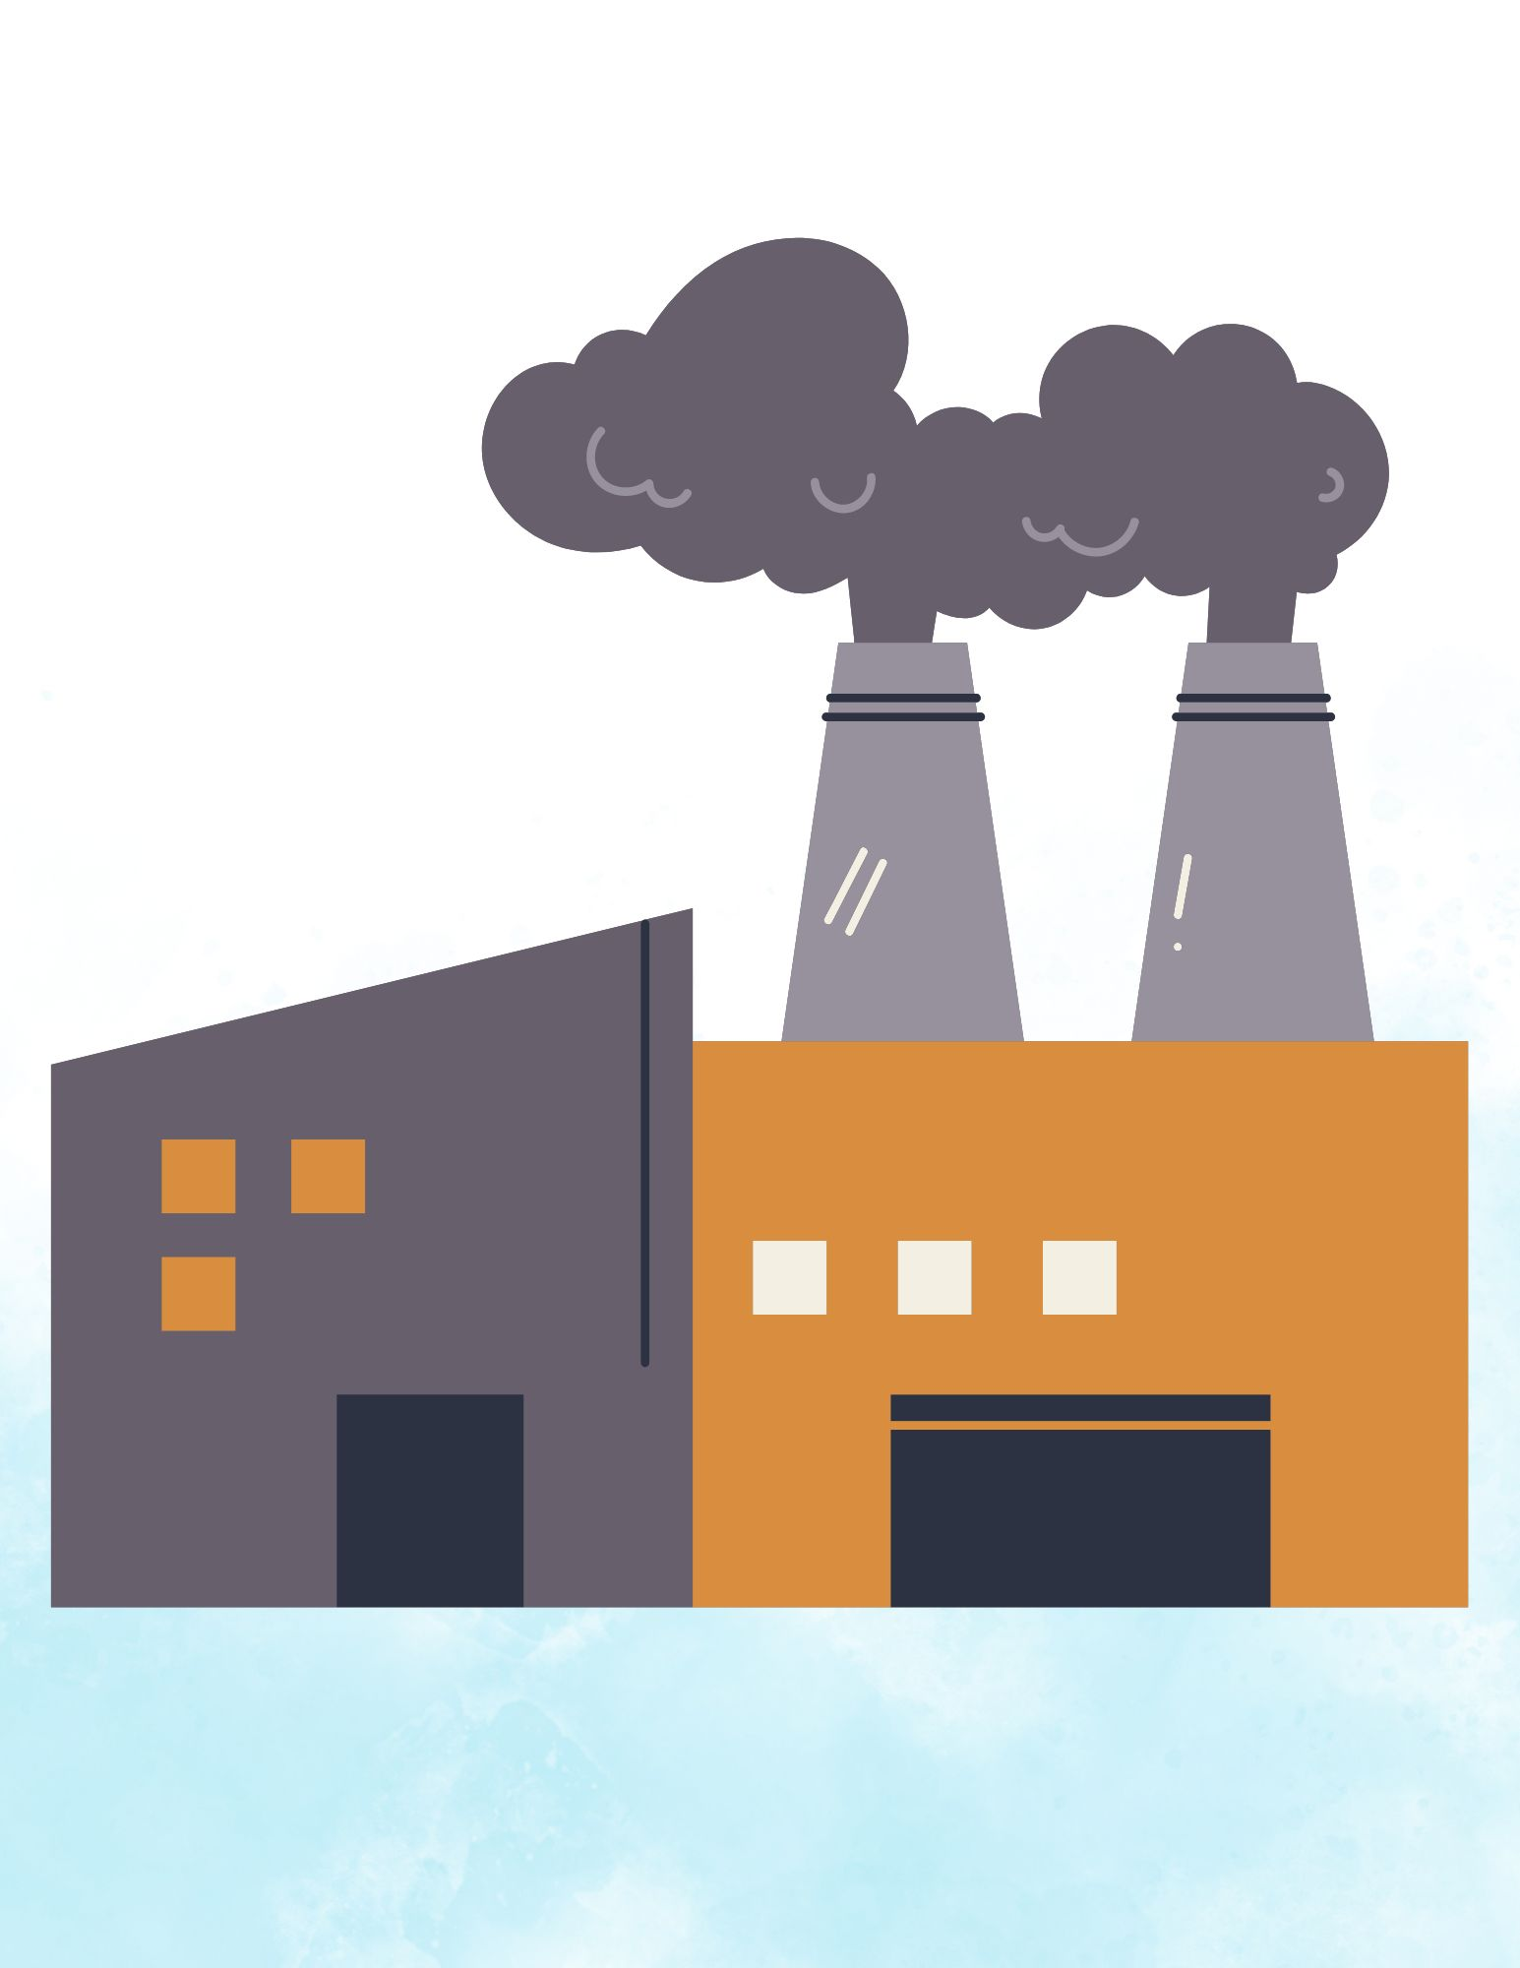
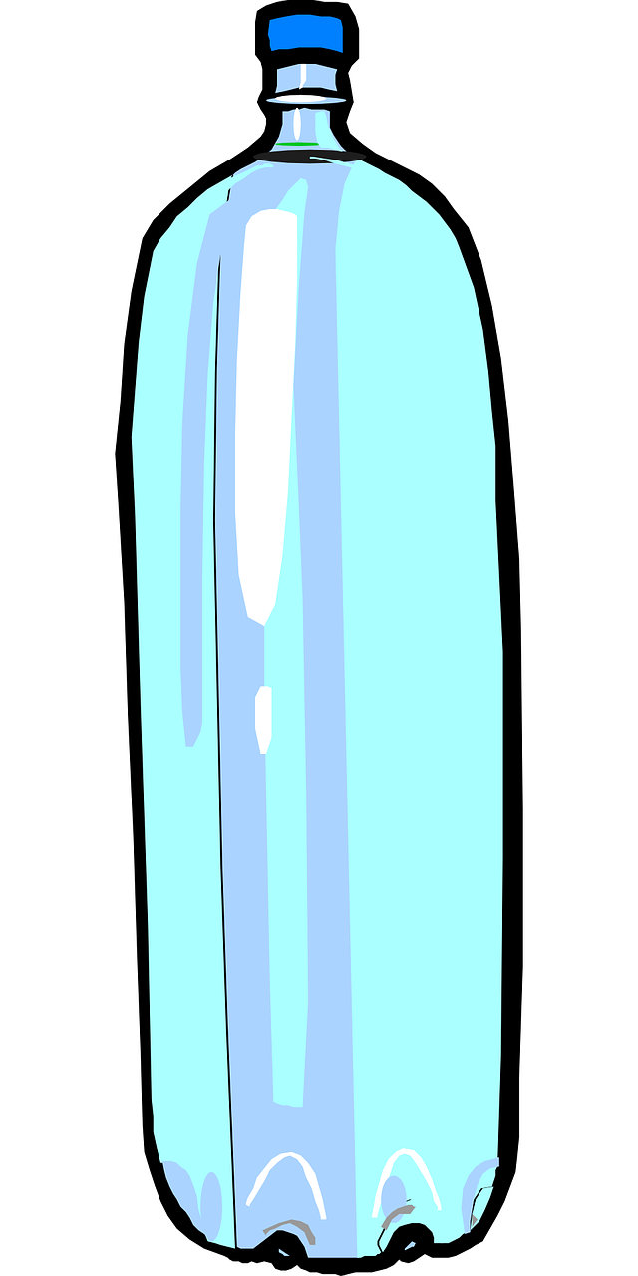
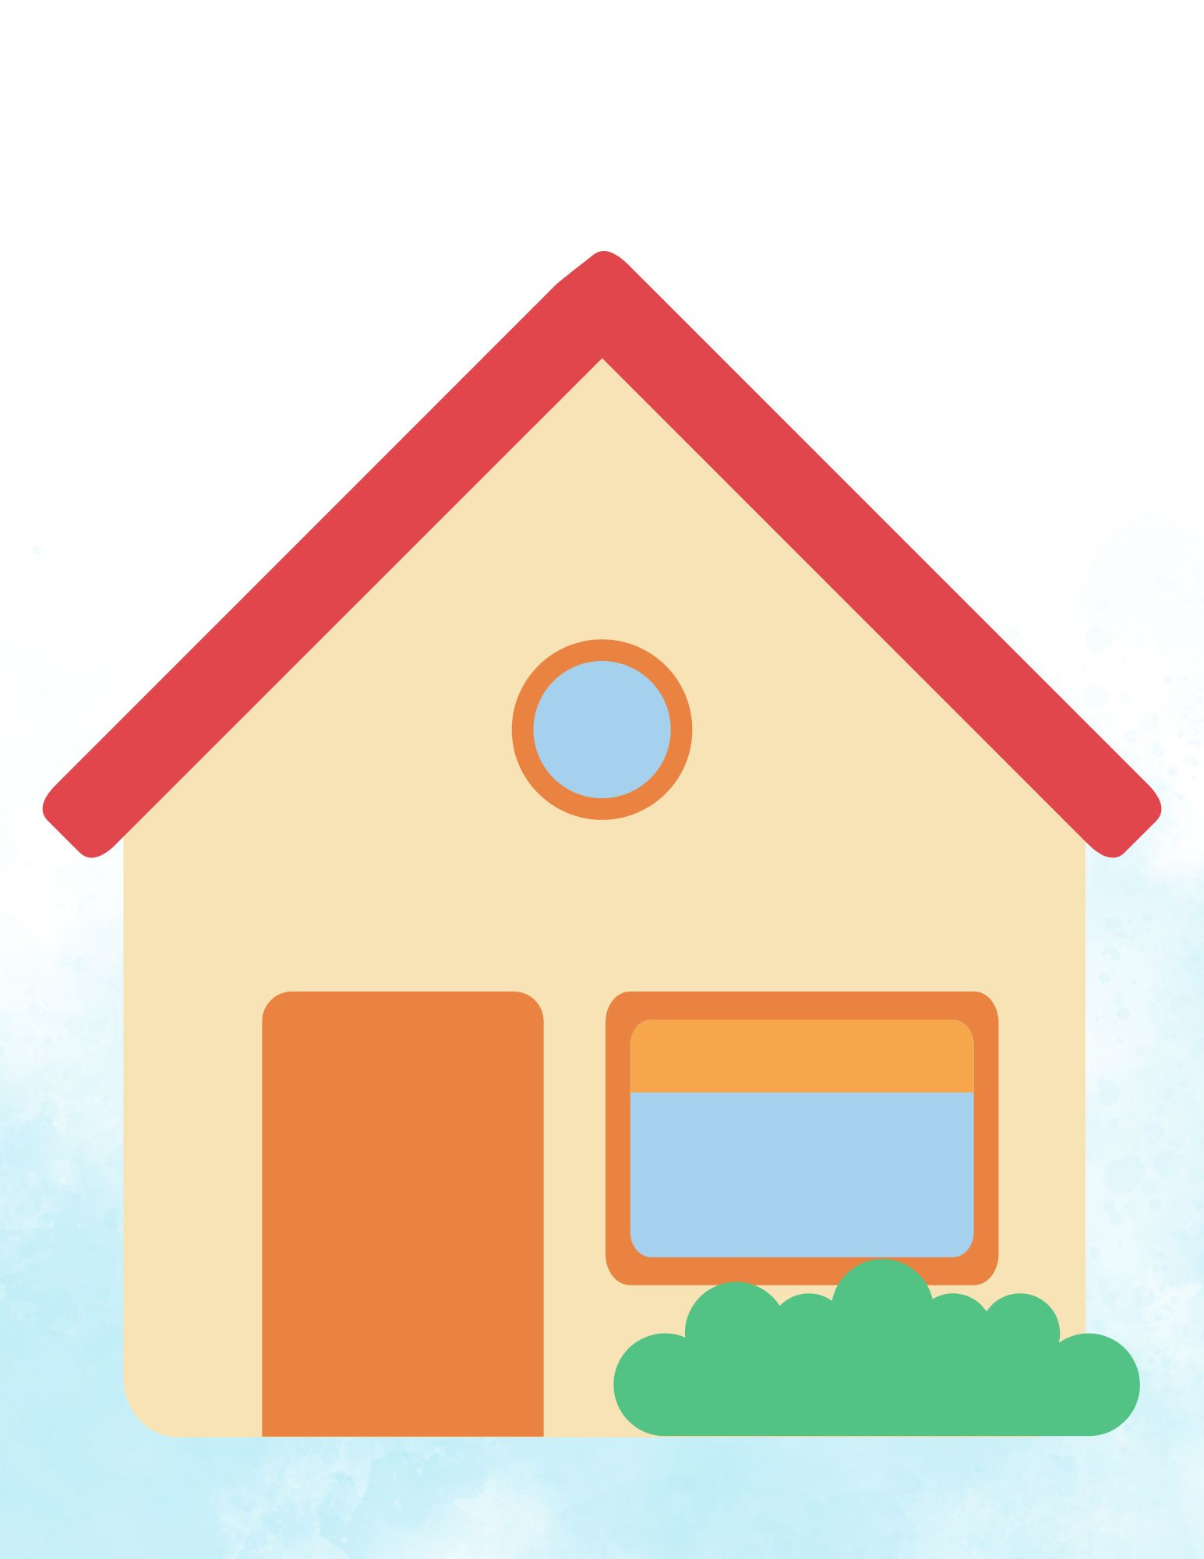
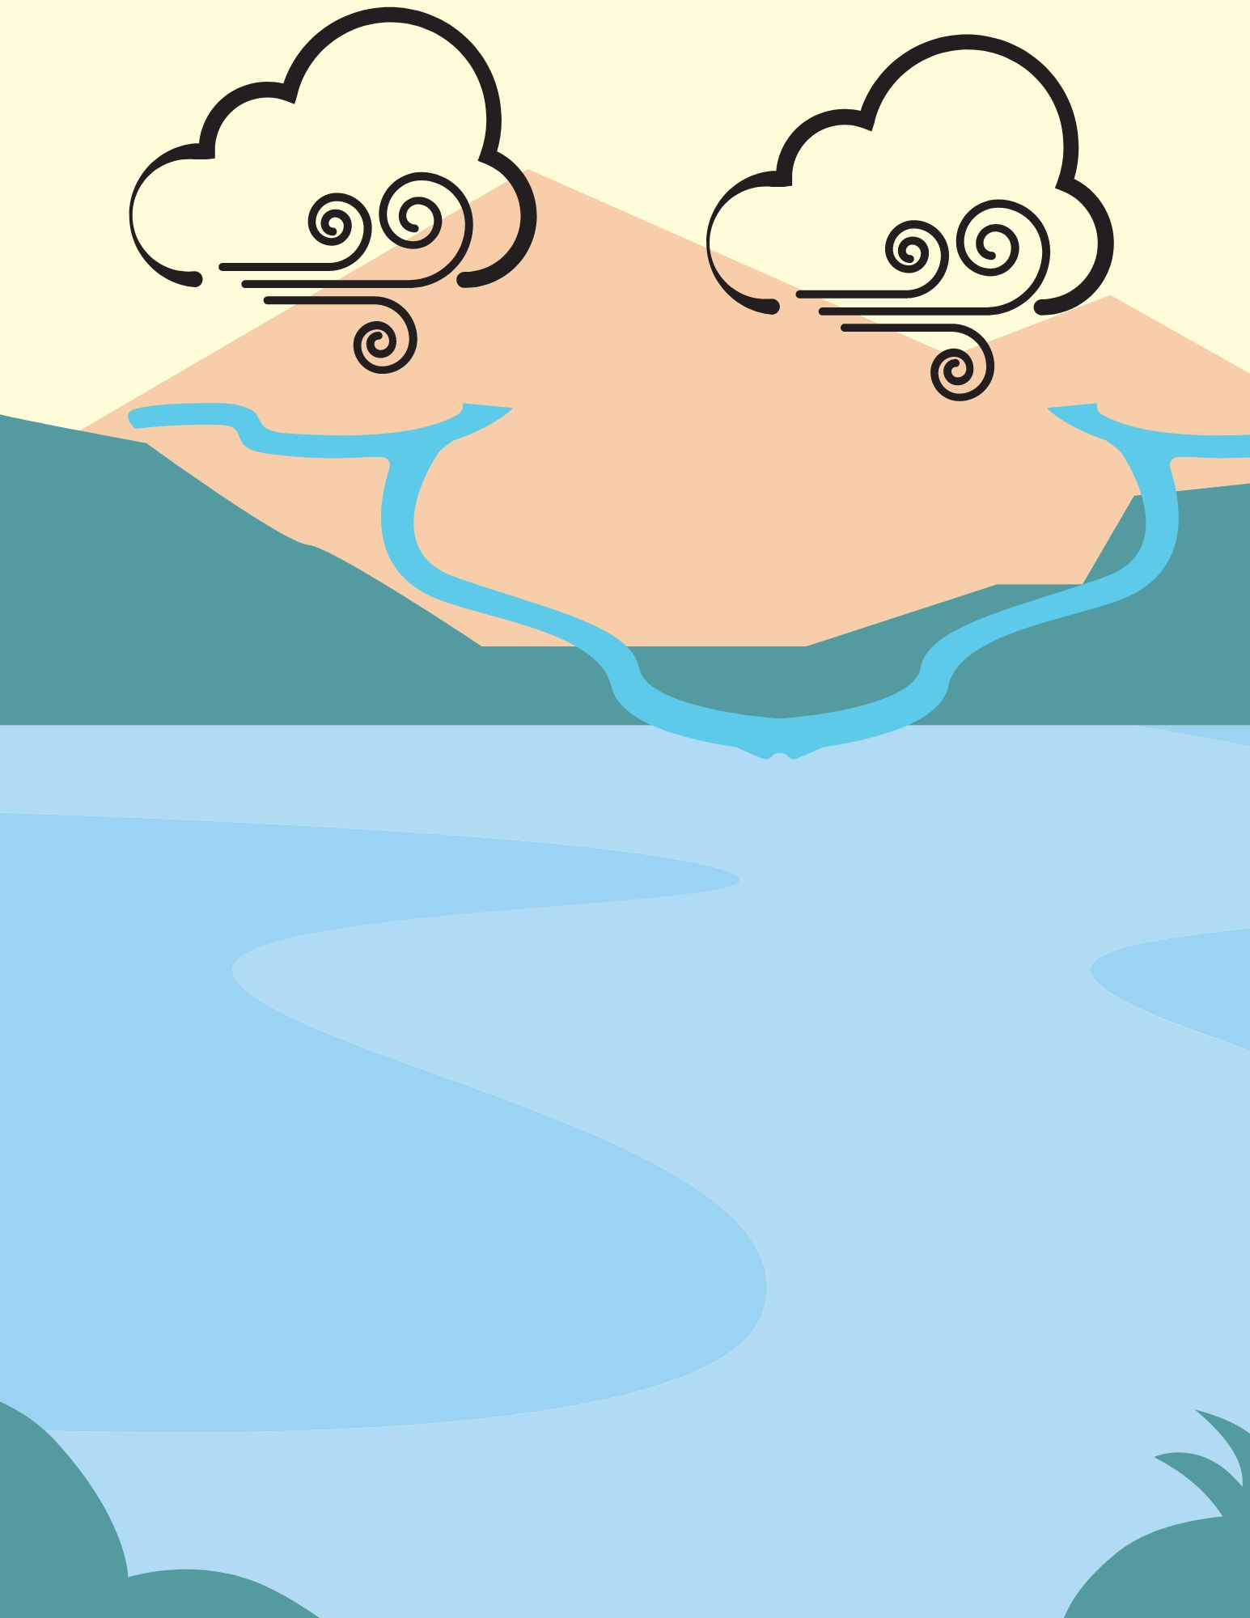
The path of plastic
The start of its journey…
Notes:
Part 1: The causes and impacts of waste and microplastics
The start of its journey
Raise your hand if you’ve ever seen garbage on the beach.
Unfortunately, it’s not uncommon to find trash lying around in nature. It can travel for a long time and over great distances.
How do you think waste gets around? How does it end up in the environment?
All plastic that ends up in the ocean first has to be manufactured.
Once plastic is produced, it’s shipped off to a store near you! However, we only use it for a short time before its real journey begins. That's why it's important to reduce our plastic consumption at the source!
Let’s see where our trash goes after it enters the environment!

Slide 3
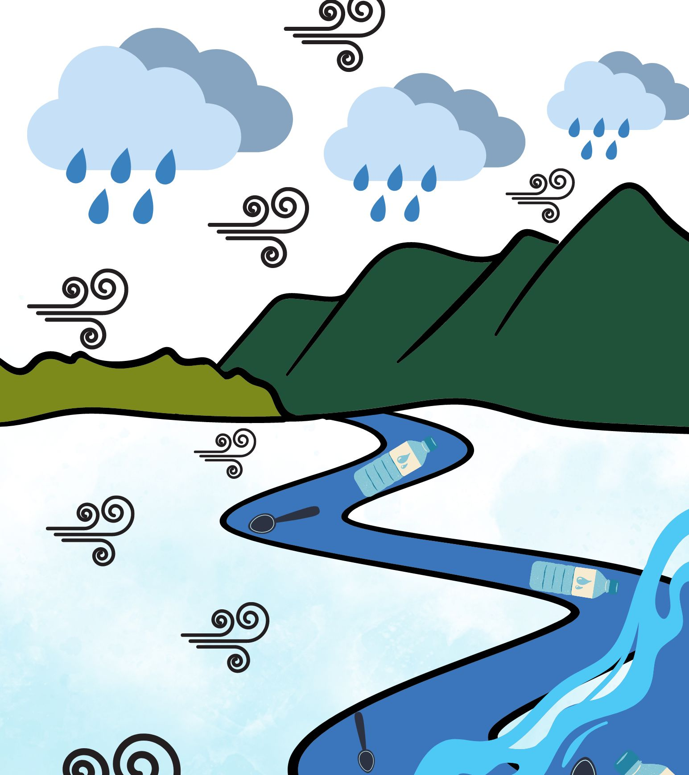
The path of plastic
Entering the environment…
Notes:
Wind, rain and water runoff are the main ways that waste enters the environment. Waste can end up at the dump, get carried away by a strong breeze, land in a stream, then be carried into the St. Lawrence and eventually end up in the ocean.
Since plastic waste varies in size and shape, some pieces will stay in the environment longer, while others will slowly disintegrate and release microplastics into the water.
Who has heard of “microplastic” before? Do you know what it is? What does it make you think of? What did you learn from the comic book about plastic waste?
*Write down the students’ answers*
Microplastics can end up directly in the ocean through the sewers. Our clothes and cosmetics contain microplastics that creep into our pipes through the drain when we shower or the washer outlet when we do laundry. The water that leaves our homes contains many substances, including microplastics too small for our water treatment systems to filter out, which eventually end up in the St. Lawrence.
*For your information, microplastics come from many sources, mainly from synthetic fabrics (35%), tires (28%), paint for boats (11%) and toiletries containing plastic microbeads (2%). Although invisible to the naked eye, these tiny pieces of plastic make their way through the food chain. We’ll come back to this.

Slide 4
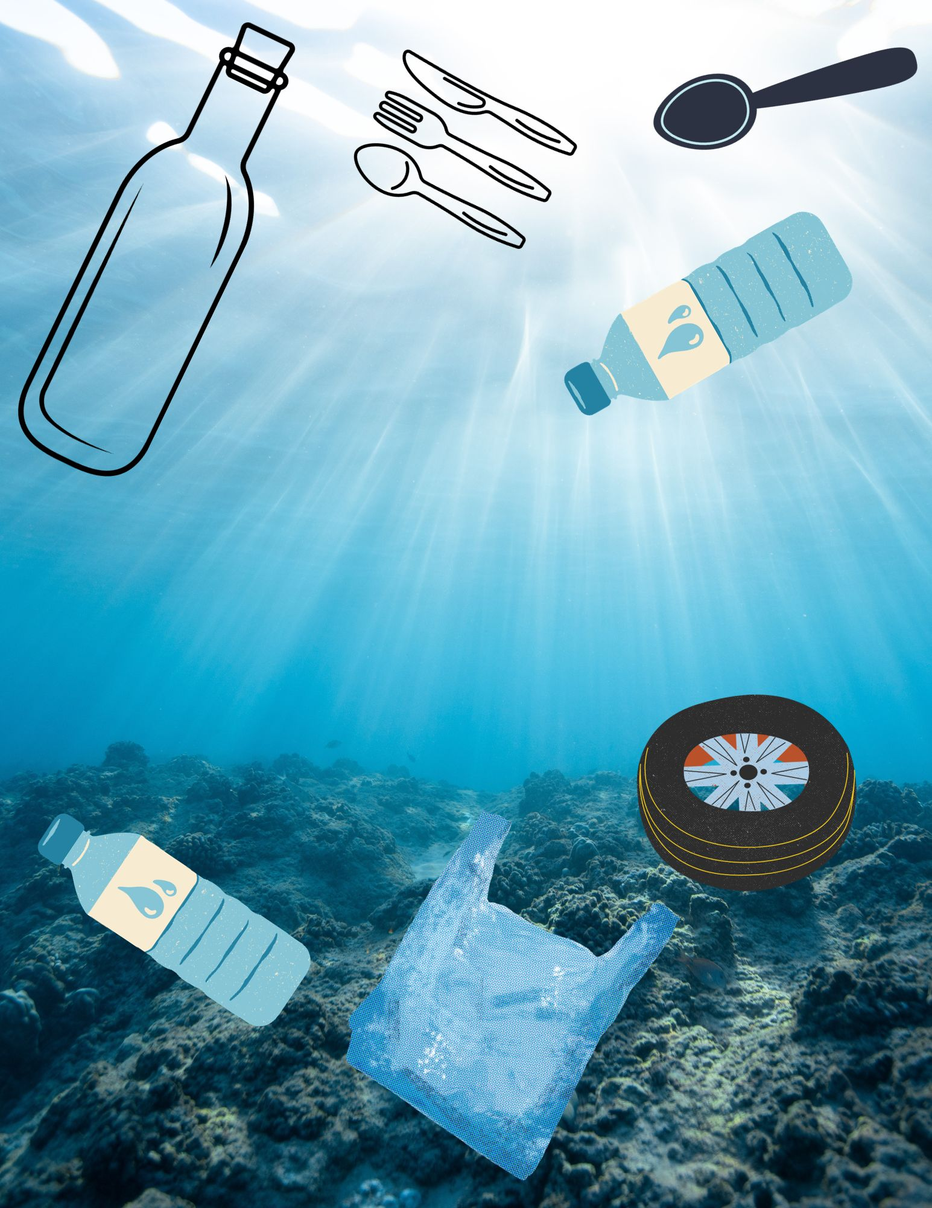
The path of plastic
Notes:
Once it ends up in the ocean, waste will travel through the water column. Here, we’ll find two types of plastic:
Plastic that is very dense or covered in algae, anemones or crustaceans will eventually sink to the ocean floor. It can stay buried in the sediment for hundreds of years.
Before being buried, most plastic will be swept away by the currents and waves, drifting on the surface of the water. It can travel long distances before ending up on our beaches or in the open sea. During that time, friction with the water and sediments, exposure to sunlight and changes in temperature will break down the plastic into very fine particles.

Slide 5
Plastic then transforms…
(2): Examples of microplastic fibers found on the seabed
Notes:
Why are microplastics dangerous?
When plastic waste is constantly tossed around, it breaks down into very small pieces known as microplastics and nanoplastics (even smaller!)
Here are examples of microplastics found at the bottom of the Pacific Ocean. Notice how thin and varied in shape they are. These microplastics cause major issues because they eventually end up in the food chain.
It's with this information that we can better focus our efforts to solve the problem.
(2) Brandon, J. A., Jones, W., & Ohman, M. D. (2019). Multidecadal increase in plastic particles in coastal ocean sediments. Science advances, 5(9), eaax0587.

Slide 6
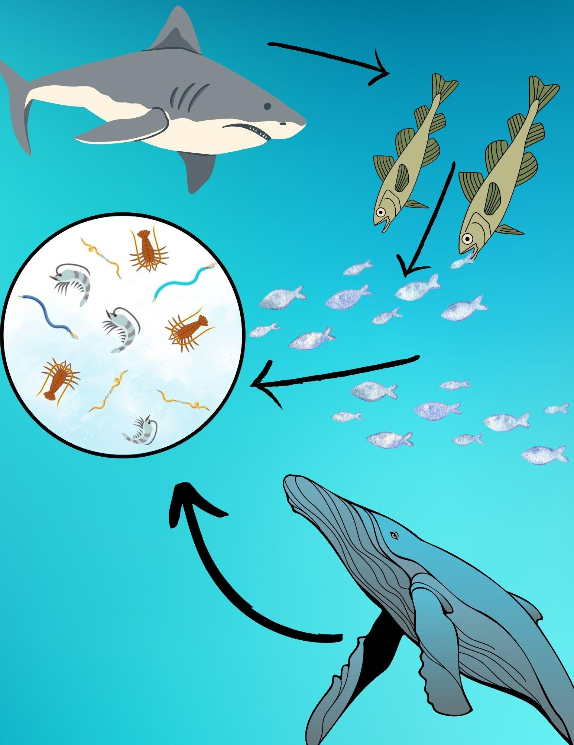
Plastic and the food chain
Microplastics accumulate in animal tissues
Notes:
Microplastics look so much like plankton that small fish mistakenly eat them instead of their usual food (zooplankton). Since zooplankton are at the bottom of the food chain, they’re a food source for many other species. Smaller fish that eat the mistaken “zooplankton” will in turn be eaten by larger fish or marine mammals, and so on. This is how plastic ends up in the food chain. These microplastics will eventually spread to marine and even terrestrial wildlife. After all, seabirds eat fish, too!
By picking up trash on the beach, we prevent it from spreading any further and turning into microplastics.
There are many people working hard to fight ocean pollution. This brings us to my favourite section: the solutions!

Slide 7
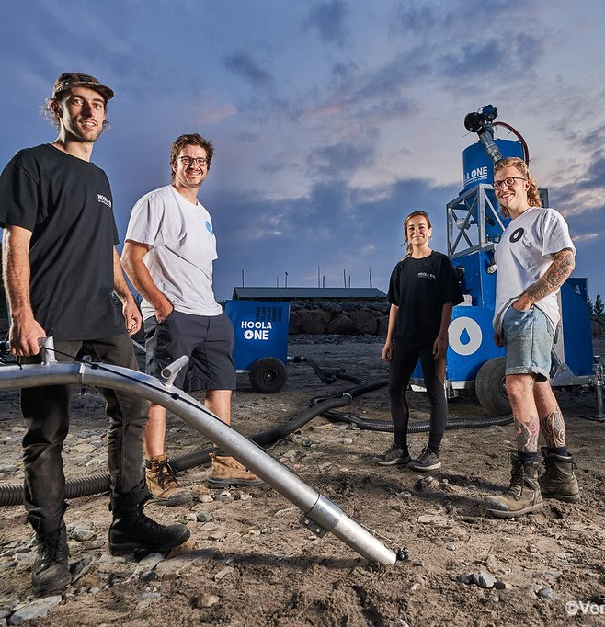
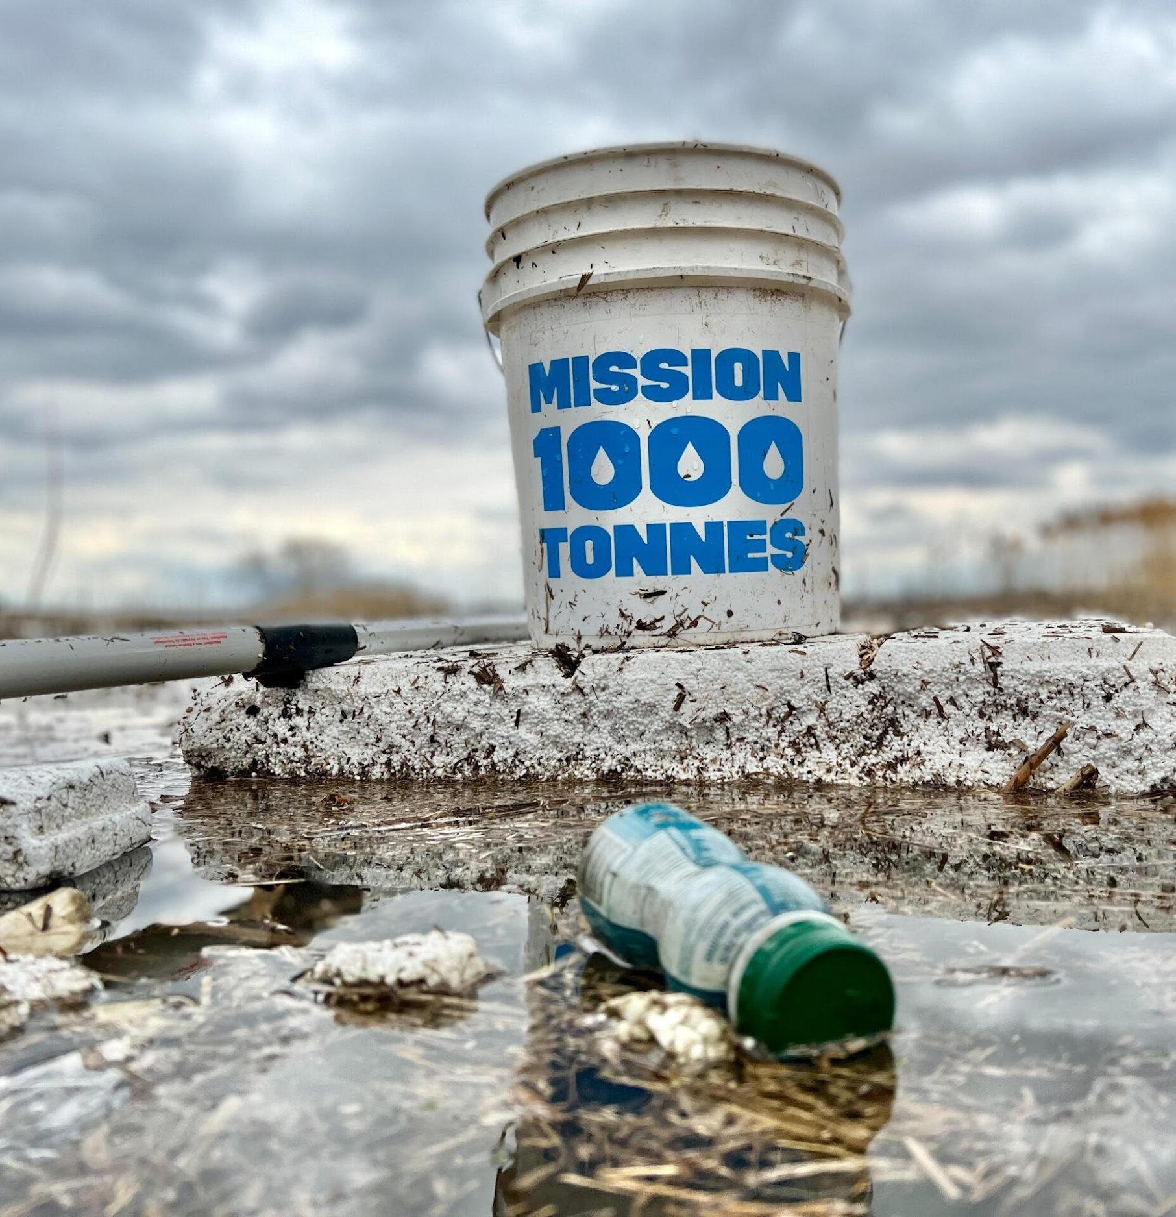
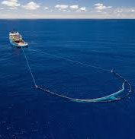
The cleaning experts!
Projet Hoola One
Mission 1000 tonnes
The ocean cleanup
Notes:
Part 2: Inspiring initiatives
Ocean pollution has been a problem for a long time. There are several organizations working hard to rid the oceans of plastic.
Hoola One
This organization has created an innovative vacuum-like machine that can remove microplastics from beaches. It separates the sand and plastic waste through a process of decantation (i.e., the sand sinks to the bottom and the waste floats to the surface). This machine can collect waste as small as half a millimetre. It was created by a group of students from Université de Sherbrooke and was tested in March 2019 with the Hawaiʻi Wildlife Fund at Kamilo Beach in Hawaii.
Mission 1000 tonnes
Mission 1000 tonnes is a Quebec organization dedicated to removing 1,000 tonnes of plastic waste from the world’s oceans and waterways. All clean-up activities organized by Mission 1000 tonnes take place in Quebec. However, people from other countries can join the cause by submitting the results of their own clean-up initiatives to the organization. Mission 1000 tonnes sometimes comes to Gaspésie, so we can tell students to keep an eye out for their next planned visit to the area!
The Ocean Cleanup
The Ocean Cleanup is a Netherlands-based environmental engineering organization dedicated to developing technologies to rid the world’s oceans and rivers of plastic. This organization has successfully tested several prototypes of nets to collect plastic from the surface of waterways, as we see in the photo.

Slide 8
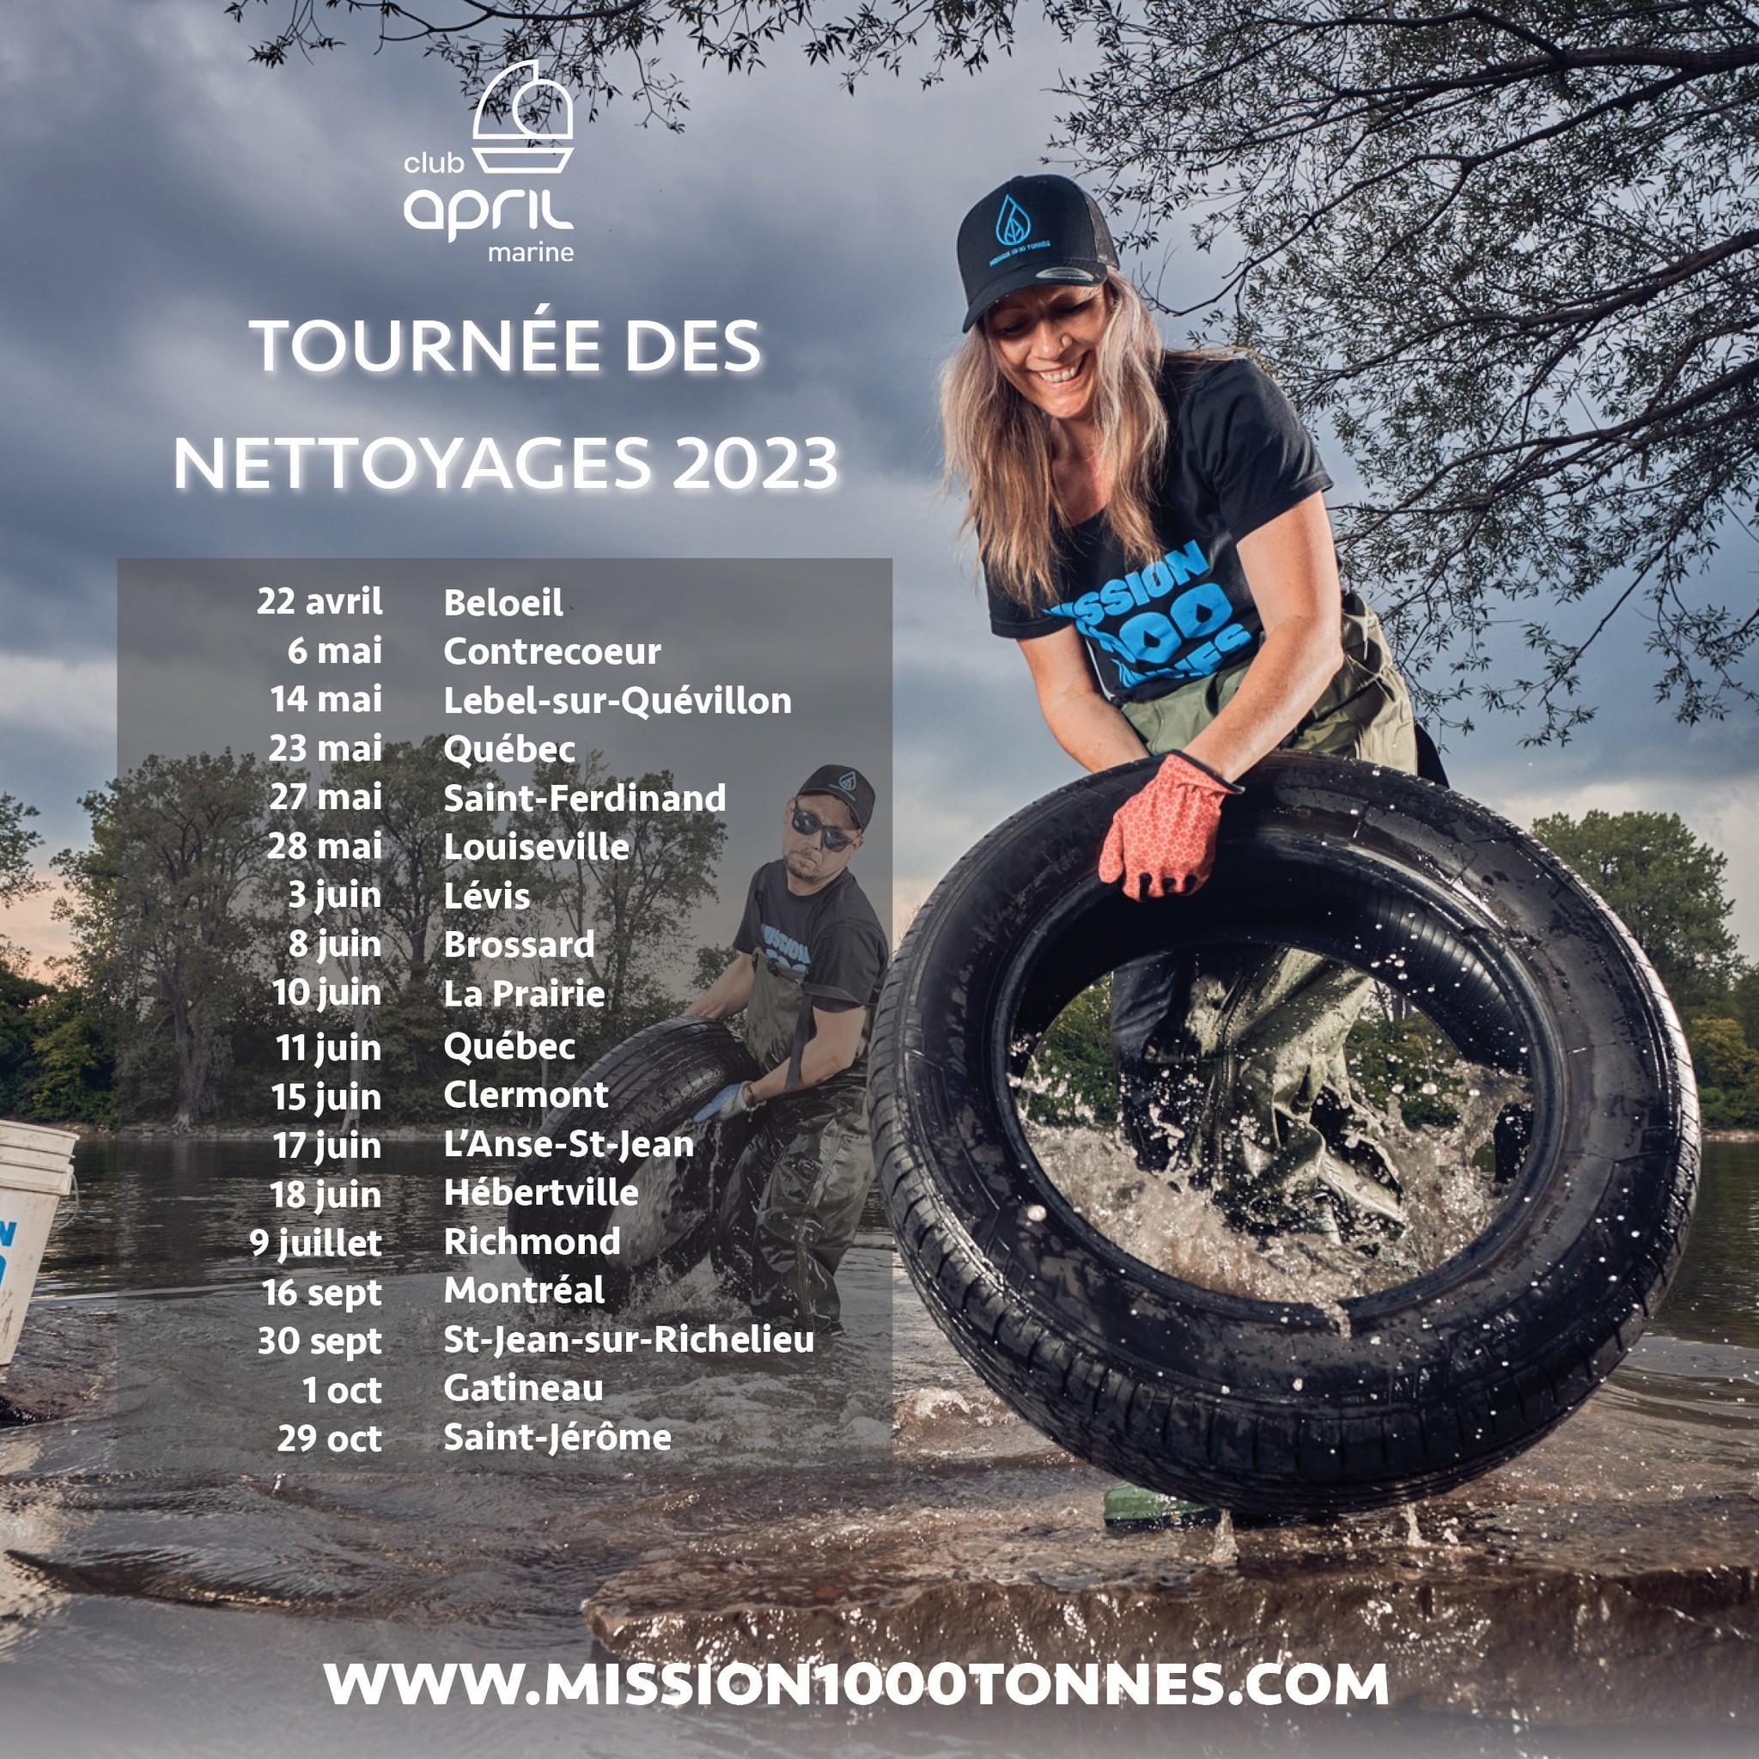
Notes:
Here is Mission 1000 tonnes’ 2023 clean-up tour. Many beaches in Quebec are cleaned up every year by volunteers. This initiative prevents waste from being swept away by the tides and releasing even more microplastics into the water.
I’ve included the link to their website. Maybe they’ll host a clean-up near you next year. Or better yet, maybe you can organize one!

Slide 9
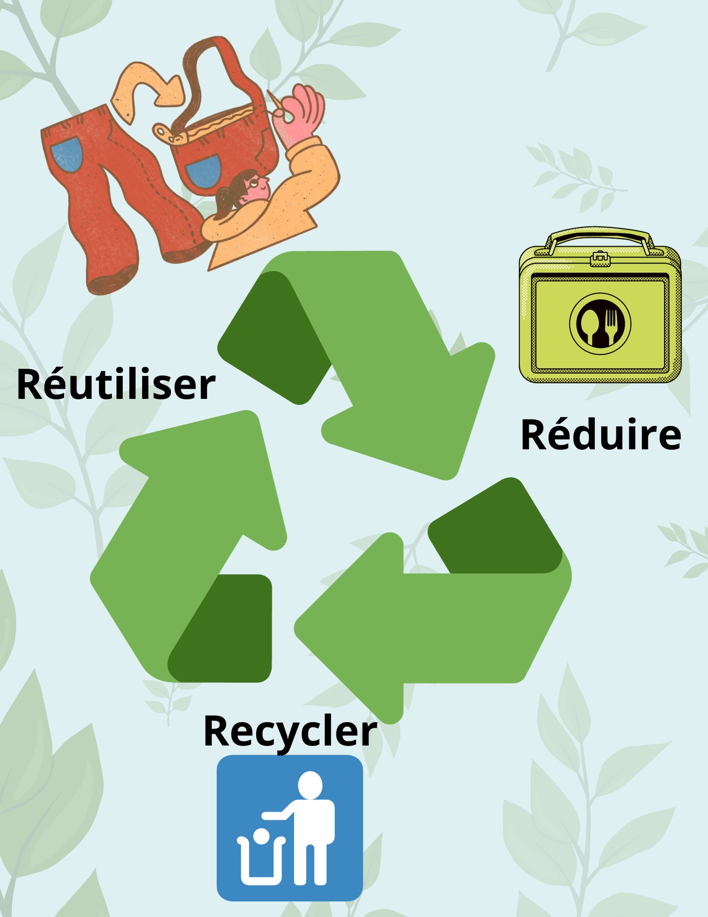
What can we do?
Play in our trash!
Notes:
Part 3: Solutions for individuals
What can we do to prevent more waste from entering the environment?
Do you know the three Rs?
Reduce: The first thing we need to do is reduce our consumption. The less we consume, the less we produce at the source!
The less waste we produce, the less likely it’ll end up in the environment. For instance, consider opting for zero-waste snacks, such as fruits and vegetables, homemade lunches, and so on.
Reuse and Donate: What do you do with an old shirt you don’t wear anymore? You can give it to someone in need, use it as a rag for cleaning or turn it into a pillowcase. By reusing old objects, we can extend their useful life and prevent them from ending up in our oceans.
Recycle: Cardboard, aluminum, cans and glass are all made from raw materials like sand, wood and certain metals. These materials are durable and reusable! Recycling raw materials extracted from the earth gives them a second life. Think about a tree that’s used to make a newspaper. Wouldn’t it be a shame if a newspaper was thrown in the garbage after being read only once, even though it could be used to print another paper?
Bonus: If time permits, we can suggest other ways to eliminate microplastics altogether, such as choosing hygiene products that don’t contain plastic microbeads or buying clothes with a higher percentage of natural fibres.

Slide 10
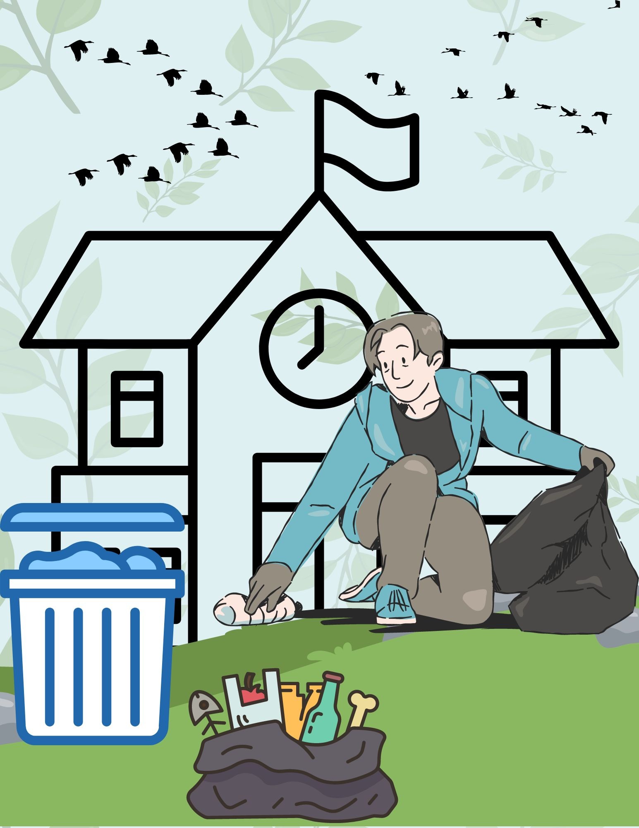
On the hunt for trash!
Notes:
Part 4: Clean-up activity
Sort your waste!
Outdoor version : the class will be divided into 3 or 4 teams. Each team will have a set of trash and four bins to separate them. Teams must take the trash to the right bins. There's a chance to make them run by scattering the bins around the schoolyard, for example.
Indoor version : Another option would be to stick the 4 bin pictures on the board and divide the group in two. Each group can come up with a team name. You can show a trash/team in turn, giving them time to discuss, and then a volunteer stands up to stick the image in the right place. This way, the whole group can make corrections as they go along.
An answer sheet is also available. Please note that the data is based on the municipality of Carleton-sur-Mer. Some items may end up in other destinations, depending on the municipality. Consult Recyc-Québec's Ça va où? application (Ça va où ce truc? - RECYC-QUÉBEC (gouv.qc.ca)) to find the data for your municipality.
*Be sure to explain why the waste is in the wrong bin and say where it should go instead*
*Be sure the materials are handed out and the teams are assigned before leaving the classroom*
End the presentation with a group discussion on how to reuse waste instead of throwing it in the garbage.

